Slide 1
Revision

Slide 2
Outline
Abstract Data Type
Object-oriented languages
Generic and interfaces
Stack, Queue and List
Sorting Algorithms
Recursion
Trees
Priority Queue
Graphs

Slide 3
Abstract Data Types
It’s an another data structure
It’s a collection of data whose representation is hidden.
It only defines the operations for manipulating data but not how that structure is implemented.
E.g. stacks, queues.
Stack can be done with an array OR with a linked list.

Slide 4
Operations
If we define a data structure in terms of what we can do with it –rather than in terms of exactly how it is arranged in memory – then we have specified the operations we can perform on it.
Such a specification is an Abstract Data Type.

Slide 5
Object-oriented languages
Object-oriented programming is based around the concept of abstract data types.
Java is an object-oriented programming language and java classes are ideal for implementing ADTs.

Slide 6
Generics
Generics enable types to be parameters when defining classes, interfaces and methods.
Advantages:
  Code reuse: write a method/class/interface once use it for any type.
  Type safety: stronger type checks at compile time instead of run time

Slide 7
Interfaces
A java interface is a collection of abstract methods and constants.
An abstract method is a method header without a method body.
An abstract method can be declared using the modifier abstract, but because all methods in an interface are abstract, usually it is left off
An interface is used to establish a set of methods that a class will implement

Slide 8
Interfaces
public interface Doable
{
public void doThis();
public int doThat();
public void doThis2 (float value, char ch);
public boolean doTheOther (int num);
}

Slide 9
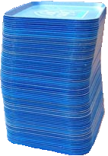
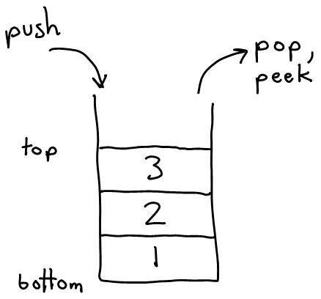
Stack ADT
A stack is data structure of ordered items such that items can be inserted and removed only at one end.
stack: a list with the restriction that insertions/deletions can only be performed at the top/end of the list
  Last-In, First-Out ("LIFO")
  The elements are stored in order of insertion
  but we do not think of them as having indexes.
  The client can only add/remove/examine
  the last element added (the "top").
basic stack operations:
  push: Add an element to the top.
  pop: Remove the top element.
  peek: Examine the top element.
Notes:
analogy: trays of food at the sizzler

Slide 10
Applications of Stacks
Programming languages:
  method calls are placed onto a stack (call=push, return=pop)
Matching up related pairs of things:
  find out whether a string is a palindrome
  examine a file to see if its braces { } and other operators match
Sophisticated algorithms:
  searching through a maze with "backtracking"
  many programs use an "undo stack" of previous operations

Slide 11

Queues
What is a queue?
  A data structure of ordered items such that items can be inserted only at one end and removed at the other end.
Example
  A line at the supermarket

Slide 12
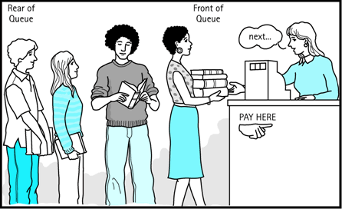
Queues
queue: Retrieves elements in the order they were added.
  First-In, First-Out ("FIFO")
  Elements are stored in order of
  insertion but don't have indexes.
  Client can only add to the end of the
  queue, and can only examine/remove
  the front of the queue.
basic queue operations:
  add (enqueue): Add an element to the back.
  remove (dequeue): Remove the front element.
  peek: Examine the front element.
front |  | back
1 | 2 | 3
remove, peek
add
queue
Notes:
analogy: trays of food at the sizzler

Slide 13
Disadvantages of arrays
Using arrays to store lists of values comes with some problems:
When we declare the array, we have to specify up front how many elements it contains.
  If we declare a variable using the code int arr[10], then it can store 10 int elements.
The size can’t be changed after the array is declared – if we want to store more elements, we must construct a new array.
  This is because Java stores an array as a contiguous chunk or “block” of memory – all the elements lie next to one another.
  If there are other variables in memory next to the array – it can’t be “expanded”, because there’s no room for it to do so.

Slide 14
Linked list
Sometimes we would like a data structure that is more flexible than an array, even if it is not quite as fast.
In this case, we may use a linked list.
  A linked list consists of a sequence of nodes, where each node contains an element. But each node also contains a “link” to the next node in the sequence – hence the name “linked list”.

Slide 15
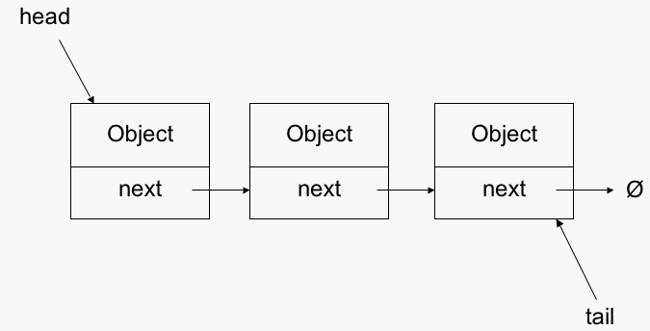
Diagram of linked list
We will discuss the following diagram which shows how a linked list is organized.

Slide 16
Sorting Algorithms
Bubble sort
Insertion sort
Selection sort
Merge sort

Slide 17
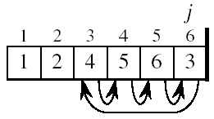
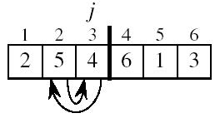
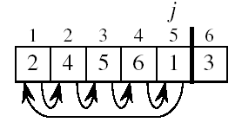
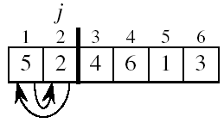
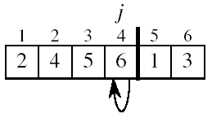
Insertion Sort

Slide 18
Selection sort
8
4
6
9
2
3
1
1
2
3
4
9
6
8
1
4
6
9
2
3
8
1
2
3
4
6
9
8
1
2
6
9
4
3
8
1
2
3
4
6
8
9
1
2
3
9
4
6
8
1
2
3
4
6
8
9

Slide 19
Recursion
Recursion is a powerful tool for solving certain kinds of problems.
Recursion breaks a problem into smaller problems that are, in some sense, identical to the original.
Solving the smaller problems provides a solution to the larger one.

Slide 20
Recursion
Every recursive problem consist of two parts:
  Base case: the case for which the solution can be stated non-recursively.
  Recursive case: the case for which the solution is expressed in terms of a smaller version of itself.

Slide 21
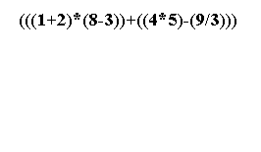
Example

Slide 22
Trees
Binary Search Tree

Slide 23
Priority Queue

Slide 24
Some bad implementations
list: store all customers/jobs in an unordered list, remove min/max one by searching for it
  problem: expensive to search
sorted list: store all in a sorted list, then search it in O(log n) time with binary search
  problem: expensive to add/remove
binary search tree: store in a BST, search it in O(log n) time for the min (leftmost) element
  problem: tree could be unbalanced on nonrandom input
balanced BST
  problem: in practice, if the program has many adds/removes, it performs slowly on AVL trees and other balanced BSTs
  problem: removal always occurs from the left side, which

Slide 25
Priority queue ADT
priority queue: a collection of ordered elements that provides fast access to the minimum (or maximum) element
  a mix between a queue and a BST
  usually implemented using a structure called a heap
priority queue operations:
  add
    O(1) average, O(log n) worst-case
  peek - returns the minimum element
    O(1)
  remove - removes/returns minimum element
    O(log n) worst-case
  isEmpty, clear, size, iterator
    O(1)

Slide 26
Java's PriorityQueue class
public class PriorityQueue<E> implements Queue<E>
public PriorityQueue<E>()
public PriorityQueue<E>(int capacity, Comparator<E> comp)
  Constructs a priority queue that uses the given comparator to order its elements.
public void add(E o)
public void clear()
public Iterator<E> iterator()
public E peek()
public E remove()

Slide 27
Graphs
A graph is a formalism for representing relationships among items
Very general definition
Very general concept
A graph is a pair: G = (V, E)
A set of vertices, also known
as nodes: V = {v₁,v₂,…,v_{n}}
A set of edges E = {e₁,e₂,…,e_{m}}
  Each edge e_{i} is a pair of vertices (v_{j},v_{k})
  An edge "connects" the vertices
Graphs can be directed or undirected
Han
Luke
Leia
V = {Han,Leia,Luke}
E = {(Luke,Leia),
(Han,Leia),
(Leia,Han)}

Slide 28
Some Graphs
For each example, what are the vertices and what are the edges?
Web pages with links
Facebook friends
"Input data" for the Kevin Bacon game
Methods in a program that call each other
Road maps
Airline routes
Family trees
Course pre-requisites

Slide 29
Scratching the Surface
Graphs are a powerful representation and have been studied deeply
Graph theory is a major branch of research in combinatorics and discrete mathematics
Every branch of computer science involves graph theory to some extent

Slide 30
Undirected Graphs
In undirected graphs, edges have no specific direction
Edges are always "two-way"
Thus, (u, v) ∊ E implies (v, u) ∊ E.
Only one of these edges needs to be in the set
The other is implicit, so normalize how you check for it
Degree of a vertex: number of edges containing that vertex
Put another way: the number of adjacent vertices
D
A
C
B

Slide 31
Directed Graphs
In directed graphs (or digraphs), edges have direction
Thus, (u, v) ∊ E does not imply (v, u) ∊ E.
Let (u, v) ∈ E mean u → v
Call u the source and v the destination
In-Degree of a vertex: number of in-bound edges (edges where the vertex is the destination)
Out-Degree of a vertex: number of out-bound edges (edges where the vertex is the source)
D
D
A
A
C
or
C
B
B
2 edges here

Slide 32
Graph Data structure

Slide 33
Adjacency Matrix
Assign each node a number from 0 to |V|-1
A |V| x |V| matrix of Booleans (or 0 vs. 1)
Then M[u][v] == true means there is an edge from u to v
 | A | B | C | D
A | F | 20 | F | F
B | T | F | F | F
C | F | T | F | T
D | F | F | F | F
D
A
C
B

Slide 34
Adjacency List
Assign each node a number from 0 to |V|-1
An array of length |V| in which each entry stores a list of all adjacent vertices (e.g., linked list)
D
A
B
/
A
C
B
A
/
B
C
D
B
/
D
/

Slide 35
Breadth-first Search
Expands the frontier between discovered and undiscovered vertices uniformly across the breadth of the frontier.
  A vertex is “discovered” the first time it is encountered during the search.
  A vertex is “finished” if all vertices adjacent to it have been discovered.
Colors the vertices to keep track of progress.
  White – Undiscovered.
  Gray – Discovered but not finished.
  Black – Finished.
    Colors are required only to reason about the algorithm. Can be implemented without colors.

Slide 36
BFS for Shortest Paths
2
3
3
2
2
3
1
S
S
S
2
1
1
2
2
3
3
Finished
Discovered
Undiscovered

Slide 37
Depth-first Search (DFS)
Explore edges out of the most recently discovered vertex v.
When all edges of v have been explored, backtrack to explore other edges leaving the vertex from which v was discovered (its predecessor).
“Search as deep as possible first.”
Continue until all vertices reachable from the original source are discovered.
If any undiscovered vertices remain, then one of them is chosen as a new source and search is repeated from that source.

Slide 38
Example (DFS)
u
v
w
1/
x
y
z

Slide 39
Example (DFS)
u
v
w
1/
2/
x
y
z

Slide 40
Example (DFS)
u
v
w
1/
2/
3/
x
y
z

Slide 41
Example (DFS)
u
v
w
1/
2/
4/
3/
x
y
z

Slide 42
Example (DFS)
u
v
w
1/
2/
B
4/
3/
x
y
z

Slide 43
Example (DFS)
u
v
w
1/
2/
B
4/5
3/
x
y
z

Slide 44
Example (DFS)
u
v
w
1/
2/
B
4/5
3/6
x
y
z

Slide 45
Example (DFS)
u
v
w
1/
2/7
B
4/5
3/6
x
y
z

Slide 46
Example (DFS)
u
v
w
1/
2/7
F
B
4/5
3/6
x
y
z

Slide 47
Example (DFS)
u
v
w
1/8
2/7
F
B
4/5
3/6
x
y
z

Slide 48
Example (DFS)
u
v
w
1/8
2/7
9/
F
B
4/5
3/6
x
y
z

Slide 49
Example (DFS)
u
v
w
1/8
2/7
9/
F
B
C
4/5
3/6
x
y
z

Slide 50
Example (DFS)
u
v
w
1/8
2/7
9/
F
B
C
4/5
3/6
10/
x
y
z

Slide 51
Example (DFS)
u
v
w
1/8
2/7
9/
F
B
C
4/5
3/6
10/
B
x
y
z

Slide 52
Example (DFS)
u
v
w
1/8
2/7
9/
F
B
C
4/5
3/6
10/11
B
x
y
z

Slide 53
Example (DFS)
u
v
w
1/8
2/7
9/12
F
B
C
4/5
3/6
10/11
B
x
y
z

Slide 54
Minimum-cost spanning trees
Suppose you have a connected undirected graph with a weight (or cost) associated with each edge
The cost of a spanning tree would be the sum of the costs of its edges
A minimum-cost spanning tree is a spanning tree that has the lowest cost
16
16
A
B
A
B
21
11
6
11
6
19
5
5
F
C
F
C
33
14
10
E
18
D
E
18
D
A connected, undirected graph
A minimum-cost spanning tree

Slide 55
Minimum Spanning Tree (MST)
A minimum spanning tree is a subgraph of an undirected weighted graph G, such that
it is a tree (i.e., it is acyclic)not cyclic.
it covers all the vertices V
  contains |V| - 1 edges
the total cost associated with tree edges is the minimum among all possible spanning trees
not necessarily unique

Slide 56
How Can We Generate a MST?
9
b
9
b
a
2
6
a
2
6
d
d
4
5
4
5
5
4
5
4
5
e
5
e
c
c

Slide 57
Two Algorithms
Prim: (build tree incrementally)
  Pick lower cost edge connected to known (incomplete) spanning tree that does not create a cycle and expand to include it in the tree
Kruskal: (build forest that will finish as a tree)
  Pick lowest cost edge not yet in a tree that does not create a cycle. Then expand the set of included edges to include it. (It will be somewhere in the forest.)

