Slide 1
CITS 5506 The Internet of Things Lecture 02
Dr Atif Mansoor
atif.mansoor@uwa.edu.au

Slide 2
Potential realization of IoT– Moving from Global Village to “Hyperconnected world”
It may force a shift in thinking about the implications and issues in a world where the most common interaction with the Internet comes from passive engagement with connected objects rather than active engagement with content.

Slide 3
Intel --------------IoT video

Slide 4
Emerging Economy and Development Issues
The Internet of Things holds significant promise for delivering social and economic benefits to emerging and developing economies.
This includes areas such as sustainable agriculture, water quality and use, healthcare, industrialization, and environmental management, among others.

Slide 5
Emerging Economy and Development Issues
The unique needs and challenges of implementation in less-developed regions will need to be addressed, including :
infrastructure readiness
market and investment incentives
technical skill requirements, and
policy resources

Slide 6
IoT Forecast
A number of companies and research organizations have offered a wide range of projections about the potential impact of IoT on the Internet and the economy during the next five to ten years.
Cisco, for example, projects more than 24 billion Internet–connected objects by 2019¹
Morgan Stanley, a global financial services firm, however, projects 75 billion networked devices by 2020²
“Cloud and Mobile Network Traffic Forecast - Visual Networking Index (VNI).” Cisco, 2015. http://cisco.com/c/en/us/solutions/serviceprovider/visual-networking-index-vni/index.html
Danova, Tony. “Morgan Stanley: 75 Billion Devices Will Be Connected To The Internet Of Things By 2020.” Business Insider, October 2, 2013. http://www.businessinsider.com/75-billion-devices-will-be-connected-to-the-internet-by-2020-2013-10
Notes:
Morgan Stanley (NYSE: MS) is a leading global financial services firm providing investment banking, securities, wealth management and investment management services.

Slide 7
IoT Forecast
Huawei forecasts 100 billion IoT connections by 2025¹
McKinsey Global Institute suggests that the financial impact of IoT on the global economy may be as much as $3.9 to $11.1 trillion by 2025²
While the variability in predictions makes any specific number questionable, collectively they paint a picture of significant growth and influence.
1. "Global Connectivity Index." Huawei Technologies Co., Ltd., 2015. Web. 6 Sept. 2015. http://www.huawei.com/minisite/gci/en/index.html
2 . Manyika, James, Michael Chui, Peter Bisson, Jonathan Woetzel, Richard Dobbs, Jacques Bughin, and Dan Aharon. “The Internet of Things: Mapping the Value Beyond the Hype.” McKinsey Global Institute, June 2015.
Notes:
McKinsey & Company is a worldwide management consulting firm. It conducts qualitative and quantitative analysis in order to evaluate management decisions across the public and private sectors. According to The New York Times, it is considered the most prestigious management consultancy in the world.^{[3]} McKinsey publishes the McKinsey Quarterly since 1964, funds the McKinsey Global Institute research organization, publishes reports on management topics, and has authored many influential books on management

Slide 8
IoT …………Conflicting Perceptions
IoT a revolutionary fully–interconnected “smart” world of progress, efficiency, and opportunity, with the potential for adding billions in value to industry and the global economy.
Others warn that the IoT represents a darker world of surveillance, privacy and security violations, and consumer lock–in.

Slide 9
IoT History
The term “Internet of Things” (IoT) was first used in 1999 by British technology pioneer Kevin Ashton to describe a system in which objects in the physical world could be connected to the Internet by sensors.
Ashton was working on RFID (radio-frequency identification) devices, and the close association of RFID and other sensor networks with the development of the IoT concept is reflected in the name of the RFID device company that Ashton joined later in his career: “ThingMagic.”
http://www.thingmagic.com/

Slide 10
IoT History
In late 1970s, systems for remotely monitoring meters on the electrical grid via telephone lines were already in commercial use¹.
In the 1990s, advances in wireless technology allowed “machine–to–machine” (M2M) enterprise and industrial solutions for equipment monitoring and operation to become widespread. Many of these early M2M solutions, however, were based on closed purpose–built networks and proprietary or industry–specific standards, rather than on Internet Protocol (IP)–based networks and Internet standards².
1. “Machine to Machine.” Wikipedia, https://en.wikipedia.org/wiki/Machine_to_machine
2. Polsonetti, Chantal. “Know the Difference Between IoT and M2M.” Automation World, July 15, 2014. http://www.automationworld.com/cloud-computing/know-difference-between-iot-and-m2m

Slide 11
IoT History
The first Internet “device”—an IP–enabled toaster that could be turned on and off over the Internet—was featured at an Internet conference in 1990¹.
Over the next several years, other “things” were IP–enabled, including a soda machine² at Carnegie Mellon University in the US and a coffee pot³ in the Trojan Room at the University of Cambridge in the UK (which remained Internet–connected until 2001)
1. "The Internet Toaster." Living Internet, 7 Jan. 2000. Web. 06 Sept. 2015. http://www.livinginternet.com/i/ia_myths_toast.htm
2. "The "Only" Coke Machine on the Internet." Carnegie Mellon University Computer Science Department, n.d. Web. 06 Sept. 2015. https://www.cs.cmu.edu/~coke/history_long.txt 18
3. Stafford-Fraser, Quentin. "The Trojan Room Coffee Pot." N.p., May 1995. Web. 06 Sept. 2015. http://www.cl.cam.ac.uk/coffee/qsf/coffee.html

Slide 12
IoT Evolution
From a broad perspective, the confluence of several technology and market trends is making it possible to interconnect more and smaller devices cheaply and easily:
• Ubiquitous Connectivity—Low cost, high–speed, pervasive network connectivity
• Widespread adoption of IP–based networking— IP has become the dominant global standard for networking,
Notes:
Pervasive ……………especially of an unwelcome influence or physical effect, spreading widely throughout an area or a group of people.

Slide 13
IoT Evolution
• Computing Economics— Greater computing power at lower price and lower power consumption
• Miniaturization— Manufacturing advances allow cutting-edge computing and communications technology to be incorporated into very small objects & small and inexpensive sensor devices
• Advances in Data Analytics— New algorithms and rapid increases in computing power, data storage, and cloud services enable the analysis of vast quantities of data

Slide 14
IoT Evolution
• Rise of Cloud Computing– Cloud computing, which leverages remote, networked computing resources to process, manage, and store data, allows small and distributed devices to interact with powerful back-end analytic and control capabilities.

Slide 15
“Settings” for IoT Applications
Setting | Description | Examples
Human | Devices attached or inside the human body | Devices (wearables and ingestibles) to monitor and maintain human health and wellness; disease management, increased fitness, higher productivity
Home | Buildings where people live | Home Controllers and Security Systems
Retail Environments | Spaces where consumers engage in commerce | Stores, banks, restaurants, arenas – anywhere consumers consider and buy; self-checkout, in-store offers, inventory optimization

Slide 16
“Settings” for IoT Applications
Setting | Description | Examples
Factories | Standardized production environments | Places with repetitive work routines, including hospitals and farms; operating efficiencies, optimizing equipment use and inventory
Worksites | Custom production environments | Mining, oil and gas, construction; operating efficiencies, predictive maintenance, health and safety
Vehicles | Systems inside moving vehicles | Vehicles including cars, trucks, ships, aircraft, and trains; condition-based maintenance,

Slide 17
“Settings” for IoT Applications
Setting | Description | Examples
Cities | Urban Environment | Public spaces and infrastructure in urban settings; adaptive traffic control, smart meters, environmental monitoring, resource management
Offices | Spaces where knowledge workers work | Energy management and security in office buildings; improved productivity, including for mobile employees
Manyika, James, Michael Chui, Peter Bisson, Jonathan Woetzel, Richard Dobbs, Jacques Bughin, and Dan Aharon. “The Internet of Things: Mapping the Value Beyond the Hype.” McKinsey Global Institute, June 2015. p.3. http://www.mckinsey.com/insights/business_technology/the_internet_of_things_the_value_of_digitizing_the_physical_world 25

Slide 18
Sensor Devices are widely available

Slide 19
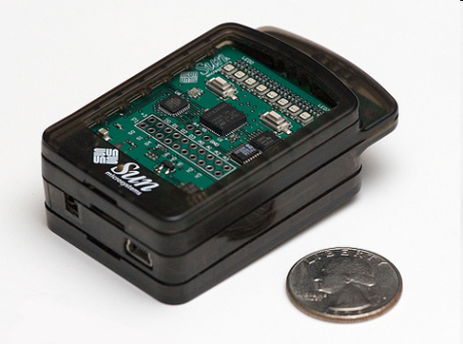
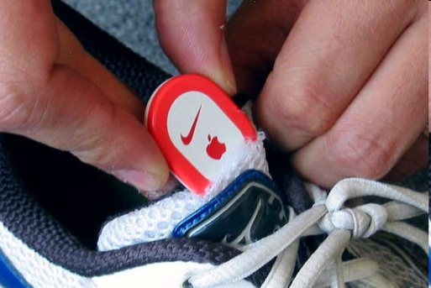
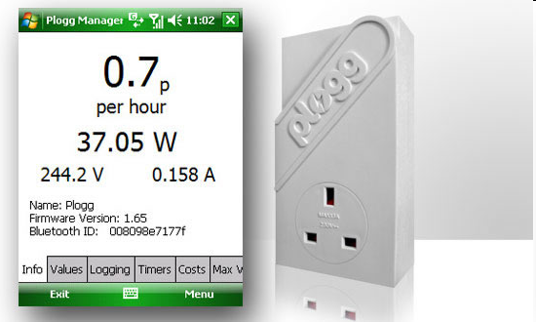
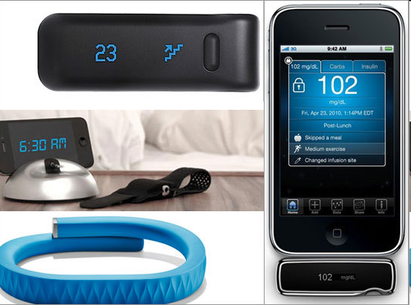
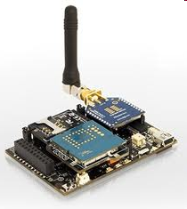
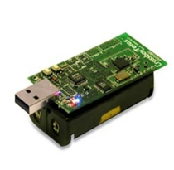
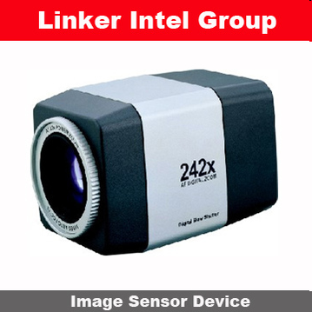
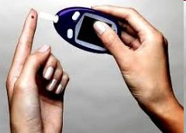
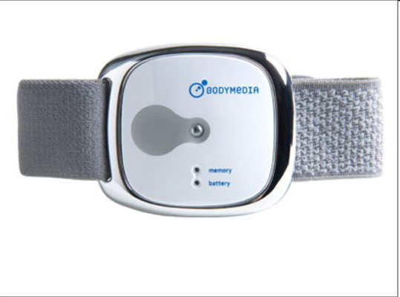
Sensor Devices are widely available
- Programmable devices
- Off-the-shelf gadgets/tools

Slide 20
How are the Network changing
Extensions
More nodes, more connections, IPv6,
Any TIME, Any PLACE, Any THING
M2M, IoT
Billions of interconnected devices,
Everybody connected.
Expansions
Broadband
Enhancements
Smart networks
Data-centric / content-oriented networking
Context-aware (autonomous) systems
Notes:
In contrast to IP-based, host-oriented, Internet architecture, content centric networking (CCN) emphasizes content by making it directly addressable and routable. Endpoints communicate based on named data instead of IP addresses. CCN is characterized by the basic exchange of content request messages (called "Interests") and content return messages (called "Content Objects"). It is considered an information-centric networking (ICN) architecture.
http://www.internetsociety.org/articles/how-data-centric-networking-could-change-internet
Context-aware computing refers to a general class of mobile systems that can sense their physical environment, and adapt their behavior accordingly. Context-aware systems are a component of a ubiquitous computing or pervasive computing environment

Slide 21
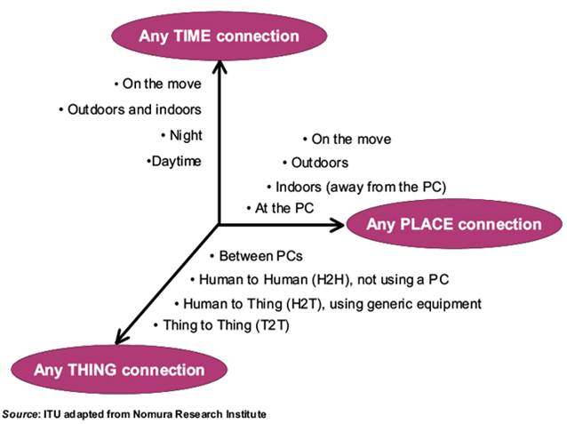
Future Networks

Slide 22
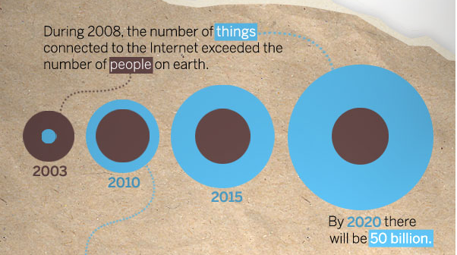
IoT Evolution

Slide 23
Internet of Things Communications Models
As stated in RFC 7452 Architectural Considerations in Smart Object Networking
Device-to-Device Communications
Device-to-Cloud Communications
Device-to-Gateway Model
Back-End Data-Sharing Model

Slide 24
Device-to-Device Communications

Slide 25
Device-to-Device Communications
The device-to-device communication model represents two or more devices that directly connect and communicate between one another, rather than through an intermediary application server.
These devices communicate over many types of networks, including IP networks or the Internet. Often, however these devices use protocols like Bluetooth, Z-Wave,or ZigBee to establish direct device-to-device communications

Slide 26
Z - Wave
Z-Wave is a wireless communications protocol used primarily for home automation.
It uses low-energy radio waves to communicate from appliance to appliance, allowing for wireless control of residential appliances and other devices, such as lighting control, security systems, thermostats, windows, locks, swimming pools and garage door openers.
Z-Wave automation system can be controlled via the Internet

Slide 27
Zigbee
Zigbee is an IEEE 802.15 based specification for a suite of high-level communication protocols used to create personal area networks
It works with small, low-power digital radios, such as for home automation, medical device data collection, and other low-power low-bandwidth needs, designed for small scale projects which need wireless connection.
Hence, zigbee is a low-power, low data rate, and close proximity (i.e., personal area) wireless ad hoc network.

Slide 28
Device-to-Cloud Communications
In a device-to-cloud communication model, the IoT device connects directly to an Internet cloud service like an application service provider to exchange data and control message traffic
This communication model is employed by some popular consumer IoT devices like the Nest Labs Learning Thermostat and the Samsung SmartTV

Slide 29
Device-to-Cloud Communications
UDP
TCP
IP
Application Service Provider
Sensor
Sensor

Slide 30
Device-to-Cloud Communications
In the case of the Nest Learning Thermostat, the device transmits data to a cloud database where the data can be used to analyze home energy consumption.
Further, this cloud connection enables the user to obtain remote access to their thermostat via a smartphone or Web interface, and it also supports software updates to the thermostat

Slide 31
Device-to-Cloud Communications
Frequently, the device and cloud service are from the same vendor.
If proprietary data protocols are used between the device and the cloud service, the device owner or user may be tied to a specific cloud service, limiting or preventing the use of alternative service providers. This is commonly referred to as “vendor lock-in’’

Slide 32
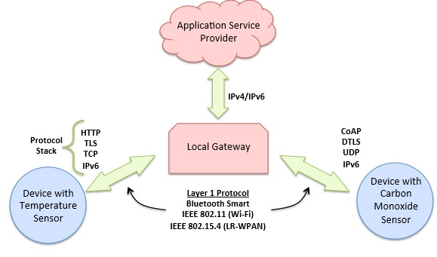
Device-to-Gateway Model

Slide 33
Device-to-Gateway Model
In the device-to-gateway model, or more typically, the device-to-application-layer gateway (ALG) model, the IoT device connects through an ALG service as a conduit to reach a cloud service.
In simpler terms, this means that there is application software operating on a local gateway device, which acts as an intermediary between the device and the cloud service and provides security and other functionality such as data or protocol translation

Slide 34
Device-to-Gateway Model
Several forms of this model are found in consumer devices. In many cases, the local gateway device is a smartphone running an app to communicate with a device and relay data to a cloud service.
This is often the model employed with popular consumer items like personal fitness trackers. These devices do not have the native ability to connect directly to a cloud service, so they frequently rely on smartphone app software to serve as an intermediary gateway to connect the fitness device to the cloud

Slide 35
Device-to-Gateway Model
The other form of this device-to-gateway model is the emergence of “hub” devices in home automation applications.
These are devices that serve as a local gateway between individual IoT devices and a cloud service, but they can also bridge the interoperability gap between devices themselves.

Slide 36
Device-to-Gateway Model
SmartThings hub is a stand-alone gateway device that has Z-Wave and Zigbee transceivers installed to communicate with both families of devices.
It then connects to the SmartThings cloud service, allowing the user to gain access to the devices using a smartphone app and an Internet connection

Slide 37
Back-End Data-Sharing Model
Back-End Data-Sharing essentially extends the single device-to-cloud communication model so that IoT devices and sensor data can be accessed by authorized third parties.
Under this model, users can export and analyze smart object data from a cloud service in combination with data from other sources, and send it to other services for aggregation and analysis.

Slide 38
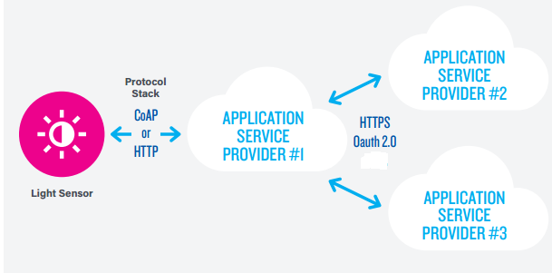
Back-End Data-Sharing Model

Slide 39
Back-End Data-Sharing Model
Constrained Application Protocol (CoAP) is an Internet Application Protocol for constrained devices (defined in RFC 7228). It enables those constrained devices to communicate with the wider Internet using similar protocols.
The Internet Protocol Suite is increasingly used on small devices with severe constraints on power, memory, and processing resources, creating constrained-node networks.
Notes:
Small devices with limited CPU, memory, and power resources, so- called "constrained devices" (often used as sensors/actuators, smart objects, or smartdevices) can form a network, becoming "constrained nodes" in that network.

Slide 40
Back-End Data-Sharing Model
OAuth is an open standard for access delegation, commonly used as a way for Internet users to grant websites or applications access to their information on other websites but without giving them the passwords
This mechanism is used by companies such as Google, Facebook, Microsoft and Twitter to permit the users to share information about their accounts with third party applications or websites.

Slide 41
Back-End Data-Sharing Model
The app Map My Fitness is a good example of this because it compiles fitness data from various devices ranging from the Fitbit to the Adidas miCoach to the Wahoo Bike Cadence Sensor. “They provide hooks, REST APIs to allow security and privacy-friendly data sharing to Map My Fitness.” This means an exercise can be analyzed from the viewpoint of various sensors.
http://about.mapmyfitness.com/2013/02/supported-compatible-devices/

Slide 42
IoT Example : ThinkMagic RFID enabled Refrigerator

Slide 43
IoT Example -----------Smart Cities

