Slide 1
CITS 5506 The Internet of Things Lecture 04
Dr Atif Mansoor
atif.mansoor@uwa.edu.au

Slide 2
Components of IoT
Sensors
Connectivity
Platform
Analytics
User Interface

Slide 3
Sensors
Different sensors available to measure temperature, humidity, light, noise, pollution, pressure, torsion, tension, acceleration, position, images, magnetic fields, electric fields, etc etc.
Sensor are now invisible and energy efficient, whilst maintaining a high measurement precision.
Miniaturization is trending and hopefully the Internet of Things by 2020 will be a healthy mix of sensors measuring things and robots acting on the insights.

Slide 4
Connectivity
Key Requirements
Availability
Reliability
Viability
Mobile phone technology is probably the best business proposition
Furthermore, an exciting class of Low Power Wide Area networking technologies is also emerging¹
Low Power Wifi, a new system, is also a great contender²
1. http://www.edn.com/design/systems-design/4440343/3/Low-power-wide-area-networking-alternatives-for-the-IoT
^{2.} https://www.wi-fi.org/news-events/newsroom/wi-fi-alliance-introduces-low-power-long-range-wi-fi-halow

Slide 5
Platform
The collected data needs to be stored and processed somewhere. Known as IoT platforms, these are typically cloud-based infrastructures which:
receive and send data via standardized interfaces, known as API (Application Programming Interface)
store the data; and
process the data.
Many commercial platforms are available today.
Recommended is scalable cloud solutions in a software-as-a-service (SaaS) model for IoT

Slide 6
Software as a service (SaaS)
Software as a service (SaaS) is a software distribution model in which a third-party provider hosts applications and makes them available to customers over the Internet.
SaaS is one of three main categories of cloud computing, alongside infrastructure as a service (IaaS) and platform as a service (PaaS).

Slide 7
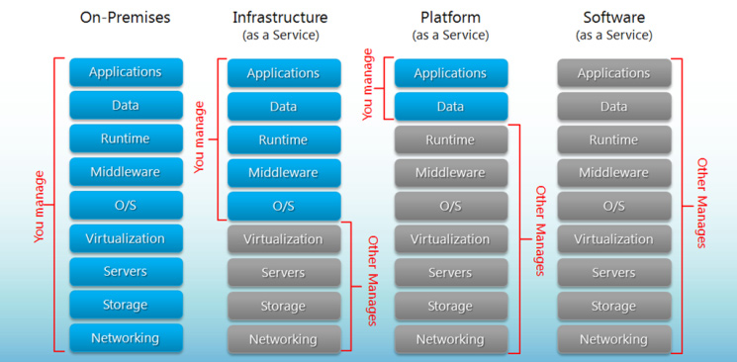
Comparison of Cloud Services

Slide 8
PaaS (Platform As A Service)
Used for applications, and other development, while providing cloud components to software.
What developers gain with PaaS is a framework they can build upon to develop or customize applications.
PaaS makes the development, testing, and deployment of applications quick, simple, and cost-effective

Slide 9
IaaS (Infrastructure As A Service)
Self-service models for accessing, monitoring, and managing remote datacenter infrastructures, such as compute (virtualized or bare metal), storage, networking, and networking services (e.g. firewalls).
Instead of having to purchase hardware outright, users can purchase IaaS based on consumption,

Slide 10
Analytics
Data analytics needs to be applied to the data to get the insight from data.
Big data analytics tools are generally available today, which stretch from simple statistical tools to more sophisticated machine learning approaches, with deep learning being the latest trend.
Think of statistical tools finding you the known knowns in the data; machine learning finding the known unknowns; whilst deep learning is able to find the unknown unknowns.

Slide 11
User Interface
User Interface is the component that how the data is presented to the final users.
IoT product needs to have a very appealing user interface, both web based as well as smart phone or tablet based.
There are many open-source as well as paying front-end products available today

