Slide 1
CITS 5506 The Internet of Things
Dr Atif Mansoor
atif.mansoor@uwa.edu.au

Slide 2
Introduction

Slide 3
Course Details
Practical Component
Raspberry Pie
Arduino board
Theoretical Component
Discussion on Research Papers
Concise Summary or salient points (written/typed on paper)
Project Proposal

Slide 4
Paper Discussion
What is it?
List key insights (e.g. claim, approach, evaluation, problem, solution, your comments)
Preferred Style:
Use a word processor
1 or 2 pages

Slide 5
Grading
Two Quizzes, providing 10% each = 20%
Class Participation (Papers Discussion) = 10%
Written Essay, providing (15 % IEEE style essay + 10% Presentation) (individual work) = 25%
Team Project = 45%
25% for the Business case/Proposal, 15-20min presentation to class
20% for the Prototype, 15 min presentation/demonstration to class

Slide 6
Essay
Individual
Decide the topic early
Short 4 page write-up (IEEE conference format)
Due last class before midterm
Follow guidelines (will be discussed in class)
Essay Presentations 04 October, 2017

Slide 7
Introduction to the IoT

Slide 8
In your opinion, what is Internet of Things ?
In your opinion, What is the Significance of IoT and what are related prospects for you?

Slide 9
How IoT works : A Video

Slide 10
The Internet of Things
*The term Internet of Things generally refers to scenarios where network connectivity and computing capability extends to objects, sensors and everyday items not normally considered computers, allowing these devices to generate, exchange and consume data with minimal human intervention.
There is, however, no single, universal definition.
* An Overview : Understanding the Issues and Challenges of a More Connected World, Whitepaper, 2015 by The Internet Society.

Slide 11
The Internet of Things
The Internet of Things is an emerging topic of technical, social, and economic significance.
Consumer products, durable goods, cars and trucks, industrial and utility components, sensors, and other everyday objects are being combined with Internet connectivity and powerful data analytic capabilities that promise to transform the way we work, live, and play.

Slide 12
The Internet of Things
Projections for the impact of IoT on the Internet and economy are impressive, with some anticipating as many as 100 billion connected IoT devices by 2025¹
Estimated global economic impact of more than $11 trillion by 2025¹.

Slide 13
HAPPY FORECAST

Slide 14
What is your opinion ?

Slide 15
Challenges for IoT
However, the Internet of Things raises significant challenges that could stand in the way of realizing its potential benefits.
Societal Challenges
privacy fears
surveillance concerns,
Security Concern (hacking of Internet-connected devices)

Slide 16
Challenges for IoT
Technical challenges
Sensors
Power Consumption
Security and Privacy
Data Analytics
Communication Technologies
Interoperability / Standards
Development Challenges/ Enabling Technologies

Slide 17
Challenges for IoT
Enabling Technologies: The concept of combining computers, sensors, and networks to monitor and control devices has existed for decades. The recent confluence of several technology market trends, however, is bringing the Internet of Things closer to widespread reality. These include Ubiquitous Connectivity, Widespread Adoption of IP-based Networking, Computing Economics, Miniaturization, Advances in Data Analytics, and the Rise of Cloud Computing

Slide 18
Challenges for IoT
Legal Challenges
The use of IoT devices raises many new regulatory and legal questions:
Issues related to cross border data flows
Data collected by IoT devices is sometimes susceptible to misuse, potentially causing discriminatory outcomes for some users.

Slide 19
Challenges for IoT
Legal Challenges
Conflict between law enforcement surveillance and civil rights
Data retention and destruction policies
Legal liability for unintended uses
Security breaches or privacy lapses

Slide 20
Potential realization of IoT– Moving from Global Village to “Hyperconnected world”
It may force a shift in thinking about the implications and issues in a world where the most common interaction with the Internet comes from passive engagement with connected objects rather than active engagement with content.

Slide 21
Emerging Economy and Development Issues
The Internet of Things holds significant promise for delivering social and economic benefits to emerging and developing economies.
This includes areas such as sustainable agriculture, water quality and use, healthcare, industrialization, and environmental management, among others

Slide 22
Emerging Economy and Development Issues
The unique needs and challenges of implementation in less-developed regions will need to be addressed, including :
infrastructure readiness
market and investment incentives
technical skill requirements, and
policy resources

Slide 23
IoT Forecast
A number of companies and research organizations have offered a wide range of projections about the potential impact of IoT on the Internet and the economy during the next five to ten years.
Cisco, for example, projects more than 24 billion Internet–connected objects by 2019¹
Morgan Stanley, however, projects 75 billion networked devices by 2020²
“Cloud and Mobile Network Traffic Forecast - Visual Networking Index (VNI).” Cisco, 2015. http://cisco.com/c/en/us/solutions/serviceprovider/visual-networking-index-vni/index.html
Danova, Tony. “Morgan Stanley: 75 Billion Devices Will Be Connected To The Internet Of Things By 2020.” Business Insider, October 2, 2013. http://www.businessinsider.com/75-billion-devices-will-be-connected-to-the-internet-by-2020-2013-10

Slide 24
IoT Forecast
Huawei forecasts 100 billion IoT connections by 2025³
McKinsey Global Institute suggests that the financial impact of IoT on the global economy may be as much as $3.9 to $11.1 trillion by 2025⁴
While the variability in predictions makes any specific number questionable, collectively they paint a picture of significant growth and influence.
3. "Global Connectivity Index." Huawei Technologies Co., Ltd., 2015. Web. 6 Sept. 2015. http://www.huawei.com/minisite/gci/en/index.html
4 . Manyika, James, Michael Chui, Peter Bisson, Jonathan Woetzel, Richard Dobbs, Jacques Bughin, and Dan Aharon. “The Internet of Things: Mapping the Value Beyond the Hype.” McKinsey Global Institute, June 2015.

Slide 25
IoT …………Conflicting Perceptions
IoT a revolutionary fully–interconnected “smart” world of progress, efficiency, and opportunity, with the potential for adding billions in value to industry and the global economy.
Others warn that the IoT represents a darker world of surveillance, privacy and security violations, and consumer lock–in.

Slide 26
IoT History
The term “Internet of Things” (IoT) was first used in 1999 by British technology pioneer Kevin Ashton to describe a system in which objects in the physical world could be connected to the Internet by sensors.
Ashton was working on RFID (radio-frequency identification) devices, and the close association of RFID and other sensor networks with the development of the IoT concept is reflected in the name of the RFID device company that Ashton joined later in his career: “ThingMagic.”
http://www.thingmagic.com/

Slide 27
IoT History
In late 1970s, systems for remotely monitoring meters on the electrical grid via telephone lines were already in commercial use¹.
In the 1990s, advances in wireless technology allowed “machine–to–machine” (M2M) enterprise and industrial solutions for equipment monitoring and operation to become widespread. Many of these early M2M solutions, however, were based on closed purpose–built networks and proprietary or industry–specific standards, rather than on Internet Protocol (IP)–based networks and Internet standards².
1. “Machine to Machine.” Wikipedia, https://en.wikipedia.org/wiki/Machine_to_machine
2. Polsonetti, Chantal. “Know the Difference Between IoT and M2M.” Automation World, July 15, 2014. http://www.automationworld.com/cloud-computing/know-difference-between-iot-and-m2m

Slide 28
IoT History
The first Internet “device”—an IP–enabled toaster that could be turned on and off over the Internet—was featured at an Internet conference in 1990¹.
Over the next several years, other “things” were IP–enabled, including a soda machine² at Carnegie Mellon University in the US and a coffee pot³ in the Trojan Room at the University of Cambridge in the UK (which remained Internet–connected until 2001)
1. "The Internet Toaster." Living Internet, 7 Jan. 2000. Web. 06 Sept. 2015. http://www.livinginternet.com/i/ia_myths_toast.htm
2. "The "Only" Coke Machine on the Internet." Carnegie Mellon University Computer Science Department, n.d. Web. 06 Sept. 2015. https://www.cs.cmu.edu/~coke/history_long.txt 18
3. Stafford-Fraser, Quentin. "The Trojan Room Coffee Pot." N.p., May 1995. Web. 06 Sept. 2015. http://www.cl.cam.ac.uk/coffee/qsf/coffee.html

Slide 29
IoT Evolution
From a broad perspective, the confluence of several technology and market trends is making it possible to interconnect more and smaller devices cheaply and easily:
• Ubiquitous Connectivity—Low cost, high–speed, pervasive network connectivity,
• Widespread adoption of IP–based networking— IP has become the dominant global standard for networking,

Slide 30
IoT Evolution
• Computing Economics— Greater computing power at lower price and lower power consumption
• Miniaturization— Manufacturing advances allow cutting-edge computing and communications technology to be incorporated into very small objects & small and inexpensive sensor devices
• Advances in Data Analytics— New algorithms and rapid increases in computing power, data storage, and cloud services enable the analysis of vast quantities of data

Slide 31
IoT Evolution
• Rise of Cloud Computing– Cloud computing, which leverages remote, networked computing resources to process, manage, and store data, allows small and distributed devices to interact with powerful back-end analytic and control capabilities.

Slide 32
“Settings” for IoT Applications
Setting | Description | Examples
Human | Devices attached or inside the human body | Devices (wearables and ingestibles) to monitor and maintain human health and wellness; disease management, increased fitness, higher productivity
Home | Buildings where people live | Home Controllers and Security Systems
Retail Environments | Spaces where consumers engage in commerce | Stores, banks, restaurants, arenas – anywhere consumers consider and buy; self-checkout, in-store offers, inventory optimization

Slide 33
“Settings” for IoT Applications
Setting | Description | Examples
Factories | Standardized production environments | Places with repetitive work routines, including hospitals and farms; operating efficiencies, optimizing equipment use and inventory
Worksites | Custom production environments | Mining, oil and gas, construction; operating efficiencies, predictive maintenance, health and safet
Vehicles | Systems inside moving vehicles | Vehicles including cars, trucks, ships, aircraft, and trains; condition-based maintenance, usage-based design,

Slide 34
“Settings” for IoT Applications
Setting | Description | Examples
Cities | Urban Environment | Public spaces and infrastructure in urban settings; adaptive traffic control, smart meters, environmental monitoring, resource management
Offices | Spaces where knowledge workers work | Energy management and security in office buildings; improved productivity, including for mobile employees
Manyika, James, Michael Chui, Peter Bisson, Jonathan Woetzel, Richard Dobbs, Jacques Bughin, and Dan Aharon. “The Internet of Things: Mapping the Value Beyond the Hype.” McKinsey Global Institute, June 2015. p.3. http://www.mckinsey.com/insights/business_technology/the_internet_of_things_the_value_of_digitizing_the_physical_world 25

Slide 35
Sensor Devices are widely available

Slide 36
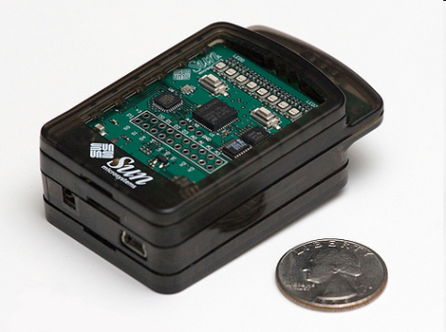
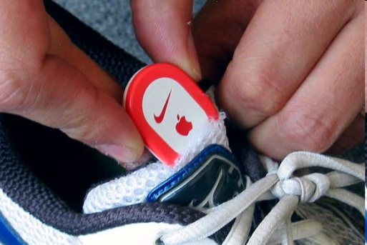
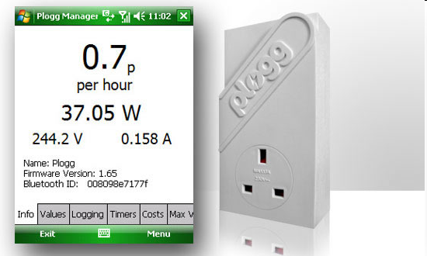
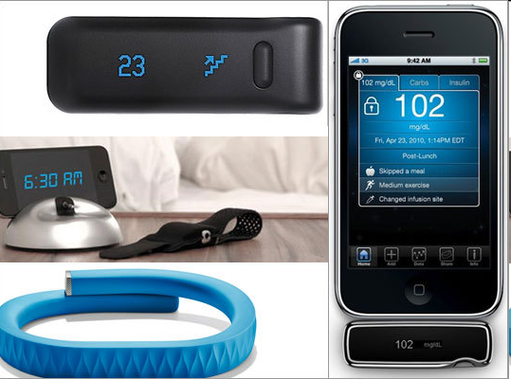
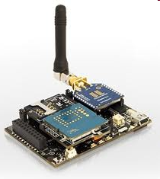
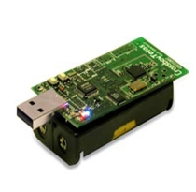
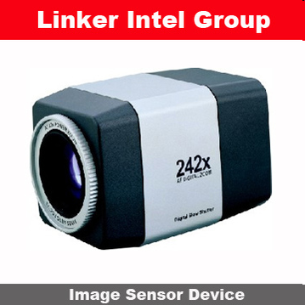
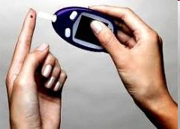
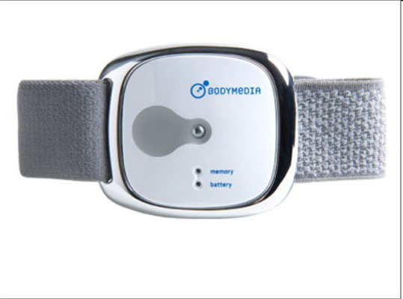
Sensor Devices are widely available
- Programmable devices
- Off-the-shelf gadgets/tools

Slide 37
How are the Network changing
Extensions
More nodes, more connections, IPv6,
Any TIME, Any PLACE + Any THING
M2M, IoT
Billions of interconnected devices,
Everybody connected.
Expansions
Broadband
Enhancements
Smart networks
Data-centric and content-oriented networking
Context-aware (autonomous) systems

Slide 38
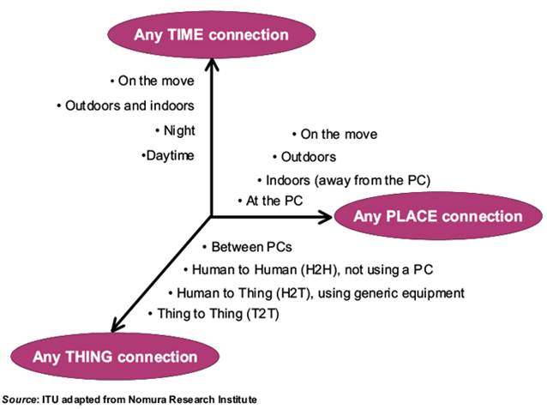
Future Networks

Slide 39
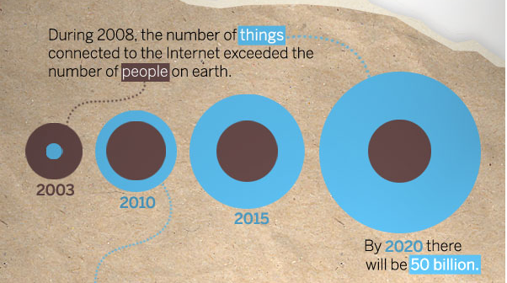
IoT Evolution

