Slide 1
CITS 4402 Computer Vision
Ajmal Mian
Mehdi Ravanbkhsh
Lecture 07
Feature Detection and Extraction

Slide 2
Objectives of this lecture
To understand the concept of feature detection
To know the properties of good features
To learn how to extract features from images
To learn the Harris corner detection algorithm
To learn the Scale Invariant Feature Transform (SIFT)

Slide 3
What are features and what is their use?
Feature is a piece of information that describes an image or a part of it
  Corners
  Edges
  Circles, ellipses, lines, blobs etc
Features are useful to match two images
  Find common points in two images to stitch them
  Object recognition, face recognition
  Structure from motion, stereo correspondence
Why not match pixels values? – Pixel values change with light intensity, colour and direction. They also change with camera orientation.

Slide 4
Properties of Good Features
Repeatability
  Should be detectable at the same locations in different images despite changes in viewpoint and illumination
Saliency (descriptiveness)
  Same points in different images should have similar features
  And vice-versa
Compactness (affects speed of matching)
  Fewer features
  Smaller features

Slide 5
Feature Extraction has Two Steps
Feature detection
  Where to extract features
  Not all locations are good to extract features
Feature extraction
  Orientation of the extraction window
  What to encode in the feature

Slide 6
Corners are Simple Features
Can you see common feature point between the two images?

Slide 7
Applications of Feature Matching
Image alignment and stitching
3D structure from motion
Motion tracking
Robot navigation
Image retrieval
Object and face recognition
Human action recognition

Slide 8
Image Stitching (to generate panorama)

Slide 9
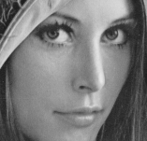
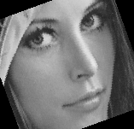
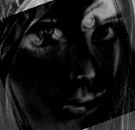
Image Alignment
Without alignment, images of the same person or object will not match
RMSE > 5000

Slide 10
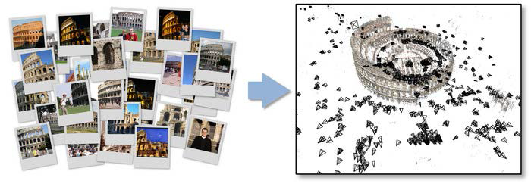
Structure from Motion (SfM)
Building Rome in a day
Matching feature points in unordered image collections
Software by Noah Snavely, Cornell University

Slide 11
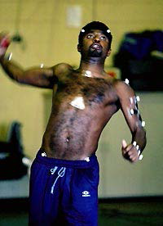
Motion Tracking
Is this bowler doing an underarm?
Track his joint positioins
Use artificial markers to make detection and tracking easy
Can be done without markers
If we can detect the same points in all
video frames

Slide 12
Feature Detectors – Classic and State of the Art
Feature | Detection | Extraction | OpenCV | Published
Harris | Yes | No | Yes | 1988
KLT | Yes | No | Yes | 1994
LBP | No | Yes | Yes | 1994
SIFT | Yes | Yes | Yes | IJCV 2004
FAST | Yes | No | Yes | ECCV 2006
SURF | Yes | Yes | Yes | CVIU 2008
BRIEF | No | Yes | ~ | ECCV 2010
ORB | Yes | Yes | Yes | ICCV 2011
BRISK | Yes | Yes | Yes | ICCV 2011
FREAK | Yes | Yes | Yes | CVPR 2012

Slide 13
Examples of Feature Extraction
Haar features
HOG: Histogram of Oriented Gradients
LBP: Local Binary Patterns
Harris Corners
Scale Invariant Feature Transform (SIFT)

Slide 14
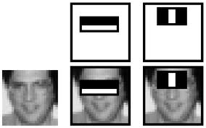
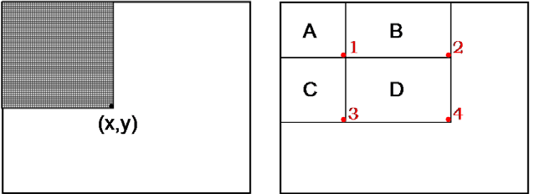
Haar Features
Haar wavelets but very simple and fast to calculate
Sum of white region pixels minus the
sum of black region pixels
Can be calculated in realtime from integral image
A large number of weak classifiers make decisions based on Haar features
When combined, they become a
strong classifier
Integral image
Sum of pixels in D = 4 – 2 – 3 + 1

Slide 15
Haar Features : Applications
Realtime XXX detection
Where XXX can be
  Faces
  Stop signs
  Fish
  Any object
Using C++ OpenCV library, you can train a Haar detector for any object
You can also do it using Matlab Computer Vision System Toolbox

Slide 16
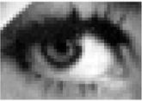
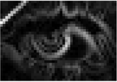
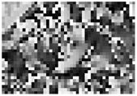
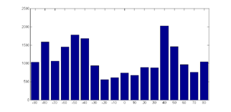
Histogram of Oriented Gradients (HOG)
Calculate gradient magnitude and orientation at each pixel
Divide orientations into N bins e.g. 360 degrees can be divided into 18 bins
The gradient magnitude of each pixel is then voted into the bin corresponding to its orientation
Improved variants
  Distribute the gradient magnitude among neighboring bins (soft voting)
  Divide image into cells, compute HOG for each cell and concatenate them
  Use a Gaussian window to weight the gradient magnitudes
  Normalize the final HOG to unit magnitude

Slide 17
HOG Applications
Can be used for detection of objects or actions
Has shown very good results for pedestrian detection
Has shown good results for action recognition

Slide 18

Local Binary Pattern (LBP)
Compare 8-connected neighborhood with center pixel
If pixel > center, replace with ‘1’ else ‘0’
Construct a binary number by going clockwise
Replace the center pixel with the decimal value of the binary number
Binary number is sensitive to starting point – LBP is not rotation invariant
Rotate binary string to minimize decimal value for rotation invariance
Minor changes in illumination can change the decimal value
Partition image into cells and construct LBP histograms in each cell

Slide 19
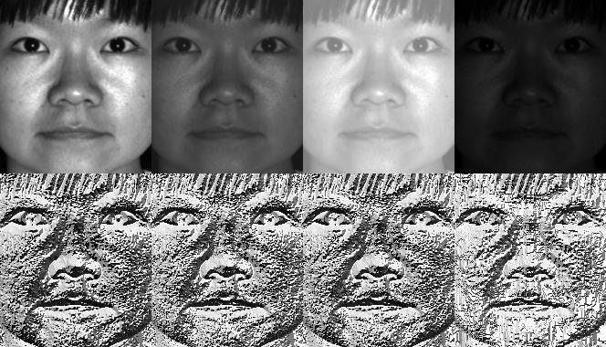
LBP Example from OpenCV
Notice how LBP feature are illumination invariant

Slide 20
Should we Extract Features from all Points?
LBP, HOG and Haar features do not have an embedded interest point detection
Such features must be calculated at each pixel or globally from the overall image
  Sensitive to occlusions
  Sensitive to orientation
  Computationally expensive

Slide 21
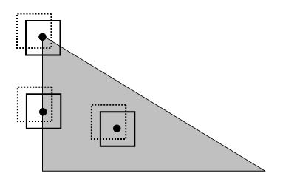
Corner Detection: Basic Idea
Where two edges meet
Where X and Y gradients are both high??

Slide 22
Harris Corner Detector
A corner is a point around which the gradient has two or more dominant directions
Corners can be repeatably detected under varying illumination and view point changes

Slide 23
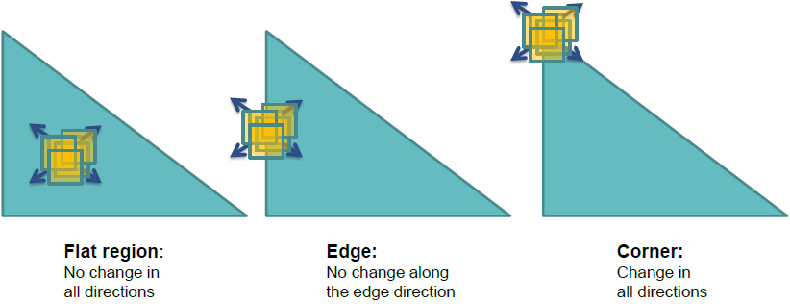
Harris Corner Detector: Basic Idea
Harris corner detector mathematically determines these three cases

Slide 24
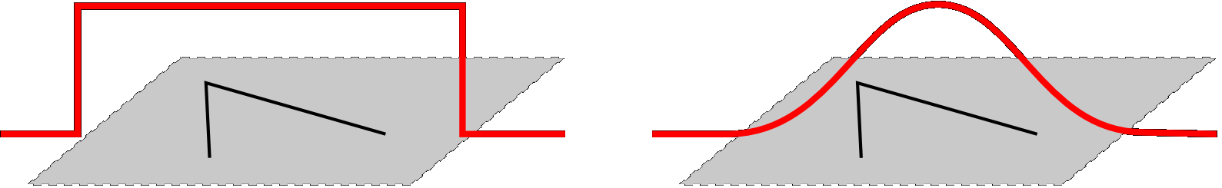


Harris Corner Detector : Mathematics
Change in appearance of window $w(x,y)$ for the shift $[u,v]$:
Window function
Shifted
intensity
Intensity
Window function $w\left(x,y\right)=$
or
Box i.e. 1 inside, 0 outside
Gaussian

Slide 25
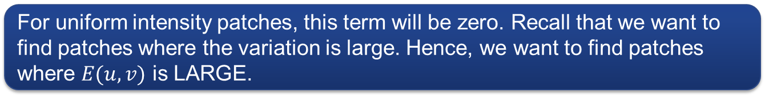
Harris Corner Detector : Intuition
Change in appearance of window $w(x,y)$ for the shift $[u,v]$:
For uniform intensity patches, this term will be zero. Recall that we want to find patches where the variation is large. Hence, we want to find patches where $E(u,v)$ is LARGE.

Slide 26
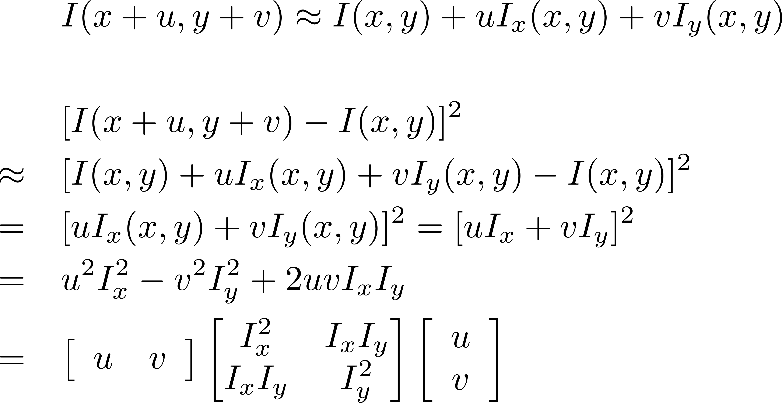

Harris Corner Detector : Derivation
First order Taylor series approximation
Recall the square term of $E(u,v)$
Removing (x,y) for readability

Slide 27
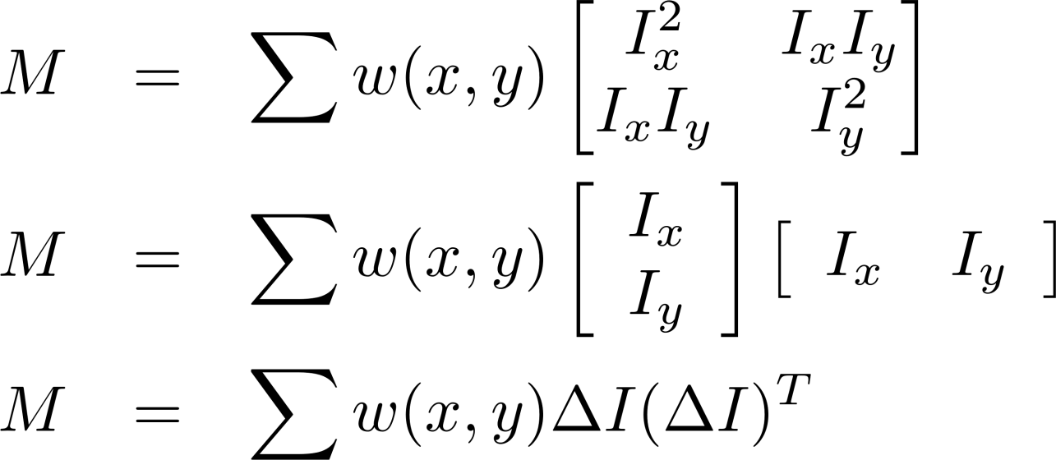
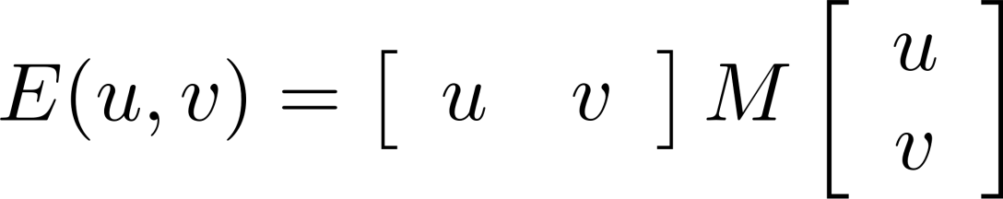
Harris Corner Detector : Mathematics
Window function can be simply w = 1
Product of first derivatives of the image

Slide 28
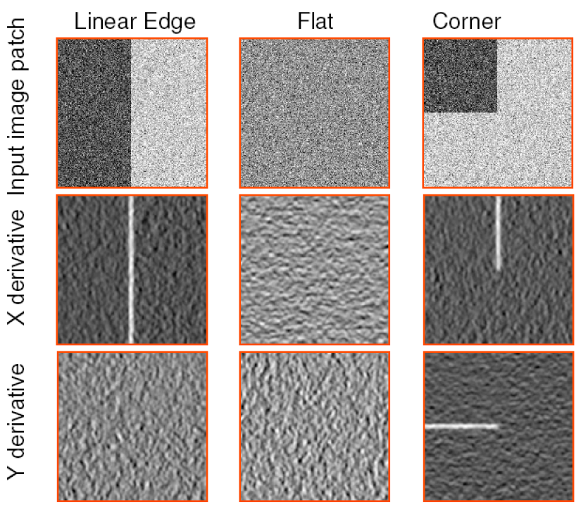
Harris Corner Detector : Intuitive Example
Treat gradient vectors as a set of (dx, dy) points with center of mass at (0,0)

Slide 29
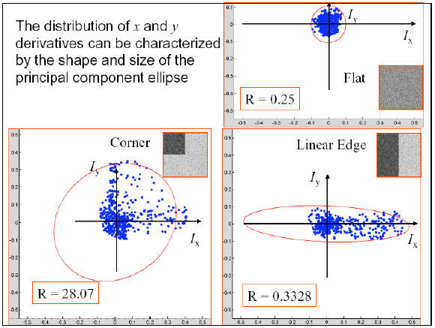
Plotting Derivatives as 2D Points for PCA

Slide 30
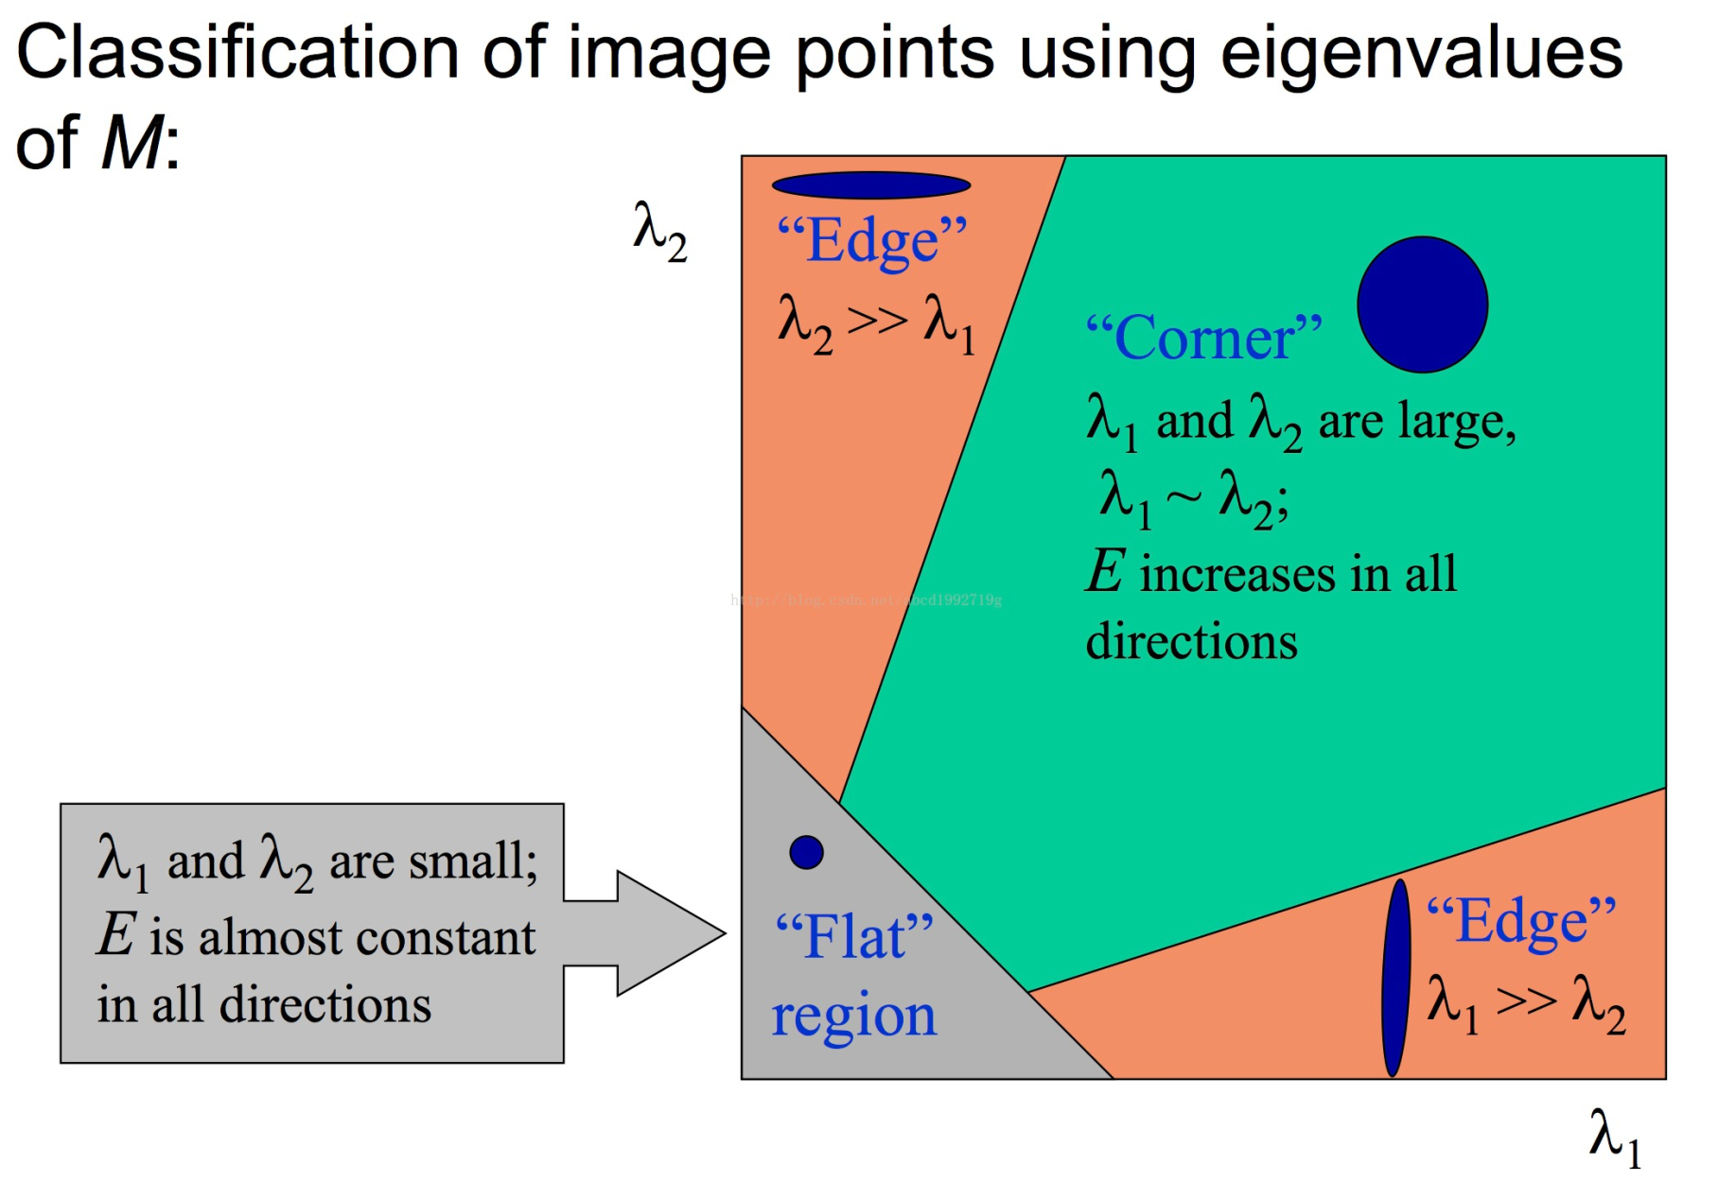

Slide 31
Harris Corner Detector: Cornerness Measure
Measure of corner response:
(k – empirical constant, k = 0.04-0.06)

Slide 32
Harris Corner Detector: Corner Response
λ₂
“Edge”
“Corner”
R depends only on eigenvalues of M
R is large for a corner
R is negative with large magnitude for an edge
|R| is small for a flat region
R < 0
R > 0
“Flat”
“Edge”
|R| small
R < 0
λ₁

Slide 33
Harris Corner Detection in Matlab
C = corner(img); % returns the locations of Harris corners in img
Type help corner to see details of the function
You can try different sensitivity levels and filter values.

Slide 34
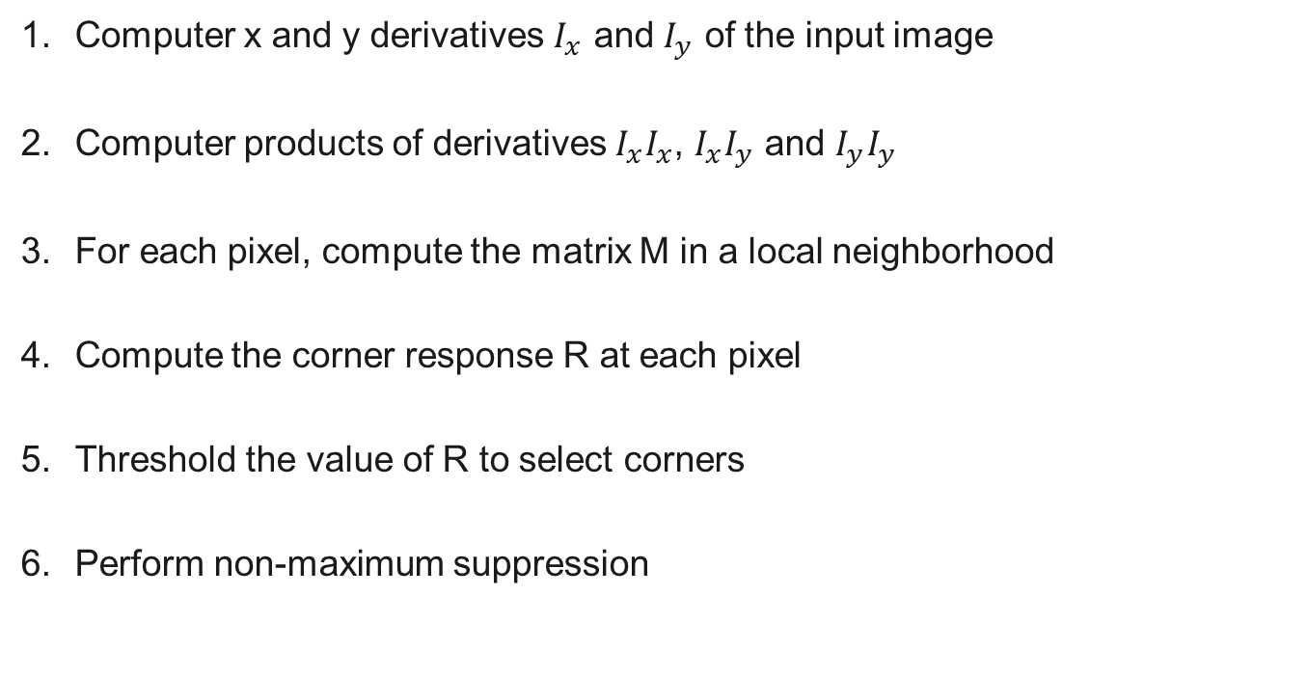
Algorithm : Harris Corner Detector
Computer x and y derivatives $I_{x}$ and $I_{y}$ of the input image
Computer products of derivatives $I_{x}I_{x}$, $I_{x}I_{y}$ and $I_{y}I_{y}$
For each pixel, compute the matrix M in a local neighborhood
Compute the corner response R at each pixel
Threshold the value of R to select corners
Perform non-maximum suppression

Slide 35
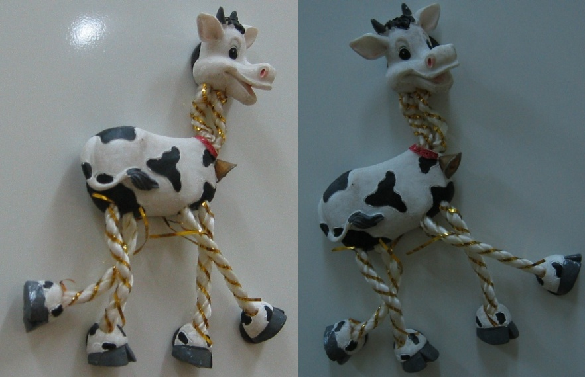
Harris Corner Detector : Example

Slide 36
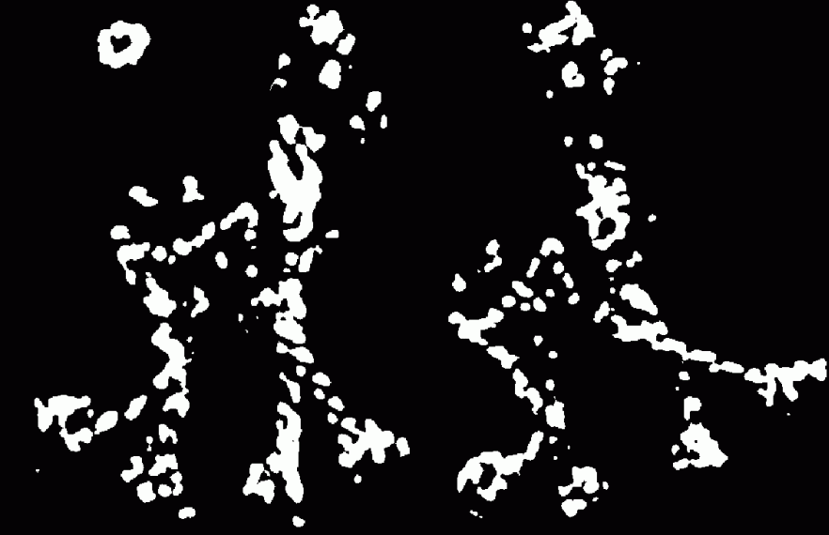
Points with R > threshold

Slide 37
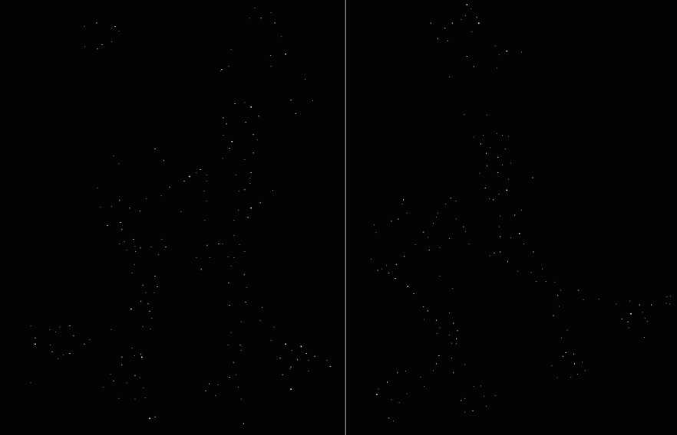
Take only the points of local maxima of R

Slide 38

Harris Corners

Slide 39
Properties of Harris Corners
Rotation Invariance
Ellipse rotates but the shape (i.e. eigenvalues) remain the same
Corner response R is invariant to image rotation.

Slide 40
Properties of Harris Corners
Partial invariance to affine intensity change
Only derivatives are used => invariance to intensity shift I → I + b
Intensity scale: I → a I
R
R
threshold
x (image coordinate)
x (image coordinate)

Slide 41
Properties of Harris Corners
NOT invariant to image scale
Corner at one scale may not be a corner at another
Scale is user specified parameter
Corner!
Edges

Slide 42
What Next?
We have found interest points, how do we extract features?
Take a square region around the corner point. But how big?
What if the images to be matched have different scales?
What if the object is rotated in the second image?

Slide 43
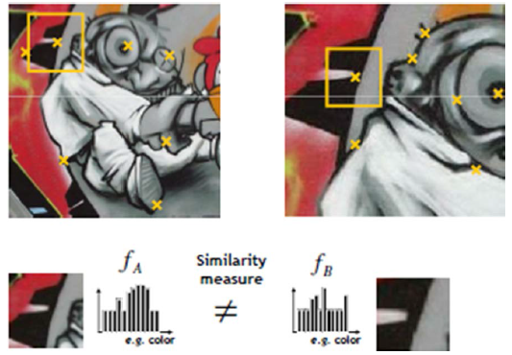
Scale Different

Slide 44
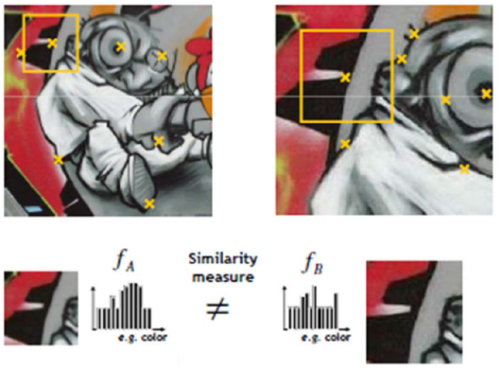
Exhaustive Search

Slide 45
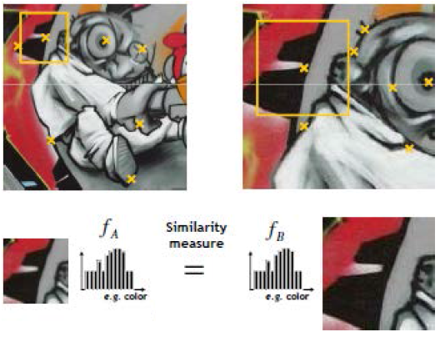
Try Different Window Sizes

Slide 46
Can we automatically find the scale of an interest point?
What would be the scale for Harris corner?
Can we efficiently find interest points and their scales together?
Such points are said to be scale invariant.
The search for these points is referred to as scale space search.

Slide 47
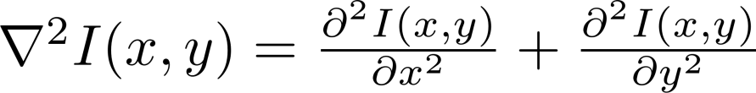
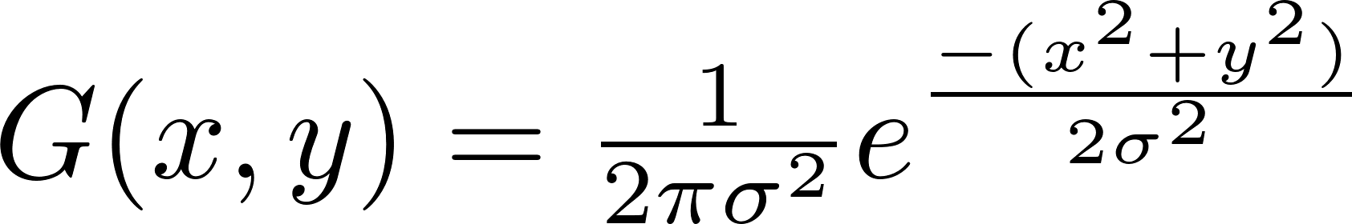
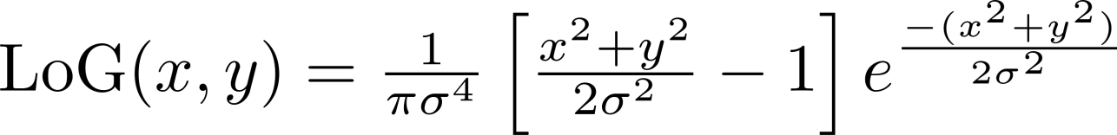
Laplacian of Gaussian (LoG) blob detector
Laplacian is the sum of 2nd derivatives in all (Cartesian) dimensions. For an image
Since derivatives are very sensitive to noise, images are first smoothed with a Gaussian filter. This two step operation is called Laplacian of Gaussian (LoG)
Laplacian and Gaussian are linear filter and can be combined

Slide 48
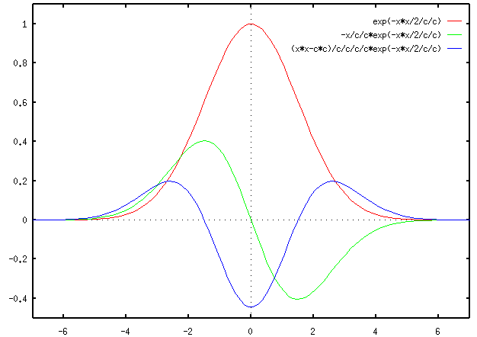
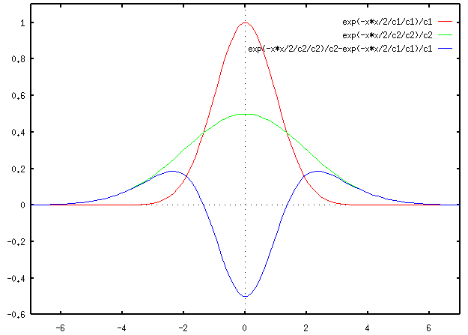
Laplacian of Gaussian : 1-D case
Notice the similarity with edge detection
Notice the similarity with Difference of Gaussian (DoG)
LoG
DoG

Slide 49
Laplacian of Gaussian : 2-D case
Convolution with a kernel (filter) is similar to comparing a small image of what you want to find with all local regions of the image

Slide 50
LoG Extrema Points
LoG is basically a blob feature detector
The scale (radius) of the blob is determined by
sigma
LoG extrema are stable features
They give excellent notion of scale
But calculation is costly

Slide 51
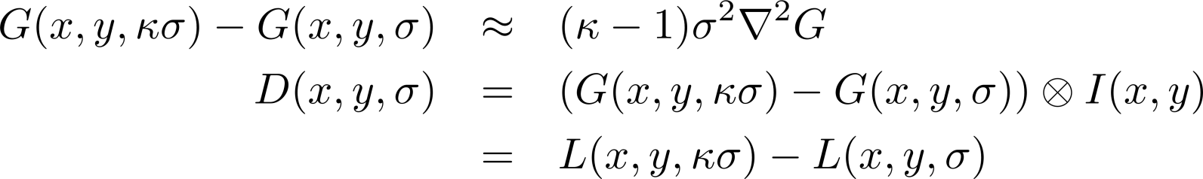
LoG approximation with DoG

Slide 52
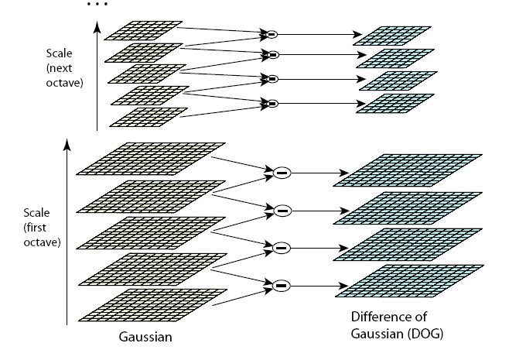
Efficient DoG Computation using Gaussian Scale Pyramid

Slide 53
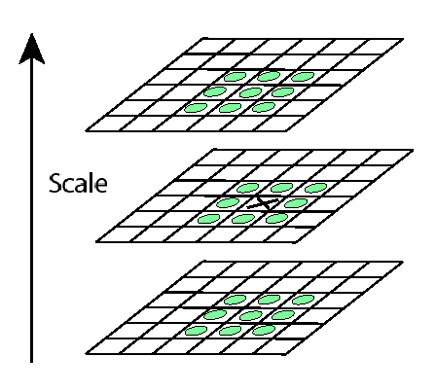
Local Extrema in DoG Images
Minima
Maxima
26 neighbourhood

Slide 54
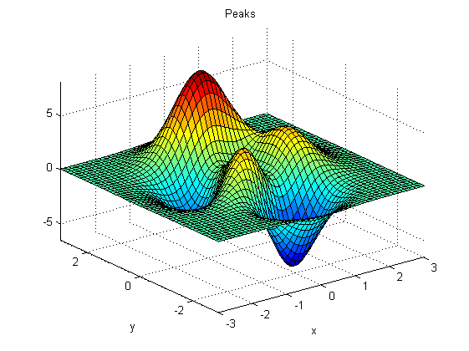
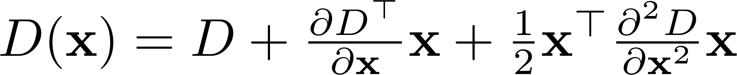
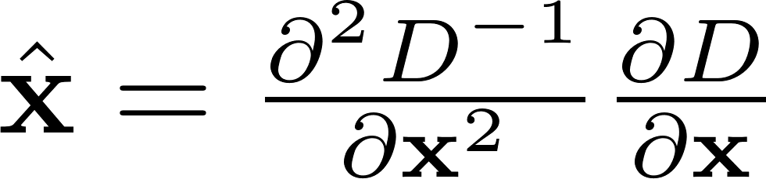

Subpixel Localization of Extrema Points
3D surface fitting
Recall the DoG convolved image $D(x,y,σ)$
Taylor series expansion
Where $x={\left(x,y,σ\right)}^{⊤}$
Differentiate w.r.t. $x$ and set to zero for the extrema values of $x={\left(x,y,σ\right)}^{⊤}$

Slide 55

Discard Low Contrast Points
Find the function value at extrema points $D(\hat{x}$)
Image pixel range [0 1]
If $|D\left(\hat{x}\right)|$ is less than 0.03, discard the point

Slide 56
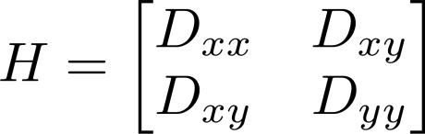
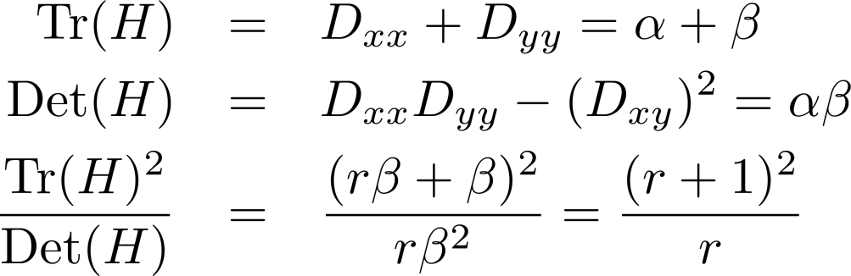
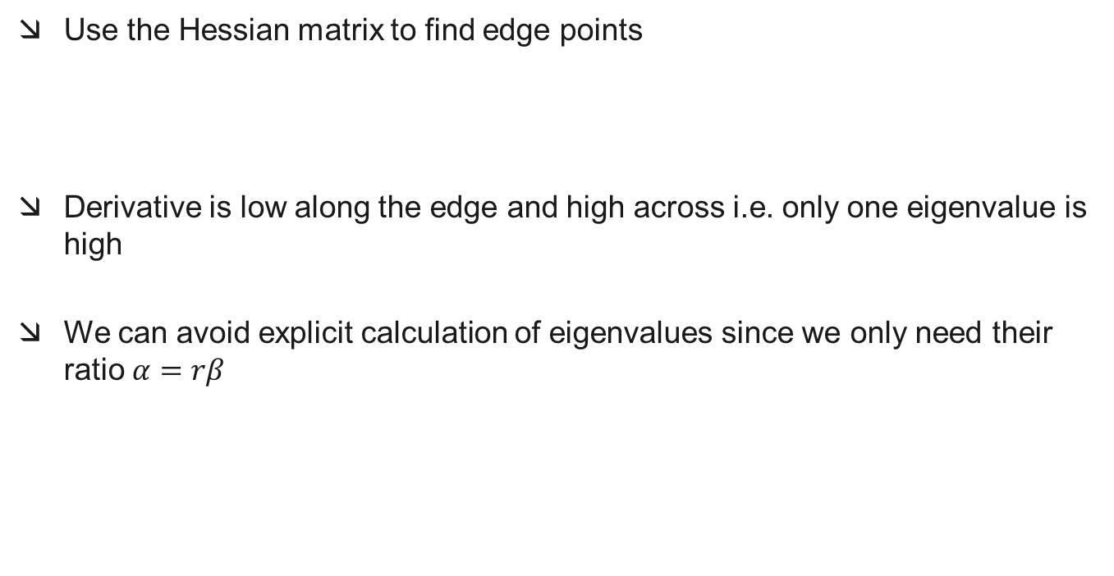
Eliminate Edge Points
Use the Hessian matrix to find edge points
Derivative is low along the edge and high across i.e. only one eigenvalue is high
We can avoid explicit calculation of eigenvalues since we only need their ratio $α=rβ$
This ratio should be small

Slide 57
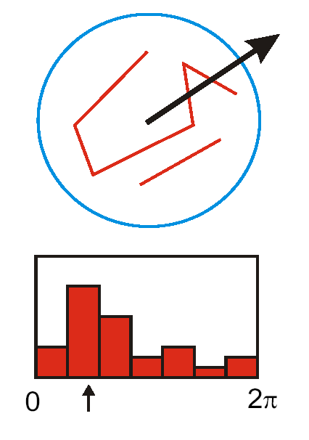
Orientation Assignment : Concept
Create histogram of local gradient
directions at the selected scale
Assign canonical orientation at the
peak of the smoothed histogram
If two major orientations, use both

Slide 58
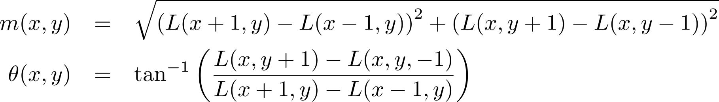
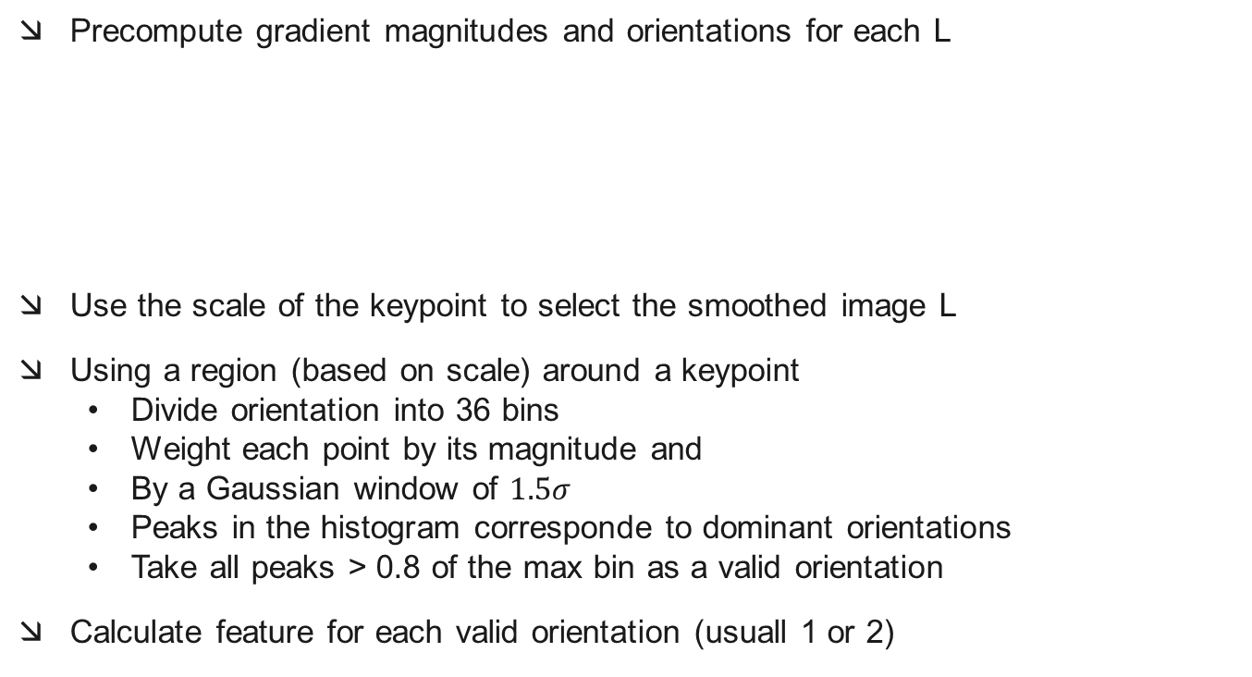
Orientation Assignment : Details
Precompute gradient magnitudes and orientations for each L
Use the scale of the keypoint to select the smoothed image L
Using a region (based on scale) around a keypoint
  Divide orientation into 36 bins
  Weight each point by its magnitude and
  By a Gaussian window of $1.5σ$
  Peaks in the histogram corresponde to dominant orientations
  Take all peaks > 0.8 of the max bin as a valid orientation
Calculate feature for each valid orientation (usuall 1 or 2)

Slide 59
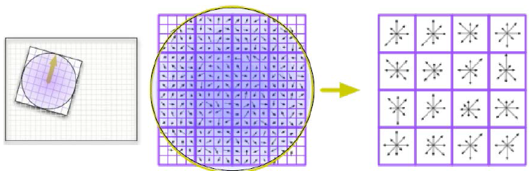
SIFT Feature Calculation
Take the region around a keypoint according to its scale
Rotate and align with the previously calculated orientation
8 orientation bins calculated at 4x4 bin array
8 x 4 x 4 = 128 dimension feature

Slide 60
Illumination Issues
SIFT is a 128 dimensional vector
For robustness to illumination, normalize the feature to unit magnitude
To cater for image saturations, truncate the feature to 0.2
Renormalize to unit magnitude
SIFT properties
  Repeatable keypoints
  Scale invariant
  Rotation invariant
  Robust to viewpoint
  Robust to illumination changes

Slide 61
Convolutional Neural Network Libraries
Caffe
  C++ framework with Python wrapper
  Open source
Matconvnet
    Matlab library
    Slow
Tensorflow
  C++ framework with Python wrapper
  Open source
  Google support
  TFLearn for better use of Tensorflow
  Becoming idustry standard

Slide 62

Neural Netowork

Slide 63

Convolutional Neural Network (CNN)

Slide 64
Transfer Learning
ConvNet as fixed feature extractor: Take a pretrained ConvNet, remove the last fully-connected layer, then treat the rest of the ConvNet as a fixed feature extractor for the new datasetCaffe
Fine-tuning the ConvNet: The second strategy is to not only replace and retrain the classifier on top of the ConvNet on the new dataset, but to also fine-tune the weights of the pretrained network by continuing the backpropagation
When and how to finetune?
  Size of the new dataset
  Similarity to the original dataset

Slide 65
Matconvnet
CNN library for Matlab
Installed in lab 2.01 computers
You can use it to extract features from the positive and negative pedestrian samples and then use them to train a classifier

Slide 66
Summary
We studied the importance of features and properties of good features
We learned about feature detection and feature extraction
We studied the Harris corner detector in detail
We studied the importance of scale and orientation invariance
We studied how the SIFT performs keypoint detection and feature extraction in a scale and orientation invariant way
We briefly discussed how to use existing CNN models for feature extraction
Acknowledgements: The slides are based on Rick Szeliski’s lecture notes, Computer Vision course of Penn State Univ, Open CV documentation and D. Low’s IJCV paper on SIFT.

