Slide 1
Requirements Engineering:
Specification & Validation
Software Requirements and Design
CITS4401
Lecture 7 and 8
Notes:
Revised Feb 2020 RCO
Earlier Versions: RCO, DH, GMH

Slide 2
Key ideas
Requirements Specification Document
  Writing down the requirements
Testing requirements
  Checking them
Prototyping requirements
  Show me!

Slide 3
The Problems of Requirements
What goal(s) are we trying to satisfy?
How do we identify the scope and properties of the solution space ?
Software Engineers differ in their views about the best way to answer these questions.
We will look at both planned and agile approaches

Slide 4
1. Requirements Specification Document

Slide 5
The Requirements Specification…
In planned methodologies
is the official statement of what is required of the system developers
forms the basis of a system contract between client and developer
is a reference tool used by clients, designers, programmers, testers and maintenance engineers.

Slide 6
Attributes of a Good Requirements Specification
Concise
Complete
Unambiguous
Testable
Consistent
Feasible
Modifiable
Traceable
Specifies external system behaviour only
Specifies constraints on the implementation
Easy to change
Reference Tool for maintainers
Records forethought about the life cycle
Characterises acceptable responses to undesired events

Slide 7
Requirements Specification
Document Template
  - 3.3 Non-functional requirements
    3.3.1 Usability
    3.3.2 Reliability
    3.3.3 Performance
    3.3.4 Supportability
    3.3.5 Implementation
    3.3.6 Interface
    3.3.7 Packaging
    3.3.8 Legal
  3.4 System models
    3.4.1 Scenarios
    3.4.2 UML use case models
    3.4.3 Object model
    3.4.4 Dynamic models
    3.4.5 User interface—navigation paths and screen mock-ups
4. Glossary
1. Introduction
  1.1 Purpose of the system
  1.2 Scope of the system
  1.3 Objectives and success criteria of the project
  1.4 Definitions, acronyms, and abbreviations
  1.5 References
  1.6 Overview
2. Current system
3. Proposed system
  3.1 Overview
  3.2 Functional requirements
Notes:
Note: You are not required to write a full RSD for the project

Slide 8
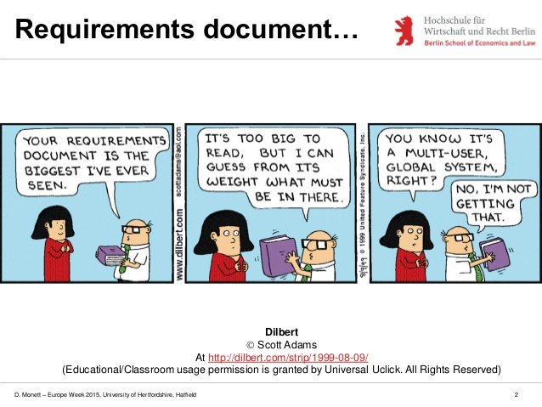
Documentation

Slide 9
2. Testing Requirements

Slide 10
Techniques for Writing Good Requirements Specifications
1. Avoid Ambiguity
2. Verifiable Requirements
3. Completeness Measures
4. Standard Document Structures
Notes:
4 things you can do to help you write better reqs specs

Slide 11
Avoiding Ambiguity: Problems with Natural Language Specification
Depends on shared linguistic experience of reader and writer
Over-flexible
Difficult to describe the system's functional architecture
Lack of support for requirements partitioning
Notes:
NL = Natural Language

Slide 12
Avoiding Ambiguity – rewrite these examples
The software system should provide acceptable performance under maximum load conditions.
The system interface should use a character set available on a standard terminal.
If the system should fail in operation, there should be minimal loss of data.
The software development process used should ensure that all of the required reviews have been carried out.
Structured programming should be used for program development.
The software must be developed in such a way that it can be used by inexperienced users.
Notes:
Rewrite these requirements so they can be objectively validated
For example, use metrics for “usability”, “acceptable performance” etc.
Bullet point 1: quantify “acceptable performance”, e.g. less than 5 seconds’ response time?
Last bullet point: need to use some metric, e.g. the learning time (such as 2 days? Half an hour?) needed for inexperienced users
Consider using some performance-based usability metrics for some of the bullet points above. These metrics include:
Task time, or the total time required for each task under study.
Snag, help, and search times, which concern the amount of time users spend dealing with problems such as seeking help or unproductively hunting through a system.
Effectiveness, which as a metric is derived from measures of the quantity and quality of task output and measures whether users succeed in achieving their goals when working with a system.
Efficiency, which relates effectiveness to the task time and thus measures the rate of task output.
Relative efficiency, which indicates how efficiently a task is performed by a general user compared with an expert user on the same system or with the same task on another system.
Productive period or the proportion of task time not spent in snag, help, or search (i.e., the relative amount of productive work time).

Slide 13
Verifiable Requirements Specs
Definition. A requirements spec is verifiable
iff (if and only if) every requirement statement is verifiable
iff there is some finite cost-effective way in which a person or machine can check to see if the SW product meets the requirement
We can use test cases, analysis or inspection to decide

Slide 14
Some Objective Metrics for
Non-functional Requirements (1)
Performance Speed
  Number of processed transactions per second
  User/event response time
  Screen refresh time
Size
  Kilobytes
  Number of RAM chips
Notes:
Non-functional requirements usually come as qualitative terms, e.g. “the system should be reliable”, “the response time should be short”. Here, to verify the specification, we need quantitative measures for the NFRs. E.g., user/event response time should be no more than 5 seconds; the screen refresh time should be 0.5 ms; the system can be stored in a 5kB harddisk

Slide 15
Some Objective Metrics for
Non-functional Requirements (2)
Reliability
  Mean time to failure
  Probability of unavailability
  Rate of failure occurrence
  Maximum size of system in kilobytes
Robustness
  Time to re-start after system failure
  Percentage of events causing failure
  Probability of data corruption on failure
Integrity
  Maximum permitted data loss after system failure

Slide 16
Some Objective Metrics for
Non-functional Requirements (3)
Ease of Use
  Training time taken to learn 75% of user facilities
  Average number of errors made by users in a given time period
  Number of help frames
Portability
  Percentage of target-dependent statements
  Number of target systems
Exercise
  Rewrite each of the non-functional requirements on slide 8 so that it can be verified objectively.

Slide 17
Completeness of Requirements
Have all the requirements needed to specify the requirements of the problem been defined?
Is the Requirements Specification document complete?

Slide 18
Completeness Issues
Are all inputs covered?
  Yes, if for every possible input event or value a response has been defined
Is every object needed by at least one use case?
Have all boundary cases been considered?
Fault-tolerance issues?
Notes:
Checking completeness is difficult – you need to notice what is NOT there – what has been left unsaid.
It is easier to check whether something written down is wrong.
It is harder to check whether something is missing – out of sight, out of mind.

Slide 19
Document Completeness
Software Requirements Document conforms to a standard document format
All requirements, figures and tables are numbered
All requirements are linked to a source or rationale
A database may be used for managing requirements
Notes:
Some of these properties can be checked automatically

Slide 20
Standard Document Structures
Using a template for the Requirements Specification Document or for stating individual requirements helps to organise a gathered set of requirements
There are many different templates and standards; these will need modification for particular projects or organisations
Examples
Pressman, Software Requirements Specification Template, Chapter 5
The Volere Requirements Specification https://www.volere.org/templates/

Slide 21
Requirements: Analysis vs Validation
Analysis works with raw requirements as elicited from the system stakeholders
  “Have we got the right requirements” is the key question to be answered at this stage
Validation works with a final draft of the requirements document i.e. with negotiated and agreed requirements
  “Have we got the requirements right” is the key question to be answered at this stage
Notes:
Have we got the right requirements? – this question refers to whether we have correctly captured the client’s requirements.
Have we got the requirements right? – this question refers to “OK, we have got the client’s requirements correctly, but did we implement the requirements correctly? Did we deliver the product that have those requirements that we correctly understood?”

Slide 22
Validation inputs
Requirements document
  Complete, formatted and organised according to organisational standards
Organisational knowledge
  Knowledge, often implicit, of the organisation; used to judge the realism of the requirements
Organisational standards
  Local standards e.g. for the organisation of the requirements document

Slide 23
Validation outputs
Problem list
  List of discovered problems in the requirements document
Agreed actions
  List of agreed actions in response to requirements problems. Some problems may have several corrective actions; some problems may have no associated actions

Slide 24
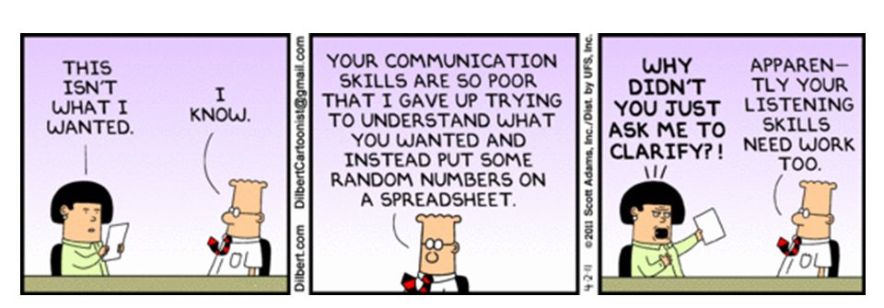
Dilbert and Validation

Slide 25
Requirements reviews
A group of people read and analyse the requirements, look for problems, meet and discuss the problems and agree on actions to address these problems

Slide 26
Review checklists (1)
Understandability
  Can readers of the document understand what the requirements mean?
Redundancy
  Is information unnecessarily repeated in the requirements document?

Slide 27
Review checklists (2)
Consistency
  Do the descriptions of different requirements include contradictions? Are there contradictions between individual requirements and overall system requirements?
Organisation
  Is the document structured in a sensible way? Are the descriptions of requirements organised so that related requirements are grouped?

Slide 28
Review checklists (3)
Conformance to standards
  Does the requirements document and individual requirements conform to defined standards? Are departures from the standards, justified?
Traceability
  Are requirements unambiguously identified, include links to related requirements and to the reasons why these requirements have been included?

Slide 29
Checklist questions
Is each requirement uniquely identified?
Are specialised terms defined in the glossary
Does a requirement stand on its own or do you have to examine other requirements to understand what it means?
Do individual requirements use the terms consistently
Is the same service requested in different requirements? Are there any contradictions in these requests?
If a requirement makes reference to some other facilities, are these described elsewhere in the document?
Are related requirements grouped together? If not, do they refer to each other?

Slide 30
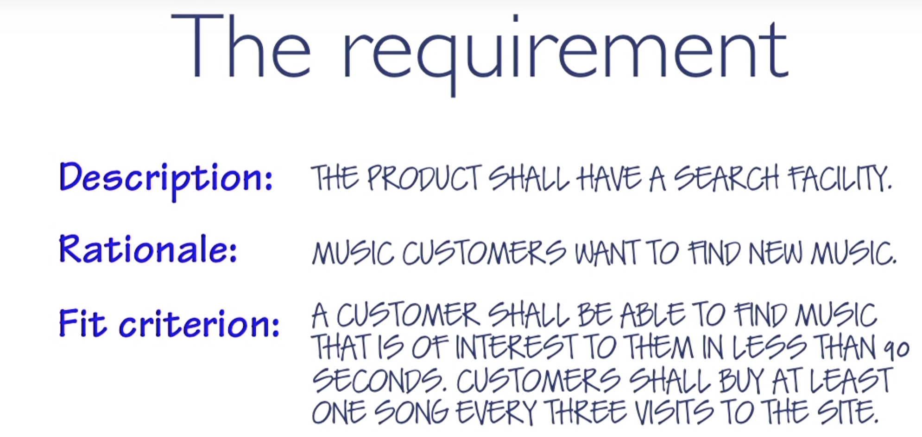
The snow card (review)
https://www.volere.org/the-perfectly-formed-requirement/ (video)
Notes:
Remember we used snow cards at the beginning of the unit to capture requirements at a high level
Here is a bit more detail

Slide 31
Ten Tests for Requirements
Reading: https://www.volere.org/ten-tests-for-requirements/
Does each requirement have a fit criterion that can be used to test whether a solution meets the requirement?
Is every requirement in the specification relevant to this system?
Does the specification contain a definition of the meaning of essential terms within the specification?
Is every reference to a defined term consistent with its definition?
Is the context of the requirements study wide enough to cover everything we need to understand?
Does the requirement contain a rationale?
Have we asked the stakeholders about conscious, unconscious and undreamed of requirements?
Does the specification contain solutions posturing as requirements?
Is the stakeholder value defined for each requirement?
Is each requirement uniquely identifiable?

Slide 32
3. Prototyping Requirements

Slide 33
Prototyping
Prototypes for requirements validation demonstrate the requirements and help stakeholders discover problems
Analysis prototypes can be lightweight and need not contain SW at all; they are for discovering what the users want
Validation prototypes should be complete, reasonably efficient and robust. It should be possible to use them in the same way as the required system
User documentation and training should be provided

Slide 34
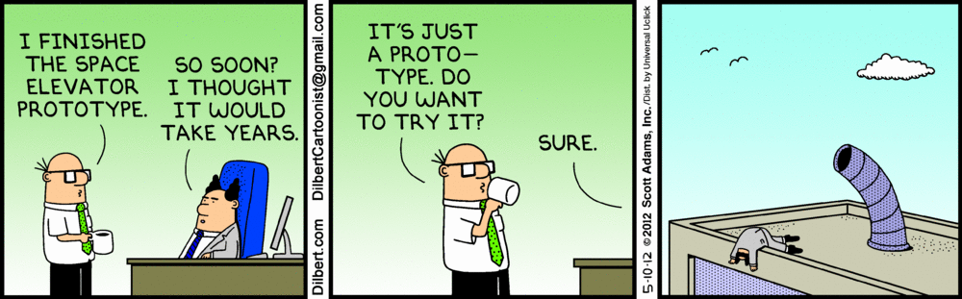
Dilbert prototyping

Slide 35
User manual development
Writing a user manual from the requirements forces a detailed requirements analysis and thus can reveal problems with the document
Information in the user manual
  Description of the functionality and how it is implemented
  Which parts of the system have not been implemented
  How to get out of trouble
  How to install and get started with the system

Slide 36
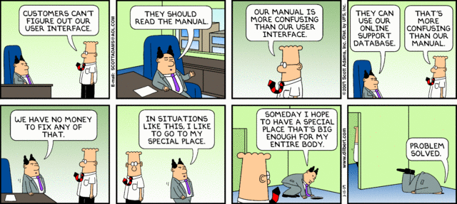
Dilbert user manual

Slide 37
Hard-to-test requirements (1)
System requirements
  Requirements which apply to the system as a whole. In general, these are the most difficult requirements to validate irrespective of the method used as they may be influenced by any of the functional requirements. Tests, which are not executed, cannot test for non-functional system-wide characteristics such as usability.

Slide 38
Hard-to-test requirements (2)
Exclusive requirements
  These are requirements which exclude specific behaviour. For example, a requirement may state that system failures must never corrupt the system database. It is not possible to test such a requirement exhaustively.

Slide 39
Hard-to-test requirements (3)
Some non-functional requirements
  Some non-functional requirements, such as reliability requirements, can only be tested with a large test set. Designing this test set does not help with requirements validation.

Slide 40
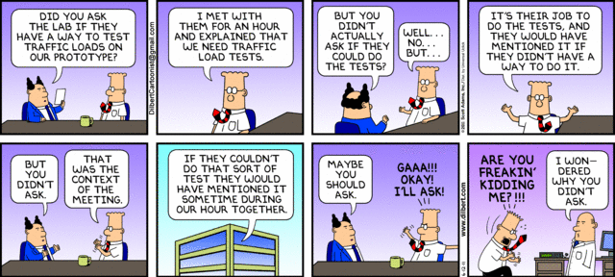
Dilbert Testing

Slide 41
Summary
Requirements Specification Document
  Writing down the requirements
Testing requirements
  Checking them
Prototyping requirements
  Show me!

Slide 42
Summary (1)
Requirements Specification Document
  Basis for client-developer contract
Desirable attributes
  Concise, complete, consistent, unambiguous, testable, modifiable, traceable, feasible
Techniques
    1. Avoid Ambiguity
    2. Make Requirements Verifiable
    3. Test for Completeness
    4. Use Standard Document Structures and Templates

Slide 43
Summary (2)
Requirements validation should focus on checking the final draft of the requirements document for conflicts, omissions and deviations from standards.
Checklists can support validation tasks
Reviews involve a group of people making a detailed analysis of the requirements.

Slide 44
Summary (3)
Prototyping is effective for requirements validation if it is in the initial stages of software engineering.
Prototypes can be physical (eg on paper) or in software

Slide 45
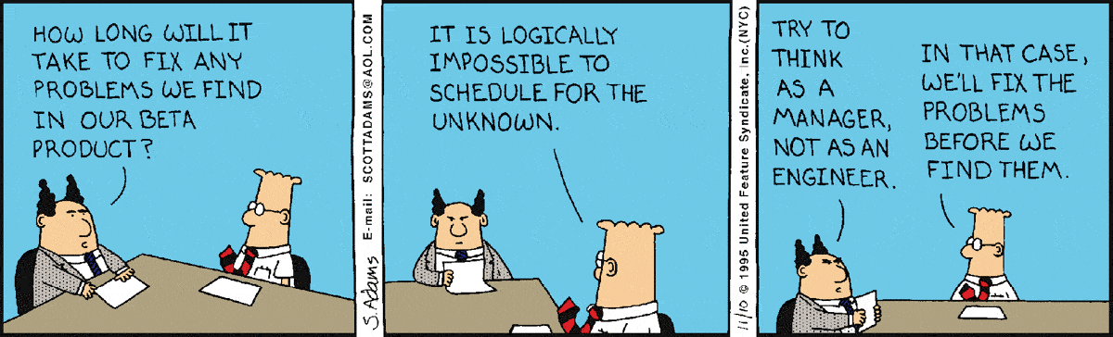
Software engineer vs manager

Slide 46
Recommended reading
R. S. Pressman, Software Engineering: A Practitioner’s Approach, 6th ed., McGraw Hill 2005
  Section 7.2.5 “Specification”
  Section 7.2.6 “Validation”
  Section 7.2.7 “Requirements Management”
  Section 7.8 “Validating Requirements”
B. Bruegge and A. H. Dutoit, Object-Oriented Software Engineering – Using UML, Patterns, and Java, 3rd ed., Prentice Hall, 2010
  Section 4.3.3 “Completeness, Consistency, Clarity, and Correctness”
  Section 4.3.4 “Realism, Verifiability, and Traceability”

