Slide 1

CITS4009 Introduction to Data Science
School of Computer Science and Software Engineering
Semester 2, 2017: Part 2 modelling methods
Chapter 8 Unsupervised methods

Slide 2
Chapter Objectives
Using R’s clustering functions to explore data and look for similarities
Choosing the right number of clusters
Evaluating a clustering
Using R’s association rules functions to find patterns of co-occurrence in data
Evaluating a set of association rules

Slide 3
Introduction
Unsupervised methods used to discover unknown relationships or patterns in data.
For example, you may want to find groups of customers with similar purchase patterns, or correlations between population movement and socioeconomic factors.
In this chapter, we’ll look at two classes of unsupervised methods.
Cluster analysis finds groups in your data with similar characteristics.
Association rule mining finds elements or properties in the data that tend to occur together.

Slide 4
Cluster analysis
Clusters is to group the observations in data that every datum in a cluster is more similar to other datums in the same cluster than it is to datums in other cluster.
Two approaches for cluster analysis:
Hierarchical clustering finds nested groups of clusters. An example of hierarchical clustering might be the standard plant taxonomy, which classifies plants by family, then genus, then species.
K-means, which is a quick and popular way of finding clusters in quantitative data.

Slide 5
Clustering and density estimation
cluster analysis is related to the problem of density estimation: if you think of your data as living in a large dimensional space, then you want to find the regions of the space where the data is densest. If those regions are distinct, or nearly so, then you have clusters.

Slide 6
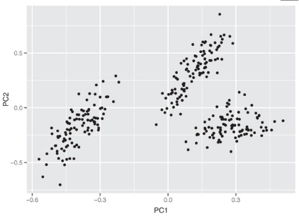
Distances
To cluster, you need the notions of similarity and dissimilarity.
Dissimilarity can be thought of as distance, so that the points in a cluster are closer to each other than they are to the points in other clusters.
Different application areas will have different notions of distance and dissimilarity. A few of the most common ones:
Euclidean distance
Hamming distance
Manhattan (city block) distance
Cosine similarity
An example of data in three clusters

Slide 7
Euclidean distance
The most common distance is Euclidean distance. The Euclidean distance between two vectors x and y is defined as
Edist(x, y) <- sqrt((x[1]-y[1])^2 + (x[2]-y[2])^2 + ...)
Optimizing squared Euclidean distance is the basis of k-means.
Euclidean distance only makes sense when all the data is real-valued (quantitative).
If the data is categorical (in particular, binary), then other distances can be used.

Slide 8
2- Hamming distance
For categorical variables (male/female, or small/medium/large), you can define the distance as 0 if two points are in the same category, and 1 otherwise. If all the variables are categorical, then you can use Hamming distance, which counts the number of mismatches:
hdist(x, y) <- sum((x[1] != y[1]) + (x[2] != y[2]) + ...)
Here, a != b is defined to have a value of 1 if the expression is true, and a value of 0 if the expression is false.
If the categories are ordered (like small/medium/large) so that some categories are “closer” to each other than others, then you can convert them to a numerical sequence.
For example, (small/medium/large) might map to (1/2/3). Then you can use Euclidean distance, or other distances for quantitative data.

Slide 9
3- Manhattan (city block) distance
Manhattan distance measures distance in the number of horizontal and vertical units it takes to get from one (real-valued) point to the other (no diagonal moves):
mdist(x, y) <- sum(abs(x[1]-y[1]) + abs(x[2]- y[2]) + ...)
This is also known as L1 distance (and squared Euclidean distance is L2 distance).

Slide 10
4- Cosine similarity
Cosine similarity measures the smallest angle between two vectors (the angle theta between two vectors is assumed to be between 0 and 90 degrees).
Two perpendicular vectors (theta = 90 degrees) are the most dissimilar; the cosine of 90 degrees is 0.
Two parallel vectors are the most similar (identical, if you assume they’re both based at the origin); the cosine of 0 degrees is 1.
From elementary geometry, you can derive that the cosine of the angle between two vectors is given by the normalized dot product between the two vectors:
dot(x, y) <- sum( x[1]*y[1] + x[2]*y[2] + ... ) cossim(x, y) <- dot(x, y)/(sqrt(dot(x,x)*dot(y,y)))
You can turn the cosine similarity into a pseudo distance by subtracting it from 1.0 (though to get an actual metric, you should use 1 - 2*acos(cossim(x,y))/pi).

Slide 11
Preparing the data
We will use small dataset from 1973 on protein consumption from nine different food groups in 25 countries in Europe.
The goal is to group the countries based on patterns in their protein consumption.
The dataset is loaded into R as a data frame called protein, as shown in the next slide.

Slide 12
protein <- read.table(“protein.txt”, sep=”\t”, header=TRUE)
summary(protein)
Country RedMeat WhiteMeat Eggs
Albania : 1 Min. : 4.400 Min. : 1.400 Min. :0.500
Austria : 1 1st Qu.: 7.800 1st Qu.: 4.900 1st Qu.:2.700
Belgium : 1 Median : 9.500 Median : 7.800 Median :2.900
Bulgaria : 1 Mean : 9.828 Mean : 7.896 Mean :2.936
Czechoslovakia: 1 3rd Qu.:10.600 3rd Qu.:10.800 3rd Qu.:3.700 ]
Denmark : 1 Max. :18.000 Max. :14.000 Max. :4.700
(Other) :19 Milk Fish Cereals Starch
Min. : 4.90 Min. : 0.200 Min. :18.60 Min. :0.600 1st Qu.:11.10 1st Qu.: 2.100 1st Qu.:24.30 1st Qu.:3.100 Median :17.60 Median : 3.400 Median :28.00 Median :4.700
Mean :17.11 Mean : 4.284 Mean :32.25 Mean :4.276 3rd Qu.:23.30 3rd Qu.: 5.800 3rd Qu.:40.10 3rd Qu.:5.700 Max. :33.70 Max. :14.200 Max. :56.70 Max. :6.500 Nuts Fr.Veg Min. :0.700 Min. :1.400 1st Qu.:1.500 1st Qu.:2.900 Median :2.400 Median :3.800 Mean :3.072 Mean :4.136 3rd Qu.:4.700 3rd Qu.:4.900 Max. :7.800 Max. :7.900

Slide 13
Units and scaling
The documentation for this dataset doesn’t mention what the units of measurement are, though we can assume all the columns are measured in the same units.
This is important: units (or more precisely, disparity in units) affect what clusterings an algorithm will discover. If you measure vital statistics of your subjects as age in years, height in feet, and weight in pounds, you’ll get different distances—and possibly different clusters—than if you measure age in years, height in meters, and weight in kilograms.
One way to try to make the clustering more coordinate-free is to transform all the columns to have a mean value of 0 and a standard deviation of 1. This makes the standard deviation the unit of measurement in each coordinate. Assuming that your training data has a distribution that accurately represents the population at large, then a standard deviation represents approximately the same degree of difference in every coordinate.
You can scale the data in R using the function scale().

Slide 14
Hierarchical clustering with hclust()
The hclust() function takes as input a distance matrix (as an object of class dist), which records the distances between all pairs of points in the data (using any one of a variety of metrics). It returns a dendrogram: a tree that represents the nested clusters.
hclust() uses one of a variety of clustering methods to produce a tree that records the nested cluster structure. You can compute the distance matrix using the function dist().
dist() will calculate distance functions using the (squared) Euclidean distance (method="euclidean"), the Manhattan distance (method="manhattan"), and something like the Hamming distance, when categorical variables are expanded to indicators (method="binary").
If you want to use another distance metric, you’ll have to compute the appropriate distance matrix and convert it to a dist object using the as.dist() call .
Let’s cluster the protein data. We’ll use Ward’s method, which starts out with each data point as an individual cluster and merges clusters iteratively so as to minimize the total within sum of squares (WSS) of the clustering.

Slide 15

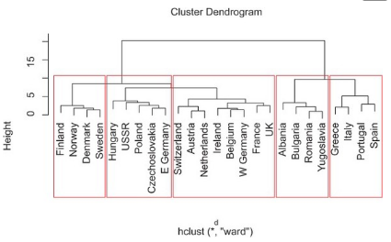
There’s a certain logic to these clusters: the countries in each cluster tend to be in the same geographical region. It makes sense that countries in the same region would have similar dietary habits. You can also see that:
Cluster 2 is made of countries with higher-than-average red meat consumption.
Cluster 4 contains countries with higher-than-average fish consumption but low produce consumption.
Cluster 5 contains countries with high fish and produce consumption

Slide 16
Visualizing clusters
We can visualize the clustering by projecting the data onto the first two principal components of the data.
If N is the number of variables that describe the data, then the principal components describe the hyperellipsoid in N-space that bounds the data.
If you order the principal components by the length of the hyperellipsoid’s corresponding axes (longest first), then the first two principal components describe a plane in N-space that captures as much of the variation of the data as can be captured in two dimensions.
We’ll use the prcomp() call to do the principal components decomposition.

Slide 17
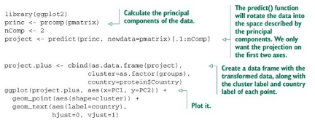
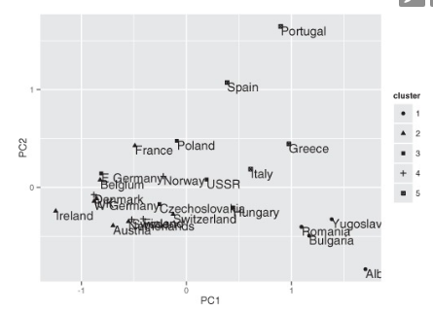
Projecting the clusters on the first two principal components
You can see in left figure that the Romania/Yugoslavia/Bulgaria/Albania cluster and the Mediterranean cluster (Spain and so on) are separated from the others.
The other three clusters co-mingle in this projection, though they’re probably more separated in other projections.
Plot of countries clustered by protein consumption, projected onto first two principal components

Slide 18
Bootstrap evaluation of clusters
An important question when evaluating clusters is whether a given cluster is “real”—does the cluster represent actual structure in the data, or is it an artifact of the clustering algorithm?
This is important with clustering algorithms like k-means, where the user has to specify the number of clusters a priori.
One way to assess whether a cluster represents true structure is to see if the cluster holds up under plausible variations in the dataset. The fpc package has a function called clusterboot() that uses bootstrap resampling to evaluate how stable a given cluster is.
clusterboot() is an integrated function that both performs the clustering and evaluates the final produced clusters. It has interfaces to a number of R clustering algorithms, including both hclust and kmeans.

Slide 19
Clusterboot’s algorithm uses the Jaccard coefficient, a similarity measure between sets.
The Jaccard similarity between two sets A and B is the ratio of the number of elements in the intersection of A and B over the number of elements in the union of A and B. The basic general strategy is as follows:
1. Cluster the data as usual.
2. Draw a new dataset (of the same size as the original) by resampling the original dataset with replacement (meaning that some of the data points may show up more than once, and others not at all). Cluster the new dataset.
3. For every cluster in the original clustering, find the most similar cluster in the new clustering (the one that gives the maximum Jaccard coefficient) and record that value. If this maximum Jaccard coefficient is less than 0.5, the original cluster is considered to be dissolved—it didn’t show up in the new clustering. A cluster that’s dissolved too often is probably not a “real” cluster.
4. Repeat steps 2–3 several times
The cluster stability of each cluster in the original clustering is the mean value of its Jaccard coefficient over all the bootstrap iterations.
As a rule of thumb, clusters with a stability value less than 0.6 should be considered unstable. Values between 0.6 and 0.75 indicate that the cluster is measuring a pattern in the data, but there isn’t high certainty about which points should be clustered together. Clusters with stability values above about 0.85 can be considered highly stable (they’re likely to be real clusters).
Different clustering algorithms can give different stability values, even when the algorithms produce highly similar clusterings, so clusterboot() is also measuring how stable the clustering algorithm is.

Slide 20
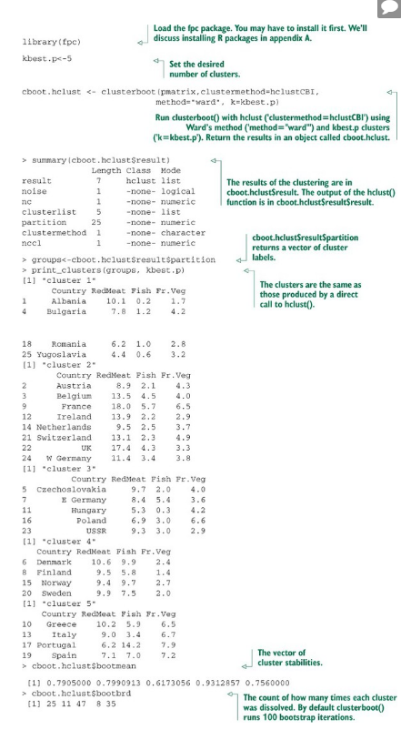
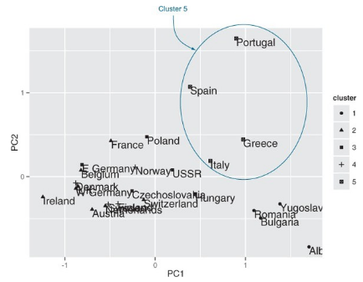
The clusterboot() results show that the cluster of countries with high fish consumption (cluster 4) is highly stable. Clusters 1 and 2 are also quite stable; cluster 5 less ,Cluster 3 has the characteristics of what we’ve been calling the “other” cluster.

Slide 21
Picking the number of clusters
clusterboot() assumes that you know the number of clusters, k. We eyeballed the appropriate k from the dendrogram, but this isn’t always feasible with a large dataset. Can we pick a plausible k in a more automated fashion?
It’s best to take advantage of domain knowledge to help set the number of clusters, if that’s possible. Otherwise, try a variety of heuristics, and perhaps a few different values of k.
variety of heuristics are :
total within sum of squares (WSS)
Calinski-Harabasz index

Slide 22
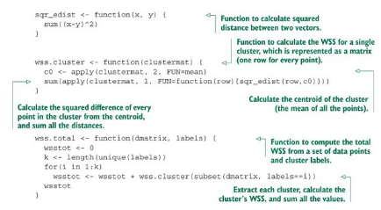
1- Total within sum of squares
One simple heuristic is to compute the total within sum of squares (WSS) for different values of k and look for an “elbow” in the curve.
Define the cluster’s centroid as the point that is the mean value of all the points in the cluster. The within sum of squares for a single cluster is the average squared distance of each point in the cluster from the cluster’s centroid.
The total within sum of squares is the sum of the within sum of squares of all the clusters.
Calculating total within sum of squares

Slide 23
2- Calinski-Harabasz index
The Calinski-Harabasz index of a clustering is the ratio of the between-cluster variance (which is essentially the variance of all the cluster centroids from the dataset’s grand centroid) to the total within-cluster variance (basically, the average WSS of the clusters in the clustering).
For a given dataset, the total sum of squares (TSS) is the squared distance of all the data points from the dataset’s centroid. The TSS is independent of the clustering.
If WSS(k) is the total WSS of a clustering with k clusters, then the between sum of squares BSS(k) of the clustering is given by BSS(k) = TSS - WSS(k).
WSS(k) measures how close the points in a cluster are to each other. BSS(k) measures how far apart the clusters are from each other. A good clustering has a small WSS(k) and a large BSS(k).

Slide 24
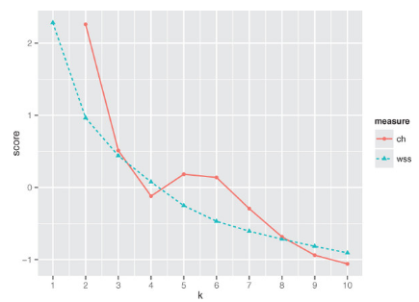
The within-cluster variance W is given by WSS(k)/(n-k), where n is the number of points in the dataset. The between-cluster variance B is given by BSS(k)/(k-1). The within-cluster variance will decrease as k increases; the rate of decrease should slow down past the optimal k.
The between-cluster variance will increase as k, but the rate of increase should slow down past the optimal k. So in theory, the ratio of B to W should be maximized at the optimal k.
From the figure you can se that the Calinski-Harabasz (CH) criterion is maximized at k=2, with another local maximum at k=5. If you squint your eyes, you can convince yourself that the WSS plot has an elbow at k=2.
There are several other indices that you can try when picking k. The gap statistic is an attempt to automate the “elbow finding” on the WSS curve. It works best when the data comes from a mix of populations that all have approximately Gaussian distributions (a mixture of Gaussian).
Plot of the Calinski-Harabasz and WSS indices for 1–10 clusters, on protein data

Slide 25
The k-means algorithm
K-means is a popular clustering algorithm when the data is all numeric and the distance metric is squared Euclidean (though you could in theory run it with other distance metrics).
It’s fairly ad hoc and has the major disadvantage that you must pick k in advance.
On the plus side, it’s easy to implement (one reason it’s so popular) and can be faster than hierarchical clustering on large datasets.
It works best on data that looks like a mixture of Gaussians (which the protein data unfortunately doesn’t appear to be).

Slide 26
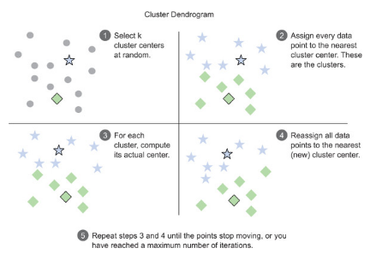
The kmeans() function
The function to run k-means in R is kmeans(). The output of kmeans() includes the cluster labels, the centers (centroids) of the clusters, the total sum of squares, total WSS, total BSS, and the WSS of each cluster.
This algorithm isn’t guaranteed to have a unique stopping point. K-means can be fairly unstable, in that the final clusters depend on the initial cluster centers.
It’s good practice to run k-means several times with different random starts, and then select the clustering with the lowest total WSS.
The kmeans() function can do this automatically, though it defaults to only using one random start.

Slide 27
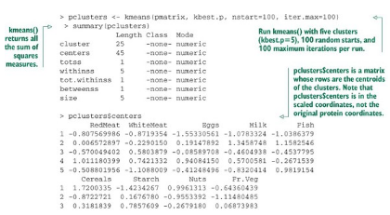
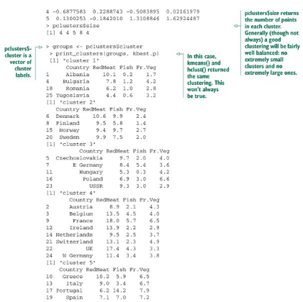
Running k-means with k=5 on the protein data
(scaled to 0 mean and unit standard deviation)

Slide 28
The kmeansruns() function for picking k
To run kmeans(), you must know k. The fpc package (the same package that has clusterboot()) has a function called kmeansruns() that calls kmeans() over a range of k and estimates the best k.
It then returns its pick for the best value of k, the output of kmeans() for that value, and a vector of criterion values as a function of k.
Currently, kmeansruns() has two criteria: the Calinski-Harabasz Index ("ch"), and the average silhouette width.

Slide 29
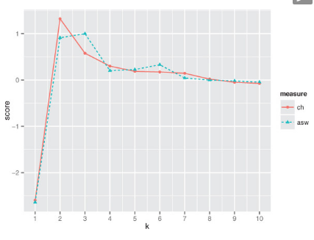
Figure show s the results of the two clustering criteria provided by kmeansruns. They suggest two to three clusters as the best choice.
Plot of the Calinski-Harabasz and average silhouette width indices for 1–10 clusters, on protein data

Slide 30
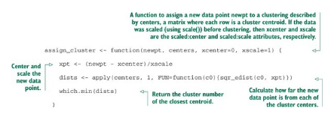
Assigning new points to clusters
You may want to use the clusters that you discovered to categorize new data.
One common way to do so is to treat the centroid of each cluster as the representative of the cluster as a whole, and then assign new points to the cluster with the nearest centroid.
Note that if you scaled the original data before clustering, then you should also scale the new data point the same way before assigning it to a cluster.
A function to assign points to a cluster

Slide 31
Clustering takeaways
The goal of clustering is to discover or draw out similarities among subsets of your data.
In a good clustering, points in the same cluster should be more similar (nearer) to each other than they are to points in other clusters.
When clustering, the units that each variable is measured in matter. Different units cause different distances and potentially different clusterings.
Ideally, you want a unit change in each coordinate to represent the same degree of change. One way to approximate this is to transform all the columns to have a mean value of 0 and a standard deviation of 1.0, for example by using the functionscale().

Slide 32
Clustering takeaways-Cont.
Clustering is often used for data exploration or as a precursor to supervised learning methods.
Like visualization, it’s more iterative and interactive, and less automated than supervised methods.
Different clustering algorithms will give different results. You should consider different approaches, with different numbers of clusters.
There are many heuristics for estimating the best number of clusters. Again, you should consider the results from different heuristics and explore various numbers of clusters.

Slide 33
Association rules
Association rule mining is used to find objects or attributes that frequently occur together—
for example, products that are often bought together during a shopping session, or queries that tend to occur together during a session on a website’s search engine.
Such information can be used to recommend products to shoppers, to place frequently bundled items together on store shelves, or to redesign websites for easier navigation.

Slide 34
Overview of association rules
The unit of “togetherness” when mining association rules is called a transaction.
Depending on the problem, a transaction could be a single shopping basket, a single user session on a website, or even a single customer.
The objects that comprise a transaction are referred to as items in an itemset:
The products in the shopping basket, the pages visited during a website session, the actions of a customer. Sometimes transactions are referred to as baskets, from the shopping basket analogy.
Mining for association rules occurs in two steps:
1. Look for all the itemsets (subsets of transactions) that occur more often than in a minimum fraction of the transactions.
2. Turn those itemsets into rules.

Slide 35
Support and Confidence
The rule “if X, then Y” means that every time you see the itemset X in a transaction, you expect to also see Y (with a given confidence).
For the apriori algorithm, Y is always an itemset with one item.
Suppose that your database of transactions is called T. Then support(X) is the number of transactions that contain X divided by the total number of transactions in T.
The confidence of the rule “if X, then Y” is given by
conf(X=>Y) = support(union(X,Y))/support(X), where union(X, Y) means that you’re referring to itemsets that contain both the items in X and the items in Y.
The goal in association rule mining is to find all the interesting rules in the database with at least a given minimum support (say, 10%) and a minimum given confidence (say, 60%).

Slide 36
The example problem
Let’s imagine that we’re working for a bookstore, and we want to identify books that our customers are interested in, based on (all of) their previous purchases and book interests.
We can get information about their book interests two ways:
either they’ve purchased a book from us, or
they’ve rated the book on our website (even if they bought the book somewhere else).
In this case, a transaction is a customer, and an itemset is all the books that they’ve expressed an interest in, either by purchase or by rating.
The data that we’ll use is based on data collected in 2004 from the book community Book-Crossing for research conducted at the Institut für Informatik, University of Freiburg.
We’ve condensed the information into a single tab-separated text file called bookdata.tsv. Each row of the file consists of a user ID, a book title (which we’ve designed as a unique ID for each book)

Slide 37
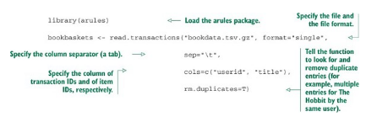
Mining association rules with the arules package
Use the package arules for association rule mining. arules includes an implementation of the popular association rule algorithm apriori, as well as implementations to read in and examine transaction data.
Reading in the data
We can read the data directly from the bookdata.tsv.gz file into the object bookbaskets using the function read.transaction().

Slide 38
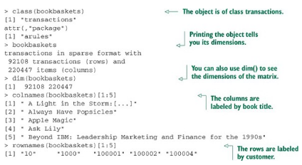
Examining the data
Transactions are represented as a special object called transactions.
You can think of a transactions object as a 0/1 matrix, with one row for every transaction and one column for every possible item. The matrix entry (i,j) is 1 if the i transaction contains item j.
You can examine the distribution of transaction sizes (or basket sizes) with the function size():
> basketSizes <- size(bookbaskets)
> summary(basketSizes)
Min. 1st Qu. Median Mean 3rd Qu. Max.
1.0 1.0 1.0 11.1 4.0 10250.0
Examining the transaction data

Slide 39
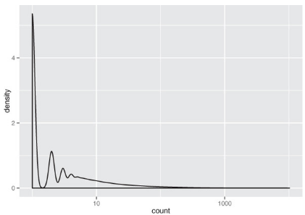
Figure shows the distribution of basket sizes. 90% of customers expressed interest in fewer than 15 books; most of the remaining customers expressed interest in up to about 100 books or so (the call quantile(basketSizes, probs=c(0.99, 1)) will show you that 99% of customers expressed interest in 179 books or fewer). Still, there are a few people who have expressed interest in several hundred, or even several thousand books.
Which books are they reading? The function itemFrequency() will give you the relative frequency of each book in the transaction data:
> bookFreq <- itemFrequency(bookbaskets) summary(bookFreq)
Min. 1st Qu. Median Mean 3rd Qu. Max. 1.086e-05 1.086e-05 1.086e-05 5.035e-05 3.257e-05 2.716e-02
> sum(bookFreq)
[1] 11.09909
A density plot of basket sizes

Slide 40
The apriori() function
In order to mine rules, you need to decide on a minimum support level and a minimum threshold level.
For this example, let’s try restricting the itemsets that we’ll consider to those that are supported by at least 100 people. This leads to a minimum support of 100/dim(bookbaskets_use)[1] = 100/40822.This is about 0.002, or 0.2%. We’ll use a confidence threshold of 75%.
The quality measures on the rules include not only the rules’ support and confidence, but also a quantity called lift.
Lift compares the frequency of an observed pattern with how often you’d expect to see that pattern just by chance.
The lift of a rule “if X, then Y” is given by support(union(X, Y))/(support(X)*support(Y)). If the lift is near 1, then there’s a good chance that the pattern you observed is occurring just by chance. The larger the lift, the more likely that the pattern is “real.” In this case, all the discovered rules have a lift of at least 40, so they’re likely to be real patterns in customer behavior.

Slide 41
Inspecting and evaluating rules
There are also other metrics and interest measures you can use to evaluate the rules by using the function interestMeasure().
We’ll look at two of these measures: coverage and fishersExactTest.
Coverage is the support of the left side of the rule (X); it tells you how often the rule would be applied in the dataset.
Fisher’s exact test is a significance test for whether an observed pattern is real, or chance (the same thing lift measures; Fisher’s test is more formal).
Fisher’s exact test returns the p-value, or the probability that you would see the observed pattern by chance; you want the p-value to be small.

Slide 42
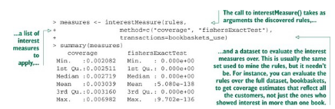
Scoring rules
he coverage of the discovered rules ranges from 0.002–0.007, equivalent to a range of about 100–250 people. All the p-values from Fisher’s test are small, so it’s likely that the rules reflect actual customer behavior patterns.
The function inspect() pretty-prints the rules. The function sort() allows you to sort the rules by a quality or interest measure, like confidence. To print the five most confident rules in the dataset, you could use the following command:
inspect(head((sort(rules, by="confidence")), n=5))
For legibility, we show the output of this command in the next table.

Slide 43
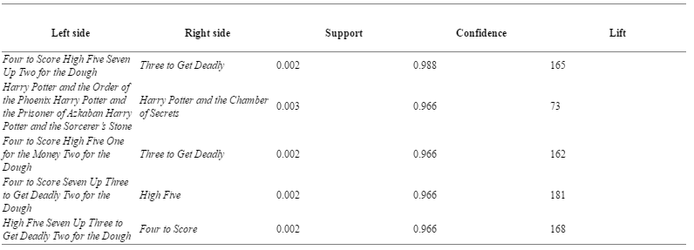
The five most confident rules discovered in the data

Slide 44
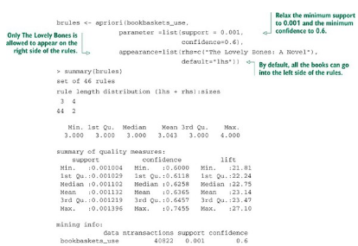
Restricting which items to mine
You can restrict which items appear in the left side or right side of a rule. Suppose you’re interested specifically in books that tend to co-occur with the novel The Lovely Bones. You can do this by restricting which books appear on the right side of the rule, using the appearance parameter.
The supports, confidences, and lifts are lower than they were in our previous example, but the lifts are still much greater than 1, so it’s likely that the rules reflect real customer behavior patterns
Finding rules with restrictions

Slide 45
Association rule takeaways
The goal of association rule mining is to find relationships in the data: items or attributes that tend to occur together.
A good rule “if X, then Y” should occur more often than you’d expect to observe by chance. You can use lift or Fisher’s exact test to check if this is true.
When a large number of different possible items can be in a basket (in our example, thousands of different books), most events will be rare (have low support).
Association rule mining is often interactive, as there can be many rules to sort and sift through.

Slide 46
Key takeaways
Unsupervised methods find structure in the data, often as a prelude to predictive modeling.
The goal of clustering is to discover or draw out similarities among subsets of your data.
When clustering, you’ll find that scaling is important.
The goal of association rule mining is to find relationships in the data: items or attributes that tend to occur together.
In association rule mining, most events will be rare, so support and confidence levels must often be set low.

