Slide 1

Project Management Bootcamp
CITS3200
CITS5206
CITS5553
Maureen Ngeow BSc (UWA)

Slide 2

About Me
My background
29 years in financial services technology – large scale project/program management; portfolio directorship for business unit technology change portfolios
Including 5 years in Enterprise Service Management including leading Enterprise Problem Management
Business unit portfolios included Cards & Payments; regulatory & compliance; Enterprise Datawarehouse and Integration platforms;
Specializing in system integration, business process re-engineering, technology mergers, replatforming, data migrations.
UWA graduate – B.Sc. Information Technology and Chemistry.
35 years in corporate technology roles

Slide 3

What will we cover ?
Principles of Project Management
Roles and responsibilities – what does a typical project structure look like
Stakeholder management
Scope definition including requirements prioritization – how do you know when you are done ?
Project plan - Task definition, documentation and management; key communication tool of responsibilities
Change request management
RAID – Risks, Assumptions, Issues and Dependencies
Constantly asking and answering
what
who
why
when
how

Slide 4
Roles and Responsibilities
Clearly defining roles and responsibilities is crucial for teamwork, productivity and accountability. It eliminates confusion, increases productivity and helps to create a healthier working environment.
Create the Project eco-system
Typical technology project team roles
Key considerations
Project Manager
Architect/solution design/technical analysts
Developers/ Engineers
Test Manager and testers
Implementation Manager / Transition manager
Resources not part of the project team but their knowledge & advice are required e.g. Network security consultant to review the internet facing component of the solution design.
Projects may require specialist skills e.g. data migration projects will require a substantial team of data architects and analysts
The client must also have assigned key roles and responsibilities
A team is made up of individuals – motivated, authorized and enabled
Clear role definitions is essential – people react well when they know their boundaries
‘You are only as good as the people around you’
Must maintain ‘intellectual control’ across all aspects of the project – technical and management
Is it a self policing eco-system ?
Celebrate success !

Slide 5
Stakeholder Management
It is hard to under-estimate the importance of continual, strong stakeholder management.
Identify key people – Who is key beneficiary ?
Who is funding the project ? What is the funding source ?
Why is this important
It is bad when.....
In identifying the ‘who’ it helps to define the ‘why’
Strong relationships with your stakeholders are essential to get through the tough times.
It becomes a collaboration rather than transactional.
Influence business outcomes with technical opportunities
Walk in the shoes of your stakeholders – what pressure are they under ?
Understand the business case => Pre-empt requirements
This includes the contractors / sub providers
Trust is broken
Stakeholders disengage – non-attendance at meetings, sending unauthorized subordinates
Lawyers are sitting in technical meetings with a copy of the contract

Slide 6
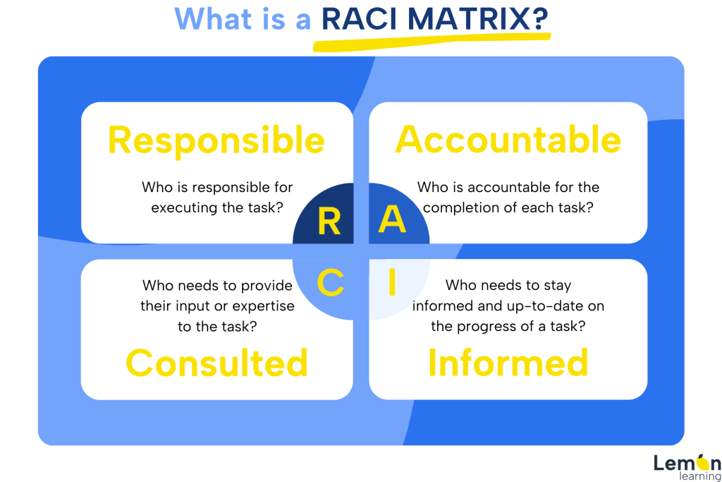
The RACI matrix
Construct a stakeholder map classifying stakeholders into key groups – RACI This includes the team members and stakeholders – clear roles and responsibilities are crucial
Responsibility and accountability must be accompanied with authority - ENABLE SUCCESS
Key stakeholder groups
Responsible – can be person, people or team. But prefer a single person / team. Every task must have at least 1 responsible assignee.
Accountable – there should be only 1 accountable person per task
Consulted – individuals or teams whose knowledge, input or opinions are required. Typically, subject matter experts not part of the immediate project team.
Informed – individuals or team who need to be kept up to date

Slide 7
What is the difference between Accountability and Responsibility ?
Responsibility is about the duties and tasks assigned to an individual or team doing the work, while accountability is about being answerable for the results and consequences of those tasks.
What does it look like in practice ?
BEWARE !!
Responsibility can be assigned to an individual or a team.
Accountability is held by a single individual
Responsible teams and team members will ultimately report to the accountable person.
Must be accompanied by appropriate AUTHORITY
Delegated Accountability or Responsibility – did it come with delegated authority ?
Did it come with the right people / teams ?
Is the delegation ENABLED to be successful ?

Slide 8
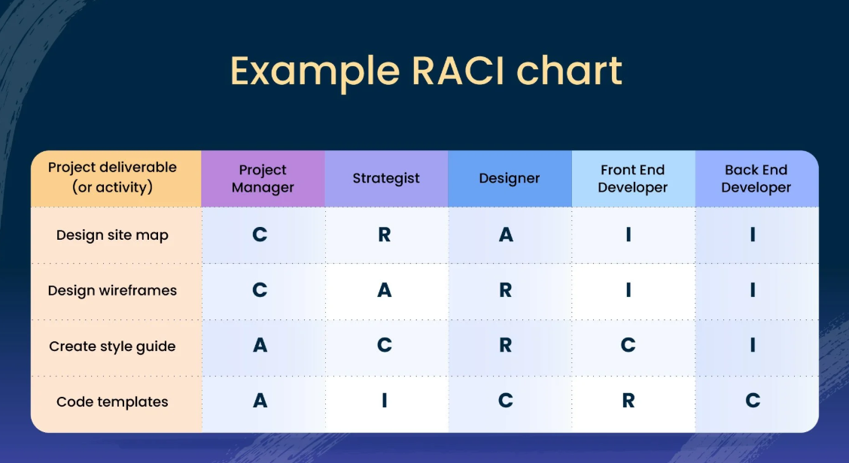
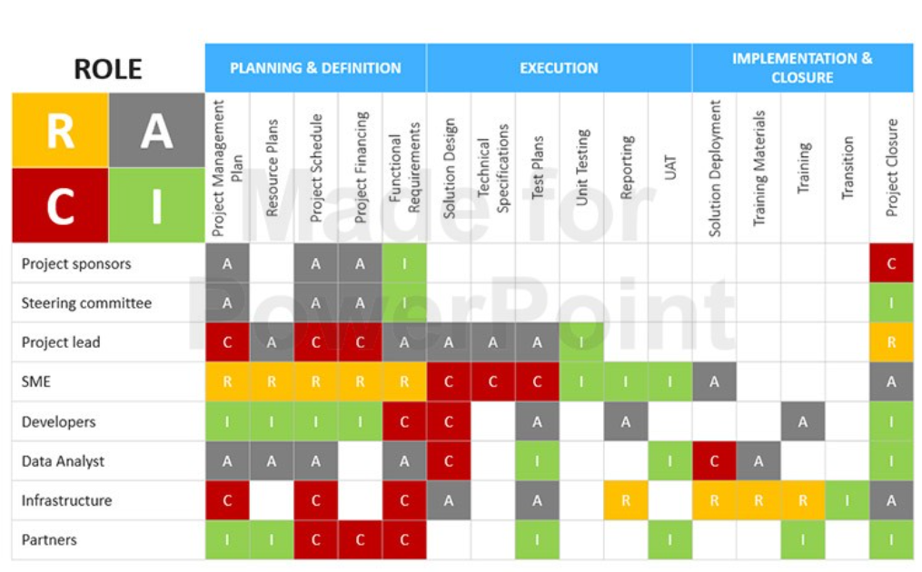

What does it look like ?
No ! Multiple accountable parties

Slide 9
Scope Definition
How do you know when you are done ?
Identifies and enables Prioritisation decisions – you simply cannot do it all.
Regardless of chosen project methodology, this needs to be done with discipline.
What and why
What happens if it is not done ?
This is your ‘contract’ with your client
It is the basis of your estimates of time and cost.
It enables expectations to be managed and further changes to be quantified against a baseline.
Ensure Service Management is considered in scope – extremely expensive to add it in later
Clearly state what is IN SCOPE. Equally important – state what is OUT OF SCOPE.
There is nothing to measure against.
Changing requirements cannot be recognized and managed
And this is how projects ‘fail’ - exceed budget and schedule.
RED FLAG : Requirements expressed as ‘like’ something else without explicitly calling out the requirement.

Slide 10
Project Planning
How do you eat an elephant ? One mouthful at a time
Understanding the ‘what’ and ‘why’ – the requirements and scope boundaries
‘Terms of Reference’ (what) and ‘Project Management Plan’ (how) will provide the governance structure
What is involved in creating The Plan
What happens when it is done poorly
Identify tasks / activities to lead you to key delivery milestones ➔ successful delivery
Build justifiable continency into your planning – this is tied to risk
Identify the critical path → PROTECT THIS !!
Assign tasks to team members
Create a culture of ownership and responsibility
Ensure dependencies are identified and understood
Communicate, communicate, communicate
Establish a status reporting/governance structure and cadence
No-one takes ownership
An unrealistic plan is developed and endorsed
Wasted resources – perception that the project is expensive (which it is !)
In execution phase, milestones are missed and the team is constantly blind sided
When things go wrong, the blame game starts. Finger pointing, scurrying for cover.

Slide 11
Change Request Management
The one thing that is guaranteed : the requirements will change – because the business is constantly changing. Be prepared for it.
A robust and agreed change management process – all stakeholders must endorse this !!
Essential and expected
If ignored or done badly
This is why scope definition is critical – then you can recognize and measure changing scope
Project team must be capable and enabled to assess change
Who has ‘Intellectual control’? A think tank within the team.
Must be able to see the bottom of the pool before diving in – budget, schedule, design, RAID
Project Manager must be strong and enabled to push back if necessary.
Budget and schedule are quickly compromised
Stakeholder satisfaction plummets
Team morale plummets as they burnout trying to deliver on impossible expectations

Slide 12
RAID
Risks, Assumptions, Issues and Dependencies
Project Management is ultimately an exercise in people management and risk management.
Don’t let the issue of the hour become the problem of the sponsor – maintain a mature perspective in communication
Definitions
Definitions
Risk - an uncertain event or condition that, if it occurs, has a positive or negative effect on a project's objectives or plans.
Assumption - any project factor that is true, real, or certain even without empirical proof or demonstration. Realistically, it's impossible to plan a project without making a few assumptions. These serve as foundations for planning and decision making. These are predictions or expectations that a project team accepts as reality until they are conclusively proven to be true or false.
Issue - an event or change necessitating immediate action as it is happening or has happened. It has or is impacting project progress, goals or deliverables.
Dependency - describes the relationship among activities and specifies the particular order in which they need to be performed.

Slide 13
RAID - continued
Risks, assumptions, issues, dependencies need to be actively managed. This is the core of project management.
Ensure risk ownership is correctly assigned – and don’t accept a risk that is not yours to own.
What does ‘actively managed’ look like
When not actively managed
Constant communication with key dependencies. Dependencies can be intra- and inter- project
Assumptions (taken as truths) need to continually be challenged until
They are conclusively proven to be true, then can be closed
They are conclusively proven to be false, then they become a risk or issue.
The prevailing conditions have changed do that the assumption is no longer relevant. It can be closed.
Risks need to be assessed and re-assessed regularly to ensure correct impact & likelihood. Action items continually updated.
Issue action items continually updated and actioned.
Risks and Issues unnecessarily become existential threats to the project
Project is constantly in fire fighting mode – issues are continually occurring – this means that risks are not being identified and managed to within risk appetite before they have become issues.
Dependency milestones are missed and no-one even knows and an issue arises.
A culture of Plausible Deniability is created and this leads to ineffective RAID management

Slide 14
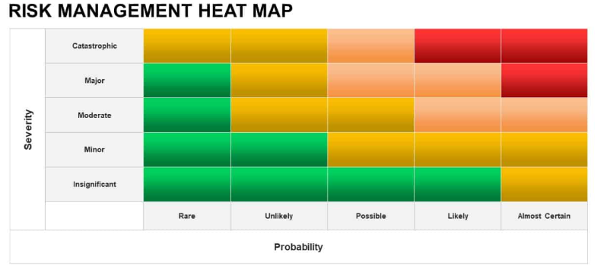












Risk Heat Map
Assess the risks in terms of Probability / Likelihood and Impact/ Significance
Prioritise resources to mitigate risks in the ‘red’ zone and move them to green.
Unmitigated risks become issues. If you are continually fire fighting issues, risks are not being managed appropriately.
Do not want surprises – no such thing as surprises, just bad risk management
Mitigate
Manage
Monitor

Slide 15

What else do you want to talk about

Slide 16



Thank You
Maureen Ngeow
www.linkedin.com/in/maureen-ngeow-94665a3

