Slide 1
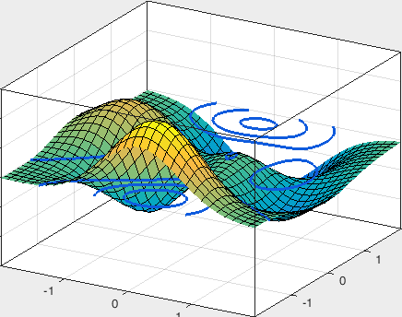
Interpolation and curve fitting
CITS2401
Computer Analysis and Visualization
School of Computer Science and Software Engineering
Lecture 9

Slide 2
Summary
Interpolation
Curve fitting
Linear regression (for single variables)
Polynomial regression
Multiple variable regression
Non-linear terms in regression

Slide 3
Interpolation
Suppose you have some known data points, and you wish to predict what other data points might be – how can you do this?
For example:
  If at t = 1 second, distance traveled = 2m, and
  at t = 5 seconds, distance traveled = 10m ...
  What would be the distance traveled at, say, t = 3 seconds?

Slide 4
Linear interpolation
The simplest interpolation technique is linear interpolation:
it assumes that data follows a straight line between adjacent measurements.

Slide 5
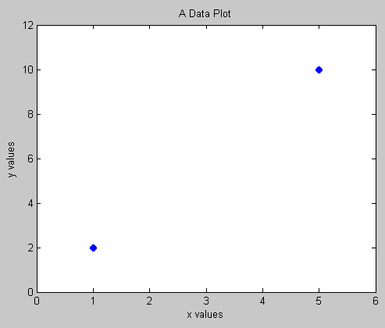
Linear interpolation (2)
Assume the function between two points is a straight line
Find equation of the line that passes through the two points
Put a value of x in the equation to find y
Put a value of y in the equation to find x
How do you find a point in between?
X=2, Y=?

Slide 6
Linear interpolation in python
numpy.interp(x, xp, yp):
  xp and yp give the x and y coordinates of the data points we have
  x contains the x coordinates that we want interpolated y-values for.

Slide 7
Linear interpolation in python – example
Linear interpolation of the sin() function:
>>> import numpy as np
>>> import matplotlib.pyplot as plt
>>> x_pts = np.linspace(0, 2*np.pi, 10)
# 10 equidistant x coords from 0 to 10
>>> y_pts = np.sin(x_pts)
>>> x_vals = np.linspace(0, 2*np.pi, 50)
# 50 desired points
>>> y_vals = np.interp(x_vals, x_pts, y_pts)
>>> plt.plot(x_pts, y_pts, 'o') # plot known data points
>>> plt.plot(x_vals, y_vals, '-x') # plot interpolated points
>>> plt.show()

Slide 8
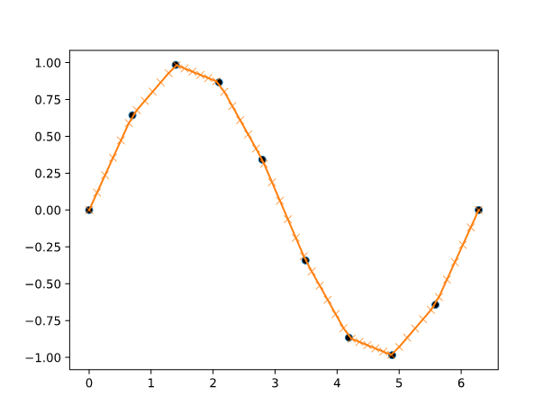
Linear interpolation in python – example (2)

Slide 9
Cubic spline interpolation
Just as a linear interpolation is made up of linear segments – a cubic spline interpolation is made of segments of cubic polynomials, whose gradients match up at the measured data points.
These cubic polynomials are continuous up to their 2nd derivative.

Slide 10
Cubic spline interpolation (2)
Using numpy and scipy, interpolation is done in 2 steps:
  scipy.interpolate.splrep(x_pts, y_pts) – returns a tuple representing the spline formulas needed
  scipy.interpolate.splev(x_vals, splines) ("spline evaluate") – evaluate the spline data returned by splrep, and use it to estimate y values.

Slide 11
Cubic spline interpolation example
>>> import numpy as np
>>> from scipy import interpolate
>>> import matplotlib.pyplot as plt
>>> x_pts = np.linspace(0, 2*np.pi, 10)
# 10 equidistant x coords from 0 to 10
>>> y_pts = np.sin(x_pts)
>>> splines = interpolate.splrep(x_pts, y_pts)
>>> x_vals = np.linspace(0, 2*np.pi, 50)
# 50 desired points
>>> y_vals = interpolate.splev(x_vals, splines)
>>> plt.plot(x_pts, y_pts, 'o') # plot known data points
>>> plt.plot(x_vals, y_vals, '-x') # plot interpolated points
>>> plt.show()

Slide 12
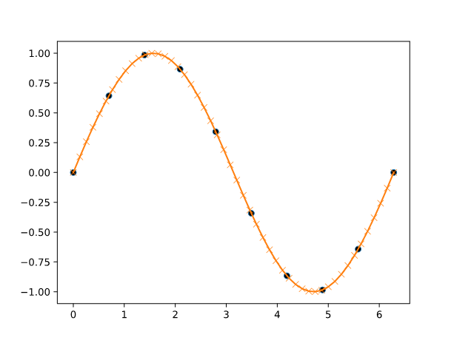
Cubic spline interpolation example (2)

Slide 13
2D interpolation
Just as we can do linear interpolation to estimate y values given x values – i.e. estimating a one-variable function f(x) – we can also do linear interpolation of a two-variable function f(x,y).

Slide 14
2D interpolation – original data (1)
We will generate some data, and demonstrate what the original data points look like, and the interpolated version.
from mpl_toolkits.mplot3d import axes3d, Axes3D
import matplotlib.pyplot as plt
from matplotlib import cm
import numpy as np
from matplotlib.mlab import bivariate_normal
...

Slide 15
2D interpolation – original data (2)
...
# a function to plot the surface.
# x, y and z should be arrays of data
def plot_data(x, y, z):
fig = plt.figure()
#ax = fig.gca(projection='3d')
ax = Axes3D(fig)
surf = ax.plot_surface(x, y, z, cmap=cm.coolwarm,
linewidth=0, antialiased=False)
plt.show()

Slide 16
2D interpolation – original data (3)
>>> x_pts = np.arange(-3, 3, 1)
>>> y_pts = np.arange(-3, 3, 1)
>>> xx, yy = np.meshgrid(x_pts, y_pts)
# the plotting functions require the x and
# y values in a grid format
>>> zz = np.sin(xx) + np.cos(yy)
>>> plot_data(xx,yy,zz)

Slide 17
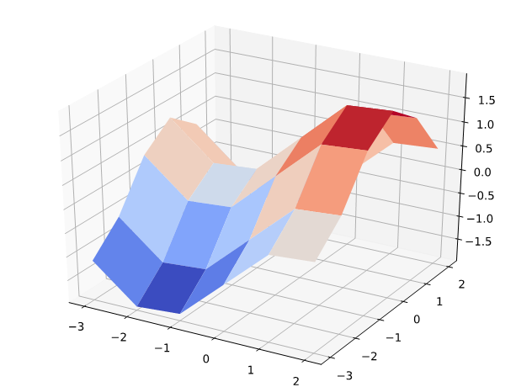
2D interpolation – original data (4)

Slide 18
2D interpolation – linearly interpolated data
Now we'll perform linear interpolation.
interpolate.interp2d(x, y, z, kind='linear') returns a function which, when called, returns the actual interpolated values.
>>> from scipy import interpolate
>>> f = interpolate.interp2d(x_pts, y_pts, zz, kind='linear')
# "kind" specifies whether we're doing linear, cubic, etc.
>>> x_vals = np.arange(-3, 3, 0.1)
>>> y_vals = np.arange(-3, 3, 0.1)
>>> xx_v, yy_v = np.meshgrid(x_vals, y_vals)
>>> zz_v = f(x_vals, y_vals)
>>> plot_data(xx_v,yy_v,zz_v)

Slide 19
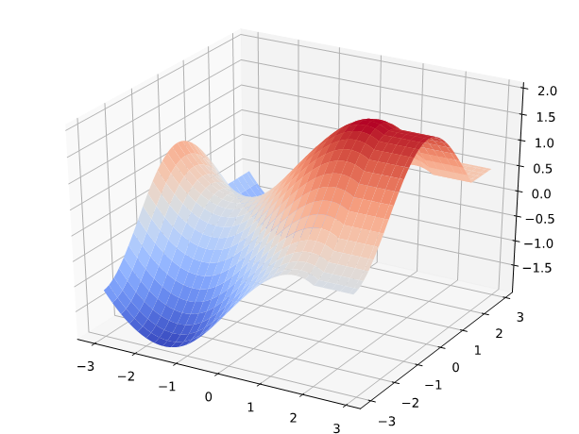
2D interpolation – linearly interpolated data (2)

Slide 20
2D interpolation – cubic interpolated data
Now we'll perform cubic interpolation.
interpolate.interp2d(x, y, z, kind='linear') returns a function which, when called, returns the actual interpolated values.
>>> from scipy import interpolate
>>> f = interpolate.interp2d(x_pts, y_pts, zz, kind='cubic')
>>> x_vals = np.arange(-3, 3, 0.1)
>>> y_vals = np.arange(-3, 3, 0.1)
>>> xx_v, yy_v = np.meshgrid(x_vals, y_vals)
>>> zz_v = f(x_vals, y_vals)
>>> plot_data(xx_v,yy_v,zz_v)

Slide 21
2D interpolation – cubic interpolated data (2)

Slide 22
Curve fitting
Collected data always contains some degree of error or imprecision
Whereas interpolation is used when we assume that all data points are accurate and we want to infer new intermediate data points –
curve fitting is used when we want to match an analytical (or symbolic) model to a set of measurements which may contain some error.

Slide 23
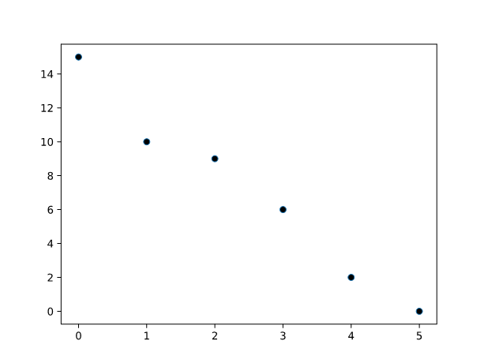
Curve fitting (2)
For instance, we may have data points which seem to represent noisy data obtained from an underlying linear relationship – how can we estimate or model that underlying relationship?

Slide 24
Linear regression
One method of curve fitting is linear regression – it minimizes the "square of the errors" (where the "error" is the distance each point is from the line).
(In Excel, there is a function called "SLOPE" which performs linear regression on a set of data points, similar to the Python functions we will see here.)

Slide 25
Polynomial regression
Linear regression is a special case of polynomial regression –
since a line (i.e., an equation of the form ax + b) is a simple polynomial.
But your data may not reflect a linear relationship – a polynomial of a higher order may be a better fit.

Slide 26
Linear regression (2)
Both linear and non-linear polynomial regression can be done with Numpy's polyfit function:
numpy.polyfit(x, y, degree)
It returns the coeffficients for the polynomial;
the easiest way to then use these in code is to use the numpy.poly1d class.
>>> import numpy as np
>>> from scipy.stats import linregress
>>> x_pts = np.arange(0,6,1)
>>> y_pts = np.array([15, 10, 9, 6, 2, 0])
>>> f = np.poly1d( np.polyfit(x_pts, y_pts, 1))
# linear regression
>>> x_vals = np.linspace(0, 6, 100)
>>> plt.plot(x_pts, y_pts, '.')
>>> plt.plot(x_vals, f(x_vals), '-')

Slide 27
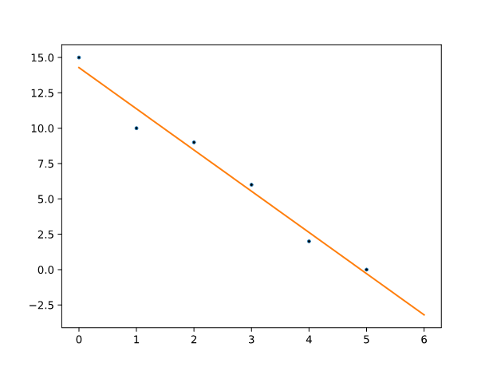
Linear regression (3)

Slide 28
Polynomial regression
If we have 6 data points, then a fifth-order polynomial will be able to give a perfect fit for them
(i.e., there is some fifth-order polynomial on which all the data points fall exactly).
>>> import numpy as np
>>> from scipy.stats import linregress
>>> x_pts = np.arange(0,6,1)
>>> y_pts = np.array([15, 10, 9, 6, 2, 0])
>>> f = np.poly1d( np.polyfit(x_pts, y_pts, 5))
# 5th-order polynomial
>>> x_vals = np.linspace(0, 6, 100)
>>> plt.plot(x_pts, y_pts, '.')
>>> plt.plot(x_vals, f(x_vals), '-')

Slide 29
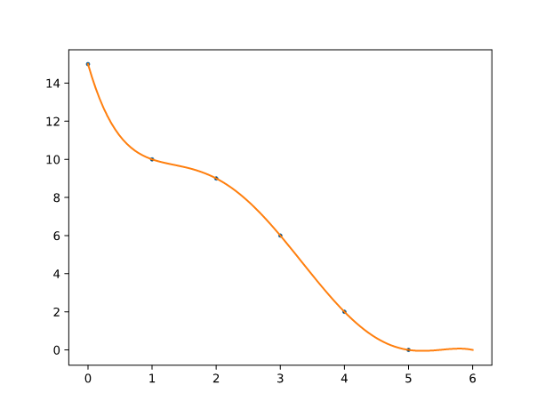
Polynomial regression (2)

Slide 30
Interpolation and curve fitting – part 2

Slide 31
Overview
Multiple variable regression
Non-linear terms in regression

Slide 32
Multiple variable data
In our regression examples, we have used models where a single output variable changes with respect to a single input variable.But real data may have multiple input variables.
For example, the top speed of a vehicle will depend on many variables such as engine size, weight, air resistance etc.

Slide 33
Predictor and response variables
The input variables are called the
  independent variables, OR
  predictor variables, OR
  experimental variables
The output variable is referred to as the
  dependent variable, OR
  response variable, OR
  outcome variable

Slide 34
Predictor and response variables (2)
We can use regression to find the relationship between input and output variables.
We will use the following for our data points:
import numpy as np
x_pts = np.arange(-5,5,0.5)
y_pts = np.arange(-5,5,0.5)
xx, yy = np.meshgrid(x_pts, y_pts)
# our dependent variable is a linear function of
# x and y, plus random noise.
zz = 3*xx - 0.5*yy - 5 + 8 * np.random.normal(size=xx.shape)

Slide 35
Predictor and response variables (3)
We build a model – i.e., we estimate the coefficients for x, y and intercept – by expressing our data as a matrix equation, and getting Python to give us a "least squares" solution for it.
The lstsq function from Numpy will return a range of information about the solution as a tuple – the coefficients we want are the first member of that tuple:
numpy.linalg.lstsq(independent_vars, dependent_var)
e.g.:
model_coefficients = numpy.linalg.lstsq(independent_vars, dependent_var)[0]

Slide 36
Predictor and response variables (4)
Let's see what our input data looks like:
from mpl_toolkits.mplot3d import axes3d, Axes3D
import matplotlib.pyplot as plt
from numpy.linalg import lstsq
def plot_points(x, y, z):
fig = plt.figure()
ax = fig.gca(projection='3d')
surf = ax.plot_surface(x, y, z, cmap=plt.cm.coolwarm)
ax.view_init(20, -120)
plt.show()
plot_points(xx,yy,zz)

Slide 37
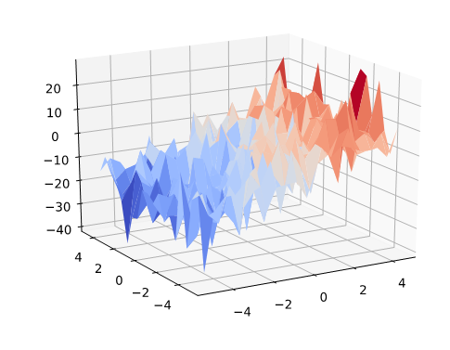
Predictor and response variables (5)

Slide 38
Predictor and response variables (6)
To estimate the coefficients in our underlying relationship, we will ask Python to solve a matrix equation of the form
where D is a matrix of representing our observations of independent variables, c are the unknown coefficients we want to estimate, and z represents our observations of the z values.
So that Python will estimate values of the intercept – the "-5" in our underlying relationship – we will need a column of ones in the D matrix.
So the equation will look like:

Slide 39
Predictor and response variables (7)
# matrix for observations of independent variables
>>> ones = [ [1] * len( xx.flatten() )]
>>> indep = np.column_stack( [xx.flatten(), yy.flatten()] + ones )
>>> model = lstsq(indep, zz.flatten())[0]
>>> model
array([ 3.27248794, -0.6004752 , -5.26689769])
Compare the estimated coefficients with the actual ones (3, -0.5 and -5).

Slide 40
Predictor and response variables (8)
We can plot the least squares solution:
>>> x_vals = np.arange(-5,5,0.1)
>>> y_vals = np.arange(-5,5,0.1)
>>> xx_vals, yy_vals = np.meshgrid(x_vals, y_vals)
>>> zz_vals = model[0] * xx_vals + model[1] * yy_vals + model[2]
>>> fig = plt.figure()
>>> ax = fig.gca(projection='3d')
>>> ax.plot_surface(xx_vals, yy_vals, zz_vals, cmap=plt.cm.coolwarm)
# the surface is our least-squares estimate
>>> ax.scatter( xx, yy, zz)
# the scatter plot shows our original data points
>>> ax.view_init(20, -120)
>>> plt.show()

Slide 41
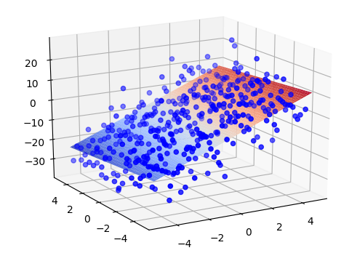
Predictor and response variables (9)

Slide 42
Curve-fitting using non-linear terms in linear regression
What if we have a non-linear relationship between our variables?
We can actually still use linear regression, as we did in the previous example: but in our matrix of independent variables, we'll include terms which are a non-linear function of our observations.
>>> xx_flat = xx.flatten()
>>> yy_flat = yy.flatten()
>>> zz_flat = zz.flatten()
>>> ones = [ [1] * len( xx_flat )]
>>> indep = np.column_stack( [xx_flat, yy_flat,
3 * np.sin(2 * xx_flat) ] + ones )
# the 3rd column is *3sin(2x)*
>>> model = lstsq(indep, zz.flatten())[0]
>>> model
array([ 2.88268949, -0.30450846, -0.02530611, -4.46351387])

Slide 43
Curve-fitting using non-linear terms in linear regression (2)
As with the linear case, we can use this model to estimate z-values.
>>> x_vals = np.arange(-5,5,0.1)
>>> y_vals = np.arange(-5,5,0.1)
>>> xx_vals, yy_vals = np.meshgrid(x_vals, y_vals)
>>> zz_vals = model[0] * xx_vals +
model[1] * yy_vals +
model[2] * 3 * np.sin(2 * xx_vals) +
model[3]
>>> fig = plt.figure()
>>> ax = fig.gca(projection='3d')
>>> ax.plot_surface(xx_vals, yy_vals, zz_vals, cmap=plt.cm.coolwarm)
# the surface is our least-squares estimate
>>> ax.scatter( xx, yy, zz)
# the scatter plot shows our original data points
>>> ax.view_init(20, -120)
>>> plt.show()

Slide 44
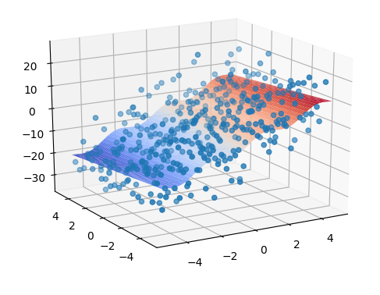
Curve-fitting using non-linear terms in linear regression (3)

