Slide 1
The University of Western Australia
School of Computer Science and Software Engineering
CITS5502 Software Processes
Lecture 2
Revision of Models of a Software Process

Slide 2
Key concepts
Types of Software Processes
  Significant shifts in Software Development
Use of Paradigms, Models, Methods/Methodologies
Twelve activities in every software project
Life Cycle Paradigm, Cascade, Waterfall or phased model
  Phased approach with specific entry/exit criteria
Prototyping Paradigm with advantages and problems
  RAD and Stepwise Refinement models
  Barry Boehm’s Model for Prototype Development
Object Oriented Approaches
  Rational Unified Process (RUP)
Development as a Maintenance Process – Incremental methods
Agile Paradigm and Manifesto
Tom Gilb’s Evolutionary Paradigm

Slide 3
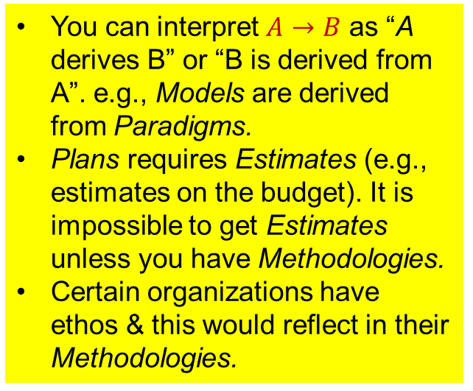
Levels of Abstraction
Paradigms
(Provides framework of concepts)
e.g., Life Cycle, Prototyping A & B, Evolutionary
(Theoretical)
Models
(Provides activities and decision points)
e.g., Waterfall, Spiral, Increment
(Practical)
Methodologies
(Provides organization specific details)
e.g., in-house or purchased
You can interpret $A→B$ as “A derives B” or “B is derived from A”. e.g., Models are derived from Paradigms.
Plans requires Estimates (e.g., estimates on the budget). It is impossible to get Estimates unless you have Methodologies.
Certain organizations have ethos & this would reflect in their Methodologies.
Estimates
(Provides project specifics)
Plans
Controls

Slide 4
The 12 Activities in every software project
F
Feasibility and
Initial Planning
A
Analysis of
Requirements
E
Education and
Tool Assembly
U
User Training
I
Integration of
Modules and
Implementation
D
Design
(Detailed)
C
Code and Test
Individual Modules
S
Support for
Customer in
Initial Use
M
Manuals and First
Prototype with
Screen Mockups
T
Testing to
Appropriate Level
T. Woodnings – 1 October 1988
P
Promotion
of Product
R
Review after short
Period of Use

Slide 5
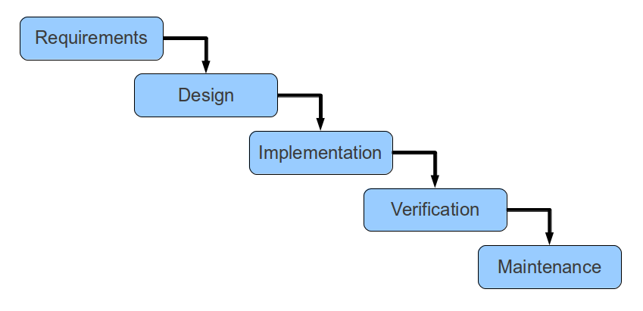
Waterfall or phased model
Question: Can you think of any suitable entry and exit criteria for each phase of the waterfall model?

Slide 6
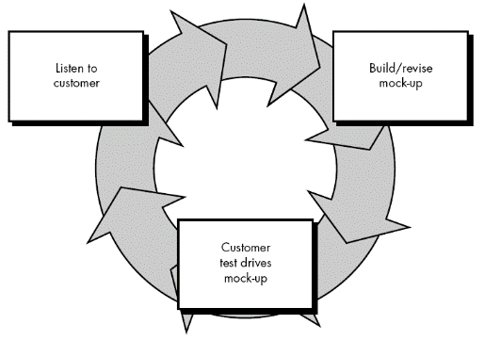
Prototyping Paradigm
A prototype typically simulates only a few aspects of, and may be completely different from, the final product
In this paradigm, the emphasis is on creating prototypes to
  get valuable feedback from the user earlier in the project
  let the client compare if the software matches the specification

Slide 7
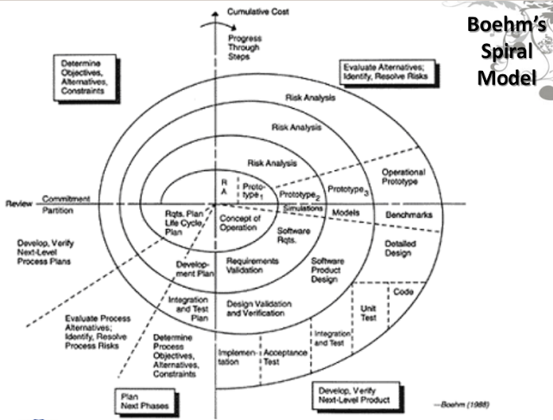
Spiral Model of the Software Process
In the Spiral model, emphasis is on building prototypes and risk analysis.
Checkpoints to decide “go” or “not go”

Slide 8
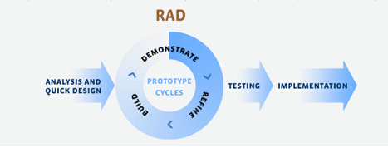
Rapid Application Development (RAD) model
Use minimal planning in favour of rapid prototyping.

Slide 9
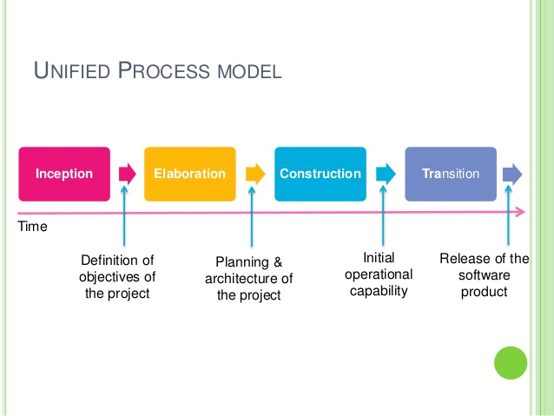
Rational Unified Process (RUP) Model
This is an iterative software development process framework created by Rational Software Corporation (part of IBM) in 2003. It is intended to help software teams to select elements of the process that are appropriate to their needs.
RUP is based on a set of building blocks and content elements, describing what is to be produced, the skills required, and explanation about how specific development goals are to be achieved.

Slide 10
Incremental Methods
This is a software development method where the product is designed, implemented, and tested incrementally.
There are some variants of incremental development, including:
  The methods may involve a series of mini-waterfalls being performed.
  The initial software concept, requirements analysis, and design of architecture and system core may be defined using the waterfall model, but the implementation and product delivery are done incrementally.

Slide 11
The Agile Paradigm and Manifesto
Individual and Interactions | over | Processes and Tools
Working Product | over | Comprehensive Documentation
Customer | over | Contract Negotiation
Responding to change | over | Following a plan
That is, while there is value in the items on the right, under the Agile paradigm, items on the left are valued more.

Slide 12
Some Agile Software Development Models
Scrum
Extreme programming (XP)
Feature-driven development (FDD)
Test-driven development (TDD)
Kanban
Adaptive software development (ASD)
Lean software development
Rapid application development (RAD)
Exercises: Research for more detail on some of these models yourself.

Slide 13
Gilb’s Evolutionary Paradigm
The 10 basic principles of the Evolutionary Project Management method are:
  E1: Decompose by performance results and stakeholders
  E2: Do high-risk steps early, learn how ‘unknowns’ really perform;
  E3: focus on improving your most valuable performance objectives first;
  E4: Base your early evolution on existing frameworks and stakeholders;
  E5: design to cost dynamically;

Slide 14
Gilb’s Evolutionary Paradigm
The 10 basic principles of the Evolutionary Project Management method are:
  E6: design to performances dynamically;
  E7: invest in an open-ended architecture early on;
  E8: Motivate your team by rewarding results;
  E9: Prioritize changes by value, not place in queue;
  E10: Learn fast, change fast, adapt to reality fast.

Slide 15
Recommended Reading
Royce: Chapter 5 “Life-Cycle Phases”
Wysocki: Chapter 2 “SDPM Roadmap”
Pressman: Sections on “The Linear Sequential Model” and “The Prototype Modell”
Sommerville: Sections on “Boehm’s Spiral Model”, “Process Iteration”
Evolutionary paradigm: http://concepts.gilb.com/dl59
Agile software development: https://en.wikipedia.org/wiki/Agile_software_development

