Slide 1
Use Cases
Software Requirements and Design
CITS4401
Lecture 06
Notes:
Revised Feb 2020 RCO
Earlier Versions: RCO, DH, GMH

Slide 2
Outline
Defining Requirements with UML use cases
Examples
What is a use case
Specification details

Slide 3
Use Case example 1
Use case name: PlanTrip
Flow of events:
The Driver activates her computer and logs into the trip-planning Web service
The Driver enters constraints for a trip as a sequence of destinations
Based on a database of maps, the planning service computes the shortest way of visiting the destinations in the order specified. The result is a sequence of segments binging a series of crossings and a list of directions.
The driver can revise the trip by adding or removing destinations
The Driver saves the planned trip by name in the planning service database for later retrieval

Slide 4
Use case example 2
Use case name: ExecuteTrip
Flow of events:
The driver starts her car and logs into the onboard route assistant
Upon successful login, the Driver specifies the planning service and the name of the trip to be executed
The onboard route assistant obtains the list of destinations, directions, segments and crossings from the planning service
Given the current position, the route assistant provides the driver with the next set of directions
The Driver arrives at the destination and shuts down the route assistant

Slide 5
What is a UML Use Case?
A general sequence of interactions between one of more actors and the system
A use case describes major categories of functional requirements from the users’ point of view
To write a use case you need to identify Actors and their interactions
A table and text-based template is useful for specifying a use case

Slide 6
Actors
external entities that interact with the system
an actor can be a user role
e.g. …
an actor can be another system
e.g. …
actors have unique names and descriptions
actors have a goal that must be satisfied by the system
Notes:
User role examples: system administrator, bank customer, bank teller (not individual people)
Another system examples: central database, production line
Actors initiate a use case to access system functionality
Goal: set of events that yield visible result for the actors

Slide 7
Use Case Diagrams
UML notation to
describe the functionality of a system as seen by the users in terms of
actors and their goals
the system boundary: what is in scope and out of the scope of the system?
the names of use cases for the system
Notes:
Used during requirements elicitation and analysis
Use case diagrams are a functional model
Describe functionality of a system from the users point of view – those that produce a visible result for an actor
The actors are outside the boundary of the system whereas the use cases are inside the boundary of the system

Slide 8
UML Use cases – some history
Projects have struggled for years to conceive the best approach to elicit, document, and trace functional requirements.
Approaches range from mini-specifications -- a text narration of the requirements in paragraph form -- to diagrams that show each requirement's flow of control.
Ivar Jacobson pioneered the notion of use cases while working on complex telecommunications projects at Ericsson

Slide 9
UML Use Cases
A powerful technique for identifying requirements.
One of the foundation techniques used in Object-oriented analysis methodologies such as UML (Unified Modeling language), Objectory and Booch OOA/OOD.
A user scenario is a sequence of events that a user performs in order to perform some function within the system.
Notes:
Objectory is an object-oriented methodology mostly created by Ivar Jacobson, who has greatly contributed to object-oriented software engineering.
The framework of objectory is a design technique called design with building blocks. With the building block technique, a system is viewed as a system of connecting blocks with each block representing a system service.
Grady Booch (born February 27, 1955) is an American software engineer, best known for developing the Unified Modeling Language with Ivar Jacobson and James Rumbaugh. He is recognized internationally for his innovative work in software architecture, software engineering, and collaborative development environments.[

Slide 10
Terminology - don’t get confused
A use case diagram is not the same as a UML use case
Use cases (planned requirements methodologies)
A use case is similar to a user story, because it also describes one specific interaction between the user and the software. Use cases are about the behaviour you’ll build into the software to meet those needs. Use cases describe a complete interaction between the software and users (and possibly other systems).
A use case diagram is a high level summary of the actors and named used cases of a system
Sometimes the term use case is used to describe a specific situation in which a product or service could potentially be used.

Slide 11
Use case diagram for a simple watch

Slide 12
Scenarios vs. use cases
Scenario
an instance of a use case
a sequence of steps describing an interaction between a user and a system
used to gather stories and build requirements
focus is on understandability
Use case
an abstraction that describes all possible scenarios involving the described functionality
focus is on completeness
Notes:
- Use case is an abstraction that describes all possible scenarios involving the described functionality (blueprint)
- Scenario is a single instance of a use case describing a concrete set of actions.
Scenarios are used as examples for illustrating common cases -> focus is on understandability
Use cases are used to describe all possible cases -> focus is on completeness

Slide 13
Scenarios and Use Cases. Why?
Comprehensible by all system stakeholders
Describe functional requirements from the users’ point of view
Great tools to manage a project. They can form basis for whole development process
User manual
System design and object design
Implementation
Test specification
Client acceptance test
An excellent basis for incremental & iterative development
Notes:
Scenarios are used as examples for illustrating common cases -> focus is on understandability
Use cases are used to describe all possible cases -> focus is on completeness

Slide 14
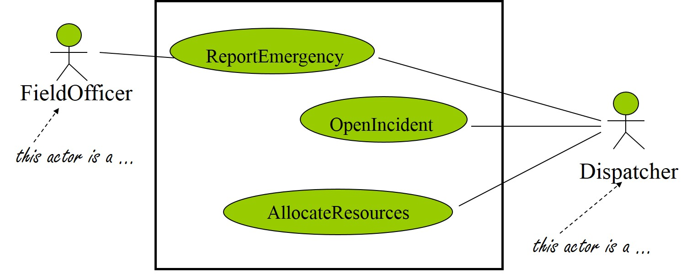
Scenario example (from FRIEND system)
Scenario name: warehouseOnFire
Participating actors:
Bob – FieldOfficer
James – Dispatcher
Flow of events:
Bob is driving down main street in a patrol car and notices smoke coming out of a warehouse. He activates the ReportEmergency function of FRIEND
Bob enters the details into the system
James is alerted by a several beeps. He reviews the information and records the incident using the OpenIncident function
James allocates a fire unit and two paramedic units to the scene with the AllocateResources function

Slide 15
Use cases - overview
The use-case approach focuses first on identifying the actors or users of the application
Actors have a goal that needs to be satisfied by the system, and they rely on the use cases to accomplish that
Use cases represent major categories of functionality as perceived by the application's user
A table and text-based template is used to describe each use case

Slide 16
Use Case Text Description (detailed)
Use Case Section
Description
Name
An appropriate name for the use case – a short active verb phrase e.g. RegisterForCourses
Goal
A brief description of the use case’s role and purpose, that is its goal
Flow of Events
A textual description (understandable to the customer) of what the system does with regard to the use case (not how specific problems are solved by the system).
Special Requirem-ents
Collects all requirements on the use case, e.g. non-functional reqs, that are not considered in the use-case model, but that need to be taken care of during design or implementation.
Pre-conditions
A textual description that defines any constraints on the system at the time the use case may start.
Post conditions
A textual description that defines any constraints on the system at the time the use case will terminate.

Slide 17
Basic and Alternate Flow of Events
Use cases describe possible flows of events.
basic flow of events describes what "normally" happens when the use case is performed.
alternate flows of events covers behavior of an optional or exceptional character relative to normal behavior, and also variations of the normal behavior.
Think of the alternate flows of events as "detours" from the basic flow of events.

Slide 18
RegisterForCourses Basic Flow of Events
Logon This use case starts when a Student accesses the University Web site. The system asks for, and the Student enters, the student ID and password.
Select 'Create a Schedule‘ The system displays the functions available to the student. The student selects "Create a Schedule.“
Obtain Course Information The system retrieves a list of available course offerings from the Course Catalog System and displays the list to the Student.
Select Courses The Student selects four primary course offerings and two alternate course offerings from the list of available course offerings.
Submit Schedule The student indicates that the schedule is complete. For each selected course offering on the schedule, the system verifies that the Student has the necessary prerequisites.
Display Completed Schedule The system displays the schedule containing the selected course offerings for the Student and the confirmation number for the schedule.

Slide 19
Some Alternate Flows of Events (1)
Unidentified Student
In Step 1 of the Basic Flow, Logon, if the system determines that the student ID and/or password is not valid, an error message is displayed
2. Quit
The Course Registration System allows the student to quit at any time during the use case. The Student may choose to save a partial schedule before quitting. All courses that are not marked as "enrolled in" are marked as "selected" in the schedule. The schedule is saved in the system. The use case ends.

Slide 20
Alternate Flow of Events (2)
3. Unfulfilled Prerequisites, Course Full, or Schedule Conflicts
In Step 5 of the Basic Flow, Submit Schedule, if the system determines that prerequisites for a selected course are not satisfied, that the course is full, or that there are schedule conflicts, the system will not enroll the student in the course. A message is displayed that the student can select a different course. The use case continues at Step 4, Select Courses, in the basic flow

Slide 21
Alternate Flow of Events (3)
4. Course Catalog System Unavailable In Step 3 of the Basic Flow, Obtain Course Information, if the system is down, a message is displayed and the use case ends
5. Course Registration Closed If, when the use case starts, it is determined that registration has been closed, a message is displayed, and the use case ends.

Slide 22
Use Case Template [Cockburn]
Title: "an active-verb goal phrase that names the goal of the primary actor"
Primary Actor
Goal in Context
Scope
Level
Stakeholders and Interests
Precondition
Minimal Guarantees
Success Guarantees
Trigger
Main Success Scenario
Extensions
Technology & Data Variations List
See the use case template download from unit web page. Remember you don’t need to fill every field!

Slide 23
Writing Use Cases - Summary
Writing a use case involves a lot of work
Ideally, the flows should be written as "dialogs" between the system and the actors
Each step should explain what the actor does and what the system does in response
It should also be numbered and have a title
Alternate flows always specify where they start in the basic flow and where they go when they end

Slide 24
Recommended reading
Martin Fowler, UML Distilled
Bruegge and Dutoit
Section 2.2.1, 2.3.5, 2.4.1, 4.4

