Slide 1
Requirements Elicitation
Software Requirements and Design
CITS4401
Lecture 4
Notes:
Revised Feb 2020 RCO
Earlier Versions: RCO, DH, GMH

Slide 2
Lecture Overview
What is Requirements Elicitation
Requirements Sources
Elicitation Techniques
Reference: SWEBOK 3.0 Chapter 1 Section 3

Slide 3
1. What is Reqs Elicitation?
Process
Essence
Communication
Scope

Slide 4
The Essence
“At the core of any requirements process is the ability to get people to tell you what they really need, rather than their perceived solution, or what they think you might be able to deliver.”
S & J Roberson, Mastering the Requirements Process, volere.org
https://www.volere.org/wp-content/uploads/2019/02/howNowBrownCow.pdf
https://www.volere.org/the-brown-cow-model/. (7 min video)
See Workshop 1
Notes:
Business events, apprenticing, use
case workshops, interviewing, brainstorming,
personas and other techniques to discover exactly
what your stakeholders do, and what they need to do it.

Slide 5
What is Requirements Elicitation?
The process through which the
customers, buyers, users, regulators and any others who are stakeholders in the development of a software system
discover, reveal, articulate and understand their requirements.
Requirements elicitation is concerned with the origins of software requirements and how the software engineer can collect them.
Also known as requirements capture, requirements discovery, requirements acquisition and requirement gathering

Slide 6
Requirements vs Specifications
“Requirements is probably the most misused word in our industry.”
“Required means nonnegotiable, yet in almost every project we see changed, bartered, and negotiated requirements”
“I propose using the word “specification” instead. Specifications are changeable and are understood as the current state of our understanding.”
    W.Royce, IEEE Software, Sep/Oct 2005
    Get a copy from http://ieeexplore.ieee.org/ via UWA

Slide 7
Communication
Elicitation is fundamentally a human activity and is where the stakeholders are identified and relationships established between the development team and the custom
One of the fundamental principles of a good requirements elicitation process is that of effective communication between the various stakeholders.
Requirements specialists mediate between the domain of the software users (and other stakeholders) and the technical world of the software engineer.

Slide 8
Project Scope
A critical element of requirements elicitation is informing the project scope.
This involves providing a description of the software being specified and its purpose and
Prioritizing the deliverables to ensure the customer’s most important business needs are satisfied first.
Notes:
Aim to minimize the risk of requirements specialists spending time eliciting
requirements that are of low importance, or
those that turn out to be no longer relevant when
the software is delivered. On the other hand, the
description must be scalable and extensible to
accept further requirements not expressed in the
first formal lists and compatible with the previous
ones as contemplated in recursive methods.

Slide 9
Reqs Elicitation Challenges
Articulation Problems
  Expressing the requirements since we don’t know what we don’t know
Communication Barriers
  Different “languages” in different domains
Knowledge and Cognitive Limitations
  Managing complexity
Human Behaviour Issues
  Conflicting needs
Technical Issues
  Change management
  Too rigid adherence to methodology

Slide 10
2. Requirements Sources
Goals
Domain knowledge
Stakeholders
Business Rules
Operational Environment
Organisational environment

Slide 11
Sources: Goals
Goals. The term “goal” (sometimes called “business concern” or “critical success factor”) refers to the overall, high-level objectives of the software.
Goals provide the motivation for the software but are often vaguely formulated.
Software engineers need to pay particular attention to assessing the value (relative to priority) and cost of goals.
A feasibility study is a relatively low-cost way of doing this.

Slide 12
What is a goal?
An objective that the system under consideration should achieve
Goals are optative (express a wish) rather than indicative (stating a thing as fact), e.g.,
  “serve more passengers”
  “acceleration command is delivered on time”
Notice the different levels of abstraction

Slide 13
Sources: Domain knowledge.
The software engineer needs to acquire or have available knowledge about the application domain.
Domain knowledge provides the background against which all elicited requirements knowledge must be set in order to understand it.
A knowledge domain ontology can be used to capture this knowledge
Ontology is a “formal, explicit specification of a shared conceptualization” (Gruber, 1993).
Relations between relevant concepts within the application domain should be identified.
See UWA’s text to knowledge graph tool (winner of ICDM’19 competition). http://agent.csse.uwa.edu.au/text2kg/

Slide 14
Sources: Stakeholders
Much software has proved unsatisfactory because it has stressed the requirements of one group of stakeholders at the expense of others.
Hence, the delivered software is difficult to use, or subverts the cultural or political structures of the customer organization.
The software engineer needs to identify, represent, and manage the “viewpoints” of many different types of stakeholders.
Requirements negotiation will be discussed later in the unit

Slide 15
Sources: Business Rules
These are statements that define or constrain some aspect of the structure or the behavior of the business itself.
“A student cannot register in next semester’s courses if there remain some unpaid tuition fees” would be an example of a business rule for a university’s course-registration software.

Slide 16
Sources: operational environment
Requirements will be derived from the environment in which the software will be executed.
These may be, for example, timing constraints in real-time software or performance constraints in a business environment.
These must be sought out actively because they can greatly affect software feasibility and cost as well as restrict design choices.

Slide 17
Src: organizational environment
Software is often required to support a business process, the selection of which may be conditioned by the structure, culture, and internal politics of the organization.
The software engineer needs to be sensitive to these since, in general, new software should not force unplanned change on the business process.

Slide 18
Approaches & Techniques
Asking
Observing and Inferring
Discussing and Formulating
Negotiating with respect to a standard set
Studying and Identifying Problems
Discovering through creative processes
Postulating
Interviews
Scenarios
Prototypes
Facilitated meetings
Observation
User stories
And others (the above list is not exhaustive)

Slide 19
3. Methods
Interviews
Facilitated meetings
Prototypes
Observation
Scenarios
User stories

Slide 20
1. Interviews
Interviewing stakeholders is a “traditional” means of eliciting requirements.
Important to understand the advantages and limitations of interviews and how they should be conducted.

Slide 21
Interviews
An interview is a systematic attempt to collect information from a person.
Interviewing success depends on ability to identify:
  work flows,
  factors that influence the operations of systems, and
  the elements (documents, procedures, policies, etc.) that make up systems.
Poorly performed interviews may:
  lead to systems which do not meet the needs of the organization
  affect the attitudes of the users and have a negative effect on the entire project effort

Slide 22
5 Steps of the Interview Process
Preparing for the interview
Planning and scheduling the interview
Opening and closing the interview
Conducting the interview
Following up for clarification

Slide 23
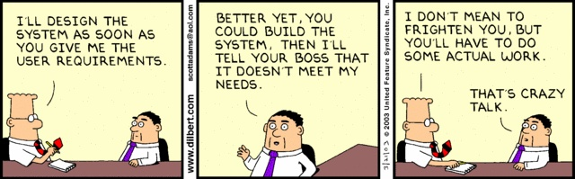
Problem: Resistance may be found

Slide 24
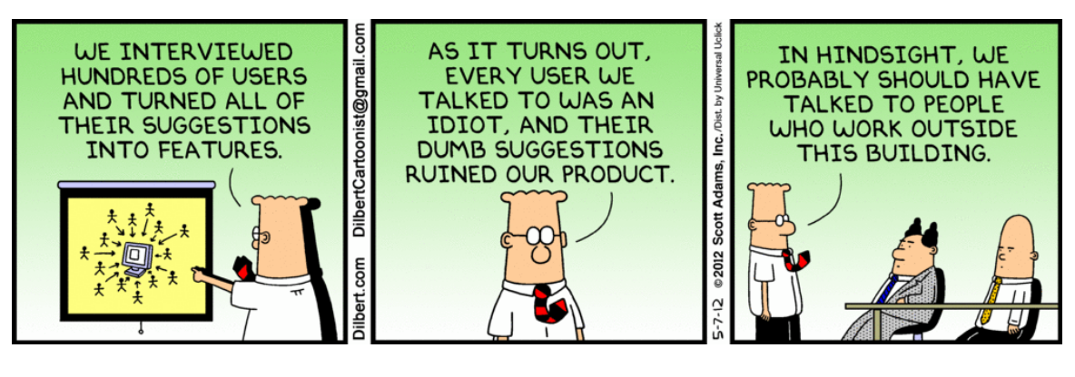
Problem: Conflicting requirements

Slide 25
2. Facilitated meetings
Purpose: try to achieve a summative effect, whereby a group of people can bring more insight into their software requirements than by working individually.
Advantage: Brainstorm and refine ideas that may be difficult to bring to the surface using interviews.
Advantage: conflicting requirements surface early on in a way that lets the stakeholders recognize where these occur.
Advantages: may result in a richer and more consistent set of requirements than might otherwise be achievable.
Disadvantage: meetings need to be handled carefully (hence the need for a facilitator) to avoid poor group dynamics
Disadvantage: Meetings are time consuming (hence the need for a facilitator)
Notes:
Meeting risks:
How to prevent a situation in which the critical abilities of the team are eroded by group loyalty, or in which requirements
reflecting the concerns of a few outspoken (and perhaps senior) people that are favoured to the detriment of others.

Slide 26
Brainstorming
A simple group technique for generating ideas
Allows people to suggest and explore ideas in an atmosphere free of criticism or judgement
Works best with 4 to 10 people – 1 person to get the session started, but not constrain it

Slide 27
Brainstorming
Generation Phase: participants encouraged to offer as many ideas as possible without discussion of the merits of ideas
Consolidation Phase: ideas are discussed, revised and organised
Notes:
See page 5. The underlying difficulties mentioned on that page are:
Articulation Problems
Communication Barriers
Knowledge and Cognitive Limitations
Human Behaviour Issues
Technical Issues
All of these difficulties will be addressed by brainstorming to some degree.

Slide 28
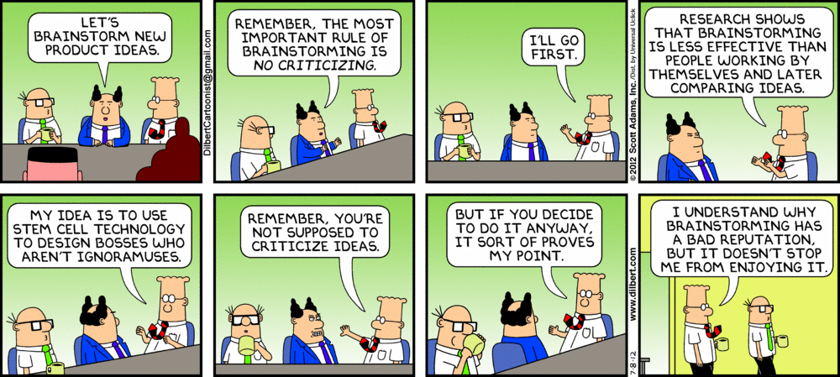
Brainstorming (cont.)

Slide 29
3. Prototypes
Valuable tool for clarifying ambiguous requirements.
Act in a similar way to scenarios by providing users with a context within which they can better understand what information they need to provide.
Wide range of prototyping techniques—from paper mockups of screen designs to beta-test versions of software products
Protypes can also be used requirements validation (see later)
Low fidelity prototypes are often preferred to avoid the stakeholder “anchoring” on minor, incidental characteristics that could limit design flexibility
Disadvantage: Choose implementation too early
Risk: Rough prototype becomes the product

Slide 30
Scenarios and Use Cases
Scenarios and use cases are commonly used in planned methodologies, especially in the object-oriented UML setting
Scenarios provide a valuable means for providing context to the elicitation of user requirements.
They allow the software engineer to provide a framework for questions about user tasks by permitting “what if” and “how is this done” questions to be asked.
The most common type of scenario is the use case description.
See week 1 and later

Slide 31
User Stories
User stories are commonly used in adaptive or agile methodologies
Short, high-level descriptions of required functionality expressed in customer terms.
A typical user story has the form: “As a <role>, I want <goal/desire> so that <benefit>.”
Just enough information so that the developers can produce a reasonable estimate of the effort to implement it.
The aim is to avoid some of the waste that often happens in projects where detailed requirements are gathered early but become invalid before the work begins.
See week 1

Slide 32
4. Observation / Ethnography
Analyst immerses herself in the working environment where the system will be used
She observes the day-to-day work and notes the actual tasks in which participants are involved
This helps discover implicit system requirements that reflect the actual rather than formal processes in which people are involved
Advantage: discovers many user tasks and business processes that are too subtle and complex for their actors to describe easily.
Disadvantage: Expensive (analyst works in client environment)
Disadvantage: Observer should be detached: end-user based, non-judgemental so not appropriate for discovering organisational or domain requirements

Slide 33
Pulling this all Together
Some Guidelines

Slide 34
A Generic Requirements Process
ELICITATION
Identify relevant sources of requirements
Ask appropriate questions to gain an understanding of their needs
AND THEN
Analyse the gathered information, looking for implications, inconsistencies or unresolved issues
Confirm your understanding of the requirements with the users (validate)
Synthesize appropriate statements of the requirements (specify)

Slide 35
Systems Thinking
What objectives are we trying to achieve?
What decisions do we control which affect those objectives?
What items dictate constraints on our range of choices?
What criteria should we use to evaluate candidate solutions?
What decision provides with the most satisfactory outcome with respect to those criteria?

Slide 36
Sommerville & Sawyer Elicitation Guidelines
Assess system feasibility
Be sensitive to organisational and political considerations
Identify and consult system stakeholders
Record Requirements Sources
Define the system’s operating environment
Use business concerns to drive requirements elicitation

Slide 37
Elicitation Guidelines (cont)
Look for domain constraints
Record requirements rationale
Collect requirements from multiple viewpoints
Prototype poorly understood requirements
Use scenarios to elicit requirements
Define operational processes
Reuse requirements

Slide 38
Lecture Summary
What is Requirements Elicitation?
  Process; Essence; Communication; Scope
Requirements Sources
Elicitation Techniques
  Interviews; Facilitated meetings; Prototypes;
  Scenarios; User Stories see next week

Slide 39
Recommended reading
SWEBOK 3.0 Chapter 1 Section 3
R. S. Pressman, Software Engineering: A Practitioner’s Approach, 9th ed., 2020
  Chapter 7 Understanding Requirements
B. Bruegge and A. H. Dutoit, Object-Oriented Software Engineering – Using UML, Patterns, and Java, 3rd ed., Prentice Hall, 2010
  Section 4.3.1 Software Specification
  Section 7.2 Requirements Elicitation and Analysis

