Slide 1
CITS4009 Introduction to Data Science
School of Computer Science and Software Engineering
Semester 2, 2017: Part 2 modelling methods
Chapter 7 Linear and logistic regression

Slide 2
Chapter Objectives
Using linear regression to predict quantities
Using logistic regression to predict probabilities or categories
Extracting relations and advice from functional models
Interpreting the diagnostics from R’s lm() call
Interpreting the diagnostics from R’s glm() call

Slide 3
Introduction
functional methods are different class of methods for both scoring and classification.
These are methods that learn a model that is a continuous function of its inputs (versus being a mere lookup table).
This class of methods is especially useful when you don’t just want to predict an outcome, but you also want to know the relationship between the input variables and the outcome.
This knowledge can prove useful because this relationship can often be used as advice on how to get the outcome that you want.

Slide 4
Using linear regression
Linear regression is the bread and butter prediction method for statisticians and data scientists.
Liner regression are useful if you’re trying to predict a numerical quantity like profit, cost, or sales volume.
Understanding linear regression:
Linear regression models the expected value of a numeric quantity (called the dependent or response variable) in terms of numeric and categorical inputs (called the independent or explanatory variables).
For example, suppose we’re trying to predict how many pounds a person on a diet and exercise plan will lose in a month:
For every person i, we want to predict pounds.lost[i] based on daily.cals[i] and daily.exercise[i]. Linear regression assumes that pounds.lost[i] is a linear combination of daily.cals[i] and daily.exercise[i]:
pounds.lost[i] = b.cals * daily.cals[i] + b.exercise * daily.exercise[i]
The goal is to find the values of b.cals and b.exercise so that the linear combination of daily.cals[i] and daily.exercise[i] comes very close to pounds.lost[i] for all persons I in the training data.
Notes:
we’ll use a real-world example (predicting personal income) to work through all of the steps of producing and using a linear regression model.

Slide 5
In General:
y[i] is the numeric quantity we want to predict, and x[i,] is a row of inputs that corresponds to output y[i]. Linear regression finds a fit function f(x) such that:
y[i] ~ f(x[i,]) = b[1] x[i,1] + ... b[n] x[i,n]
We want numbers b[1],...,b[n] (called the coefficients or betas) such that f(x[i,]) is as near as possible to y[i] for all (x[i,],y[i]) pairs in our training data. R supplies a one-line command to find these coefficients: lm().
In the idealized theoretic situation, linear regression is used to fit y[i]when the y[i] are themselves given by
y[i] = b[1] x[i,1] + b[2] x[i,2] + ... b[n] x[i,n] + e[i]
This means that y is linear in the values of x
If y = 3 + 2*x, and if we increase x by 1, then y will always increase by 2
This wouldn’t be true for, say, y = 3 + 2*(x^2).
The last term, e[i], represents what are called unsystematic errors, or noise. Unsystematic errors average to 0 (so they don’t represent a net upward or net downward bias) and are uncorrelated with x[i,] and y[i].

Slide 6
The technical meaning of regression
Regression means the unbiased prediction of the conditional expected value.
A prediction is a function f() such that f(x[i,]) is near the unknown ideal quantity E[y[i]|x[i,]] (where E[|] is the conditional expected value operator averaging over all possible y[j] where x[j,] is sufficiently similar to x[i,]).
Unbiased predictors have E[f(x[i,])-y[i]]=0 under an appropriate expectation operator E[].
Regression isn’t so much a prediction of an individual y[i] but a forecast of E[y[i]|x[i,]] (the conditional expectation).
For a good regression model, we expect f(x[i,]) to be a good estimate of E[y[i]|x[i,]] and to have low conditional variance (y[i] tending to be near E[y[i]|x[i,]])
When both of these conditions are met, then f(x[i,]) is in general a good estimate for y[i].
Under these assumptions, linear regression is absolutely relentless in finding the best coefficients.
One thing that linear regression doesn’t do is reshape variables to be linear.

Slide 7
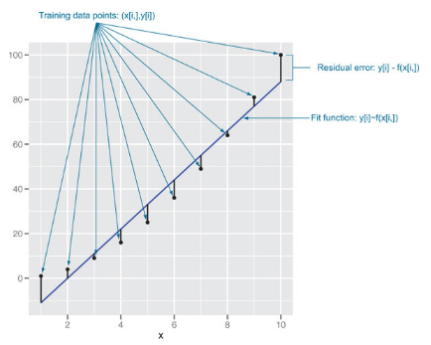
Consider trying to fit the squares of the first 10 integers using only a linear function plus the constant 1. We’re asking for coefficients b[0] and b[1]such that
x[i]^2 nearly equals b[0] + b[1] x[i]
This is clearly not a fair thing to ask, but linear regression still does a great job. It picks the following fit:
x[i]^2 nearly equals -22 + 11 x[i]
The example in the figure is typical of how linear regression is “used in the field”—we’re using a linear model to predict something that is itself not linear.
Fit versus actuals for y=x²

Slide 8
Representativeness of data-Example
Predict personal income from other demographic variables such as age and education from 2011 US Census PUMS data. In addition to predicting income,
We also have a secondary goal: to determine the effect of a bachelor’s degree on income, relative to having no degree at all.
PUMS data is a sample of individual households that are representative of the US population if each person and household is counted proportionally to one of the PWGTP* and WGTP*columns. There are 80 columns so the researcher can evaluate the impact of sampling noise on their work (using lm()’s weights argument).
We’ll consider the input variables age (AGEP), sex (SEX), class of worker (COW), and level of education (SCHL). The output variable is personal income (PINCP). We’ll also set the reference level, or “default” sex to M (male); the reference level of class of worker to Employee of a private for-profit; and the reference level of education level to no high school diploma.

Slide 9
Building a linear regression model
The first step in either prediction or finding relations (advice) is to build the linear regression model
The command to build the linear regression model in R is lm().
The formula specifies what column of the data frame is the quantity to be predicted, and what columns are to be used to make the predictions.
Statisticians call the quantity to be predicted the dependent variable and the variables/columns used to make the prediction the independent variables.
This command builds the linear regression model and stores the results in the new object called model.
This model is able both to make predictions and to extract important advice from the data

Slide 10
R stores training data in the model
R holds a copy of the training data in its model to supply the residual information seen in summary(model).
Holding a copy of the data this way is not strictly necessary and can needlessly run you out of memory.
You can mitigate this problem somewhat by setting the parameters model = F, x = F, y = F, qr = F in the lm() call. If you’re running low on memory (or swapping), you can dispose of R objects like model using the rm() command. In this case, you’d dispose of the model by running rm("model").

Slide 11
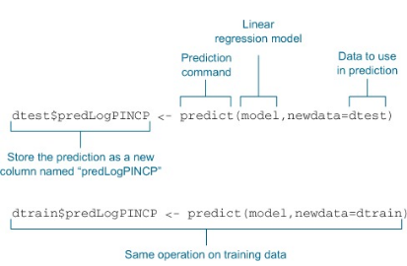
Making predictions
The goal now is to predict income by passing data to predict()
Making predictions with a linear regression model using both the test and training data frames dtest and dtrain:

Slide 12
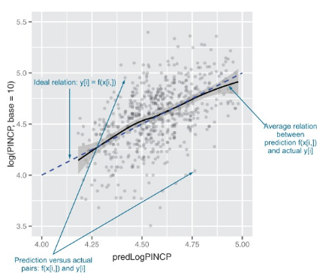
Characterizing prediction quality
To inspect prediction model and quality, We recommend plotting the actual y.
log(PINCP,base=10) as if it were a function of predLogPINCP. If the predictions are very good, then the plot will be dots arranged near the line y=x, which we call the line of perfect prediction

Slide 13
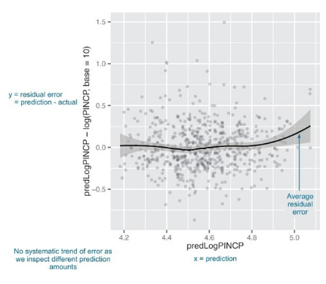
The figure shows statisticians prefer the residual plot, where the predictions errors predLogPINCP-log(PINCP,base=10) are plotted as a function of predLogPINCP.
In this case, the line of perfect prediction is the line y=0.
Notice the points are scattered widely from this line (a possible sign of low-quality fit)
On average, are the predictions correct? Or does the smoothing curve lie more or less along the line of perfect prediction?
Ideally, the points will all lie very close to that line, but you may instead get a wider cloud of points if your input variables don’t explain the output too closely.
But if the smoothing curve lies along the line of perfect prediction, then the model predicts correctly on average: it underpredicts about as much as it overpredicts.

Slide 14
Why are the predictions, not the true values, on the x-axis?
Residual graph with predictions on the x-axis gives you a sense of when the model may be under- or overpredicting, based on the model’s output.
A residual graph with the true outcome on the x-axis instead gives you a sense of where the model under-or overpredicts based on the actual outcome.
Are there systematic errors?
If the smoothing curve veers off the line of perfect prediction too much, this is a sign of systematic under- or overprediction in certain ranges: the error is correlated with y[i].
Many of the theoretical claims about linear regression depend on the observation error being uncorrelated with y[i].
Unstructured observation errors (the good case) are called homoscedastic, and structured observation errors are called heteroscedastic and introduce prediction bias.

Slide 15
R-squared
In addition to inspecting graphs, you should produce quantitative summaries of the quality of the predictions and the residuals. One standard measure of quality of a prediction is called R-squared.
You want R-squared to be fairly large (1.0 is the largest you can achieve) and R-squareds that are similar on test and training.
A significantly lower R-squared on test data is a symptom of an overfit model that looks good in training and won’t work in production.
R-squared can be thought of as what fraction of the y variation is explained by the model.
For well-fit models, R-squared is also equal to the square of the correlation between the predicted values and actual training values.

Slide 16
R-squared can be overoptimistic
R-squared on training data will be higher for models with more input parameters, independently of whether the additional variables actually improve the model or not
R-squared is related to correlation, and the correlation can be artificially inflated if the model correctly predicts a few outliers (because the increased data range makes the overall data cloud appear “tighter” against the line of perfect prediction).
Another good measure to consider is root mean square error (RMSE).
The RMSE is as a measure of the width of the data cloud around the line of perfect prediction. We’d like RMSE to be small, and one way to achieve this is to introduce more useful explanatory variables.

Slide 17
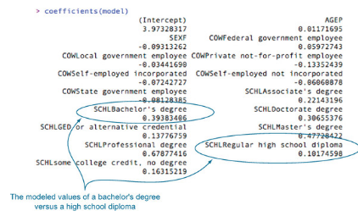
Finding relations and extracting advice
Recalling our goal : find the value of having a bachelor’s degree.
All of the information in a linear regression model is stored in a block of numbers called the coefficients. The coefficients are available through the coefficients(model) command. The coefficients of our income model.
The model coefficients

Slide 18
Reported coefficients
Our original modelling variables were only AGEP, SEX, COW, and SCHL; yet the model reports many more coefficients than these four.
There are eight coefficients that start with SCHL. The original variable SCHL took on these eight string values plus one more not shown: no high school diploma.
Each of these possible strings is called a level, and SCHL itself is called a categorical variable or a factor variable.
The level that isn’t shown is called the reference level; the coefficients of the other levels are measured with respect to the reference level.
SCHLBachelor's degree we find the coefficient 0.39, which is read as “The model gives a 0.39 bonus to log income for having a bachelor’s degree, relative to not having a high school degree.” This means that the income ratio between someone with a bachelor’s degree and the equivalent person (same sex, age, and class of work) without a high school degree is about 10^0.39, or 2.45 times higher.

Slide 19
Indicator variables
Most modeling methods handle a string-valued (categorical) variable with n possible levels by converting it to n (or n-1) binary variables, or indicator variables.
R has commands to explicitly control the conversion of string-valued variables into well-behaved indicators: as.factor() creates categorical variables from string variables; relevel() allows the user to specify the reference level.

Slide 20
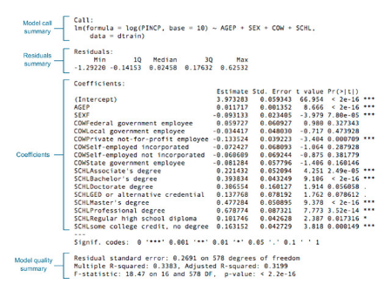
Reading the model summary and characterizing coefficient quality
Check how to check whether model coefficients are reliable.
Most of what we need to know is already in the model summary, which is produced using the summary() command: summary(model)
First break down the summary()into pieces.
1- The original model call
The first part of the summary() is how the lm() model was constructed:
Call: lm(formula = log(PINCP, base = 10) ~ AGEP + SEX + COW + SCHL, data = dtrain)
This is a good place to double-check whether we used the correct data frame, performed our intended transformations, and used the right variables.

Slide 21
2- The residuals summary
Residuals: Min 1Q Median 3Q Max -1.29220 -0.14153 0.02458 0.17632 0.62532
In linear regression, the residuals are everything. Most of what we want to know about the quality of our model fit is in the residuals. The residuals are our errors in prediction:
log(dtrain$PINCP,base=10) - predict(model,newdata=dtrain)
We can find useful summaries of the residuals for both the training and test sets.
In linear regression, the coefficients are chosen to minimize the sum of squares of the residuals.
This is the why the method is also often called the least squares method. So for good models, we expect the residuals to be small.
In the residual summary, you’re given the Min. and Max., which are the smallest and largest residuals seen.
Also given three quantiles of the residuals: 1st. Qu., Median, and 3rd Qu. An r-quantile is a number r such that an r-fraction of the residuals is less than x and a (1-r)-fraction of residuals is greater than x. The 1st. Qu., Median, and 3rd Qu. quantiles’ values are the values of the 0.25, 0.5, and 0.75 quantiles.

Slide 22
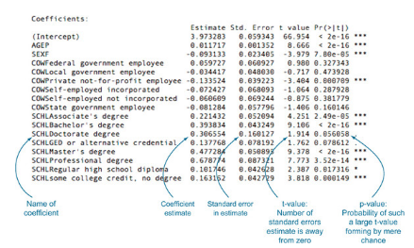
3- The coefficients table
Each model coefficient forms a row of the summary coefficients table.
The columns report the estimated coefficient, the uncertainty of the estimate, how large the coefficient is relative to the uncertainty, and how likely such a ratio would be due to mere chance.
For example, the coefficient of -0.093 for SEXF means that our model learned a penalty of -0.093 to log(PINCP,base=10) for being female. Females are modeled as earning 1-10^-0.093 relative to males, or 19% less, all other model parameters being equal.

Slide 23
P-value
The p-value (also called the significance) is one of the most important diagnostic columns in the coefficient summary.
The p-value estimates the probability of seeing a coefficient with a magnitude as large as we observe if the true coefficient is really 0 (if the variable has no effect on the outcome).
Don’t trust the estimate of any coefficient with a large p-value.
The general rule of thumb, p>=0.05, is not to be trusted

Slide 24
Collinearity also lowers significance
Sometimes, a predictive variable won’t appear significant because it’s collinear (or correlated) with another predictive variable.
For example, if we did try to use both age and number of years in the workforce to predict income, neither variable may appear significant.
This is because age tends to be correlated with number of years in the workforce. If you remove one of the variables and the other one gains significance, this is a good indicator of correlation.
Another possible indication of collinearity in the inputs is seeing coefficients with an unexpected sign: for example, seeing that income is negatively correlated with years in the workforce.

Slide 25
Overall model quality summaries
The last part of the summary(model)report is the overall model quality statistics.
It’s a good idea to check the overall model quality before sharing any predictions or coefficients. The summaries are as follows:
Residual standard error: 0.2691 on 578
degrees of freedom
Multiple R-squared: 0.3383,
Adjusted R-squared: 0.3199
F-statistic: 18.47 on 16 and 578 DF,
p-value: < 2.2e-16
The degrees of freedom is the number of data rows minus the number of coefficients fit; in our case, this:
df <- dim(dtrain)[1] - dim(summary(model)$coefficients)[1]
You want the degrees of freedom to be large compared to the number of coefficients fit to avoid overfitting. Overfitting is when you find chance relations in your training data that aren’t present in the general population.

Slide 26
The residual standard error is the sum of the square of the residuals (or the sum of squared error) divided by the degrees of freedom. So it’s similar to the RMSE (root mean squared error) that we discussed earlier, except with the number of data rows adjusted to be the degrees of freedom; in R, this:
modelResidualError <- sqrt(sum(residuals(model)^2)/df)
Multiple R-squared is just the R-squared
The adjusted R-squared is the multiple R-squared penalized by the ratio of the degrees of freedom to the number of training examples.
This attempts to correct the fact that more complex models tend to look better on training data due to overfitting. Usually it’s better to rely on the adjusted R-squared.
The F-statistic is similar to the p-values we saw with the model coefficients.
It’s used to measure whether the linear regression model predicts outcome better than the constant mode (the mean value of y).
The corresponding p-value is the estimate of the probability that we would’ve observed an F-statistic this large or larger if the two variances in question are in reality the same.
So you want the p-value to be small (rule of thumb: less than 0.05).

Slide 27
Interpreting model significances
Most of the tests of linear regression, including the tests for coefficient and model significance, are based on the error terms, or residuals are normally distributed.
It’s important to examine graphically or using quantile analysis to determine if the regression model is appropriate.

Slide 28
Linear regression takeaways
Linear regression is the go-to statistical modeling method for quantities.
You should always try linear regression first, and only use more complicated methods if they actually outperform a linear regression model.
Linear regression will have trouble with problems that have a very large number of variables, or categorical variables with a very large number of levels.
You can enhance linear regression by adding new variables or transforming variables (like we did with the log() transform of y, but always be wary when transforming yas it changes the error model).
With linear regression, you think in terms of residuals. You look for variables that correlate with your errors and

Slide 29
Linear regression takeaways Cont.
add them to try and eliminate systematic modeling errors.
Linear regression can predict well even in the presence of correlated variables, but correlated variables lower the quality of the advice.
Overly large coefficient magnitudes, overly large standard errors on the coefficient estimates, and the wrong sign on a coefficient could be indications of correlated inputs.
Linear regression packages have some of the best built-in diagnostics available, but rechecking your model on test data is still your most effective safety check.

Slide 30
Using logistic regression
Logistic regression is the most important (and probably most used) member of a class of models called generalized linear models.
Unlike linear regression, logistic regression can directly predict values that are restricted to the (0,1) interval, such as probabilities
It’s the go-to method for predicting probabilities or rates, and like linear regression, the coefficients of a logistic regression model can be treated as advice.
It’s also a good first choice for binary classification problems.
Notes:
Until here about 2 hours

Slide 31
Understanding logistic regression
Logistic regression predicts the probability y that an instance belongs to a specific category—for instance, the probability that a flight will be delayed.
When x[i,] is a row of inputs (for example, a flight’s origin and destination, the time of year, the weather, the air carrier), logistic regression finds a fit function f(x) such that
P[y[i] in class] ~ f(x[i,]) = s(a+b[1] x[i,1] + ... b[n] x[i,n])
Here, s(z) is the so-called sigmoid function, defined as s(z) = 1/(1+exp(z)).
If the y[i] are the probabilities that the x[i,] belong to the class of interest (in our example, that a flight with certain characteristics will be delayed), then the task of fitting is to find the b[1], ..., b[n] such that f(x[i,]) is the best possible estimate of y[i].
R supplies a one-line command to find these coefficients: glm()

Slide 32
Understanding logistic regression-Cont.
think of logistic regression as a linear regression that finds the log-odds of the probability that you’re interested in.
logistic regression assumes that logit(y)is linear in the values of x.
Like linear regression, logistic regression will find the best coefficients to predict y, including finding advantageous combinations and cancellations when the inputs are correlated.

Slide 33
Example
Imagine that you’re working at a hospital. The goal is to design a plan that provisions neonatal emergency equipment to delivery rooms. Newborn babies are assessed at one and five minutes after birth using what’s called the Apgar test, which is designed to determine if a baby needs immediate emergency care or extra medical attention. A baby who scores below 7 (on a scale from 0 to 10) on the Apgar scale needs extra attention.
Such at-risk babies are rare, so the hospital doesn’t want to provision extra emergency equipment for every delivery. On the other hand, at-risk babies may need attention quickly, so provisioning resources proactively to appropriate deliveries can save lives. The goal of this project is to identify ahead of time situations with a higher probability of risk, so that resources can be allocated appropriately.

Slide 34
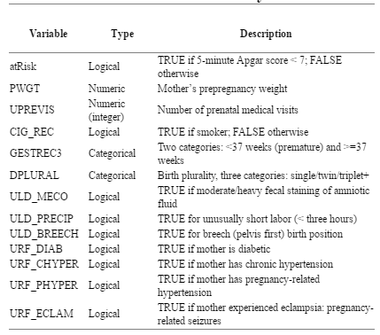
Example- Cont.
The table lists the columns of the dataset that we’ll use. Because the goal is to anticipate at-risk infants ahead of time, we’ll restrict variables to those whose values are known before delivery or can be determined during labour. For example, facts about the mother’s weight or health history are valid inputs, but post-birth facts like infant birth weight are not. We can consider in-labour complications like breech birth by reasoning that the model can be updated in the delivery room (via a protocol or checklist) in time for emergency resources to be allocated before delivery.
Some variables in natality dataset
Notes:
use a sample dataset from the CDC 2010 natality public-use data file (http://mng.bz/pnGy). This dataset records statistics for all births registered in the 50 US States and the District of Columbia, including facts about the mother and father, and about the delivery. We’ll use a sample of just over 26,000 births in a data frame calledsdata.^{[5]}

Slide 35
Building a logistic regression model
The command to build a logistic regression model in R is glm().
In our case, the dependent variable y is the logical (or Boolean)
In our case, the dependent variable y is the logical (or Boolean) atRisk; all the other variables in the table are the independent variables x.
Notes:
use a sample dataset from the CDC 2010 natality public-use data file (http://mng.bz/pnGy). This dataset records statistics for all births registered in the 50 US States and the District of Columbia, including facts about the mother and father, and about the delivery. We’ll use a sample of just over 26,000 births in a data frame calledsdata.^{[5]}

Slide 36
Building the model formula
complications <-
c("ULD_MECO","ULD_PRECIP","ULD_BREECH") riskfactors <- c("URF_DIAB", "URF_CHYPER", "URF_PHYPER", "URF_ECLAM")
y <- "atRisk"
x <- c("PWGT", "UPREVIS", "CIG_REC", "GESTREC3", "DPLURAL", complications, riskfactors)
fmla <- paste(y, paste(x, collapse="+"), sep="~")
Now we build the logistic regression model, using the training dataset.
Fitting the logistic regression model
print(fmla)
[1] "atRisk ~ PWGT+UPREVIS+CIG_REC+GESTREC3+DPLURAL+ULD_MECO+ULD_PRECIP+ ULD_BREECH+URF_DIAB+URF_CHYPER+URF_PHYPER+URF_ECLAM"
model <- glm(fmla, data=train, family=binomial(link="logit"))
Without an explicit family argument, glm defaults to standard linear regression (like lm).

Slide 37
Making predictions
Making predictions with a logistic model is similar to making predictions with a linear model—use the predict()function.
train$pred <- predict(model, newdata=train, type="response")
test$pred <- predict(model, newdata=test, type="response")
We’ve again stored the predictions for the training and test sets as the column pred in the respective data frames. Note the additional parameter type="response".
This tells the predict() function to return the predicted probabilities y. If you don’t specify type="response", then by default predict() will return the output of the link function, logit(y).
If you sum up the predicted probability scores for the entire training set, that quantity will be equal to the number of positive outcomes (atRisk == T) in the training set.

Slide 38
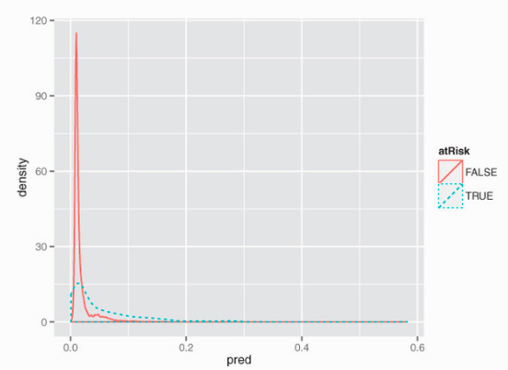
Characterizing prediction quality
If the goal is to use the model to classify new instances into one of two categories, then we want the model to give high scores to positive instances and low scores otherwise.
We can check if this is so by plotting the distribution of scores for both the positive and negative instances.
Plotting distribution of prediction score grouped by known outcome
Both distributions are concentrated on the left, meaning that both positive and negative instances score low.
his means that the model did identify subpopulations in the data where the rate of at-risk newborns is higher than the average.
Distribution of score broken up by positive examples (TRUE) and negative examples (FALSE)
Notes:
+30 mintues ((

Slide 39
To use the model as a classifier, you must pick a threshold;
scores above the threshold will be classified as positive, those below as negative.
When you pick a threshold, you’re trying to balance the precision of the classifier (what fraction of the predicted positives are true positives) and its recall (how many of the true positives the classifier finds).
In the current case, the two distributions aren’t well separated, which indicates that the model can’t build a classifier that simultaneously achieves good recall and good precision.
We can build a classifier that identifies a subset of situations with a higher-than-average rate of at-risk births, so preprovisioning resources to those situations may be advised.
We’ll call the ratio of the classifier precision to the average rate of positives the enrichment rate.
The higher we set the threshold, the more precise the classifier will be (we’ll identify a set of situations with a much higher-than-average rate of at-risk births); but we’ll also miss a higher percentage of at-risk situations, as well.

Slide 40
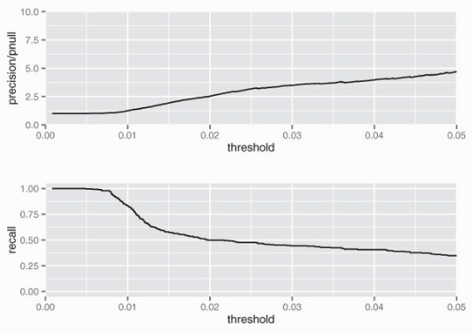
To help pick the threshold, we can use a plot like figure 7.10, which shows both enrichment and recall as a functions of the threshold.
“The best trade-off between precision and recall is a function of how many resources the hospital has available to allocate, and how many they can keep in reserve (or redeploy) for situations that the classifier missed.
A threshold of 0.02 (which incidentally is about the overall rate of at-risk births in the training data) might be a good trade-off.
The resulting classifier will identify a set of potential at-risk situations that finds about half of all the true at-risk situations, with a true positive rate 2.5 times higher than the overall population.
Enrichment (top) and recall (bottom) plotted as functions of threshold for the training set.

Slide 41
Evaluating our chosen model.
Can evaluate the resulting classifier by looking at the confusion matrix.
Let’s use the test set to evaluate the classifier, with a threshold of 0.02.
The resulting classifier is low-precision, but identifies a set of potential at-risk cases that contains 55.5% of the true positive cases in the test set, at a rate 2.66 times higher than the overall average.
A logistic regression model also helps you extract useful information and advice.

Slide 42
Finding relations and extracting advice from logistic models
The coefficients of a logistic regression model encode the relationships between the input variables and the output in a way similar to how the coefficients of a linear regression model do. You can get the model’s coefficients with the call coefficients(model).
Negative coefficients that are statistically significant correspond to variables that are negatively correlated to the odds (and hence to the probability) of a positive outcome (the baby being at risk).
Positive coefficients that are statistically significant are positively correlated to the odds of a positive outcome
The original variable has n levels, there will be n-1 indicator variables; the remaining level is the reference level.
Logistic regression also dislikes a very large variable count

Slide 43
Reading the model summary and characterizing coefficients
Conclusions about the coefficient values are only to be trusted if the coefficient values are statistically significant.
Model is actually explaining something. The diagnostics in the model summary will help us determine some facts about model quality. The call, as before, is summary(model).
Check that we’ve used the correct training set and the correct formula (although in our case, the formula itself is in another variable). We can also verify that we used the correct family and link function to produce a logistic model.

Slide 44
The deviance Residuals Summary
The deviance residuals are the analog to the residuals of a linear regression model:
Deviance Residuals:
Min 1Q Median 3Q Max
-0.9732 -0.1818 -0.1511 -0.1358 3.2641
In linear regression, the residuals are the vector of differences between the true out come values and the predicted output values (the errors).
In logistic regression, the deviance residuals are related to the log likelihoods of having observed the true outcome, given the predicted probability of that outcome.
The idea behind log likelihood is that positive instances y should have high probability py of occurring under the model; negative instances should have low probability of occurring (or putting it another way, (1-py) should be large.

Slide 45
Logistic models can also be used to explicitly compute rates: given several groups of identical data points (identical except the outcome), predict the rate of positive outcomes in each group. This kind of data is called grouped data.
The summary coefficients table
The summary coefficients table for logistic regression has the same format as the coefficients table for linear regression. The columns of the table represent:
A coefficient
Its estimated value
The error around that estimate
The signed distance of the estimated coefficient value from 0 (using the standard error as the unit of distance)
The probability of seeing a coefficient value at least as large as we observed, under the null hypothesis that the coefficient value is really 0

Slide 46
Overall model quality summaries
Null deviance: 2698.7 on 14211 degrees of freedom
Residual deviance: 2463.0 on 14198 degrees of freedom
AIC: 2491
Null and residual deviances
Deviance is again a measure of how well the model fits the data.
The null deviance is similar to the variance of the data around the average rate of positive examples.
The residual deviance is similar to the variance of the data around the model.
Check whether the model’s probability predictions are better than just guessing the average rate of positives, statistically speaking.

Slide 47
The pseudo R-squared
A useful goodness of fit measure based on the deviances is the pseudo R-squared: 1 - (dev.model/dev.null).
It’s a measure of how much of the deviance is “explained” by the model.
Ideally, you want the pseudo R-squared to be close to 1.

Slide 48
Goodness of fit versus significance
The good p-value tells us that the model is legitimate: it gives us more information than the average rate of at-risk births does alone.
The poor pseudo R-squared means that the model isn’t giving us enough information to predict at-risk births with high reliability.
It’s also possible to have good pseudo R-squared (on the training data) with a bad p-value.
This is an indication of overfit.

Slide 49
The AIC
The last metric given in the section of the summary is the AIC, or the Akaike information criterion.
The AIC is the log likelihood adjusted for the number of coefficients.
Just as the R-squared of a linear regression is generally higher when the number of variables is higher, the log likelihood also increases with the number of variables.
The AIC is usually used to decide which and how many input variables to use in the model.

Slide 50
Fisher scoring iterations
The Fisher scoring method is an iterative optimization method similar to Newton’s method that glm()uses to find the best coefficients for the logistic regression model.
Separation and quasi-separation
The probable reason for nonconvergence is separation or quasi-separation: one of the model variables or some combination of the model variables predicts the outcome perfectly for at least a subset of the training data.

Slide 51
Unfortunately, there are situations when it seems that no warning is issued, but there are other warning signs:
An unusually high number of Fisher iterations
Very large coefficients, usually with extremely large standard errors
Residual deviances larger than the null deviances
If you see any of these signs, the model is suspect. To try to fix the problem, remove any variables with unusually large coefficients; they’re probably causing the separation. You can try using a decision tree on the variables that you remove to detect regions of perfect prediction.

Slide 52
The right way to deal with separation
The correct way to handle separation is to regularize. Unfortunately, the default, glm() doesn’t regularize.
The package glmnet can. But its calling interface isn’t the standard interface that lm(), glm().
To regularize glm() in an ad hoc way, you can use the weights argument. The weights argument lets you pass a vector of weights (one per datum) to the glm() call.
Add another copy of the data, but with opposite outcomes, and use this faux data in glm() with a small weight.

Slide 53
Logistic regression takeaways
Logistic regression is the go-to statistical modeling method for binary classification. Try logistic regression first, and then more complicated methods if logistic regression doesn’t perform well.
Logistic regression will have trouble with problems with a very large number of variables, or categorical variables with a very large number of levels.
Logistic regression is well calibrated: it reproduces the marginal probabilities of the data.
Logistic regression can predict well even in the presence of correlated variables, but correlated variables lower the quality of the advice.

Slide 54
Logistic regression takeaways- Cont.
Overly large coefficient magnitudes, overly large standard errors on the coefficient estimates, and the wrong sign on a coefficient could be indications of correlated inputs.
Too many Fisher iterations, or overly large coefficients with very large standard errors, could be signs that an input or combination of inputs is perfectly correlated with a subset of your responses. You may have to segment the data to deal with this issue.
glm() provides good diagnostics, but rechecking your model on test data is still your most effective diagnostic.
Pseudo R-squared is a useful goodness-of-fit heuristic.

Slide 55
Key Takeaways
Functional models allow you to better explore how changes in inputs affect predictions.
Linear regression is a good first technique for modeling quantities.
Logistic regression is good first technique for modeling probabilities.
Models with simple forms come with very powerful summaries and diagnostics.

